Slide 1
CLADE Forum: Pulleys
Theme: Pulley surgery
Rio Di Janiero Brazil April 2013
Lionel Kowal Melbourne Australia
Logan Mitchell Dunedin New Zealand

Slide 2
Augmenting BMR for Convergence Excess
    ET 25, ET’ 35 :
    [nearly] everyone will do BMR 5mm
    ET 35, ET’ 50 :
    [nearly] everyone BMR 6mm
    This talk is not about such patients.

Slide 3
What about VERY LARGE amounts of Convergence Xs?
    ET 15Δ, ET’ 50Δ N-D 35Δ
    What surgical dosage BMR?
  20th century options
    Parks’ tables
      Operate on distance angle. Add 1mm if N-D ≥ 10 Δ
    Operate for near angle – are you scared to do BMR 6mm when distance ET only 15Δ?
    Kushner: titratable additions for different amounts of convergence Xs
    BMR augmented by posterior fixation suture (Scleral Faden)

Slide 4


Commonest use: augment effect of MR recess in convergence Xs
Attaches rectus muscle to globe 12-14mm behind insertion
Limits effect of muscle in its field of action
Minimal effect on primary position
IA
IA
AC
r
r
C
C
IA
r
C
AC
IF
IF
IF
F
F
  Prevents arc of muscle contact from unravelling - decreases moment arm and the torque acting on muscle
F
O
O
O
A
B
C

Slide 5

Seminal Paper on mechanism of Scleral Faden
  Forced duction test post - Faden shows restriction of aDduction - movement of the medial rectus through its pulley is restricted
  Change of lever arm is not the only effect
Clark, Demer
Posterior fixation sutures: a revised mechanical explanation for the faden operation Am J Ophth 1999

Slide 6





MR passes through its pulley as RE aDducts
PULLEY -
from A to B
A
MR insertion
If we want to
impair Adduction
without affecting
primary position…
Medial orbital wall
B
A, B : ant & post extent of pulley sleeve

Slide 7

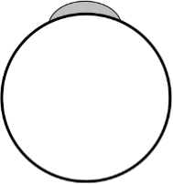










FADEN: SCLERAL SUTURE @ P
Primary gaze
18 degrees ADd
Original MR insertion
A
A
P
18º
P
PULLEY
Medial orbital wall
B
B
P prevents normal MR movement through MR pulley - Adduction is
restricted
by P .. as well as its effect on moment arm
MR
MR

Slide 8
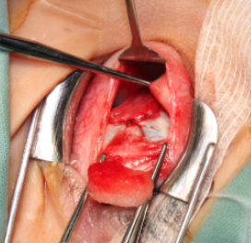
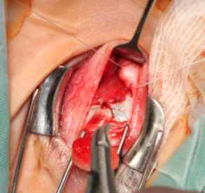
The New Faden: The Medial Rectus Pulley Suture Clark, Ariyasu & Demer AJO, June 2004
  Radiological & histological anatomy are well defined
  Surgical anatomy of the MR pulley is [usually] well defined but not well known [yet]
  Effect ≈ scleral Faden
  2 papers from UCLA

Slide 9
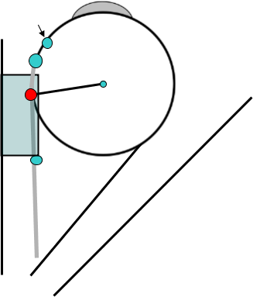
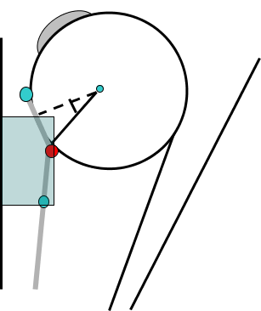
Medial Rectus Pulley Suture
P = muscle sutured
to its pulley –
now restricts full aDduction
Original MR insertion
A
A
P
18º
P
PULLEY
Medial orbital wall
B
B
MR
MR
A, B : ant & post extent of pulley sleeve

Slide 10
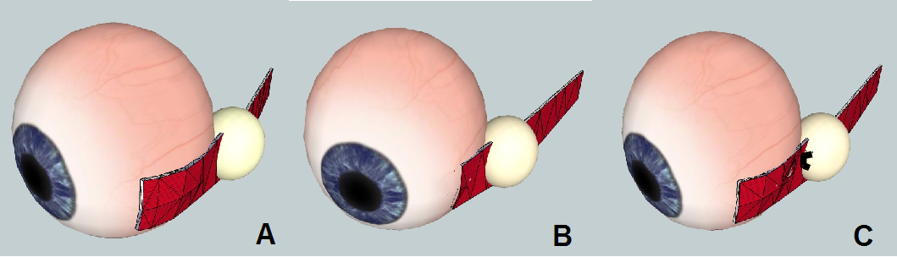
By Logan Mitchell
A: aBducted RE
B: aDducted RE. RMR passes through pulley
C: RMR sutured to pulley.
Some restriction of aDduction

Slide 11
PERSONAL EXPERIENCE >50 CASES
    Invaluable guidance/advice from Joe Demer who taught LK the procedure & has offered continuing assistance in planning surgery
  Multiple indications – mostly convergence Xs ET with large D-N disparity

Slide 12


SURGICAL TECHNIQUE
  PLAY VIDEO

Slide 13
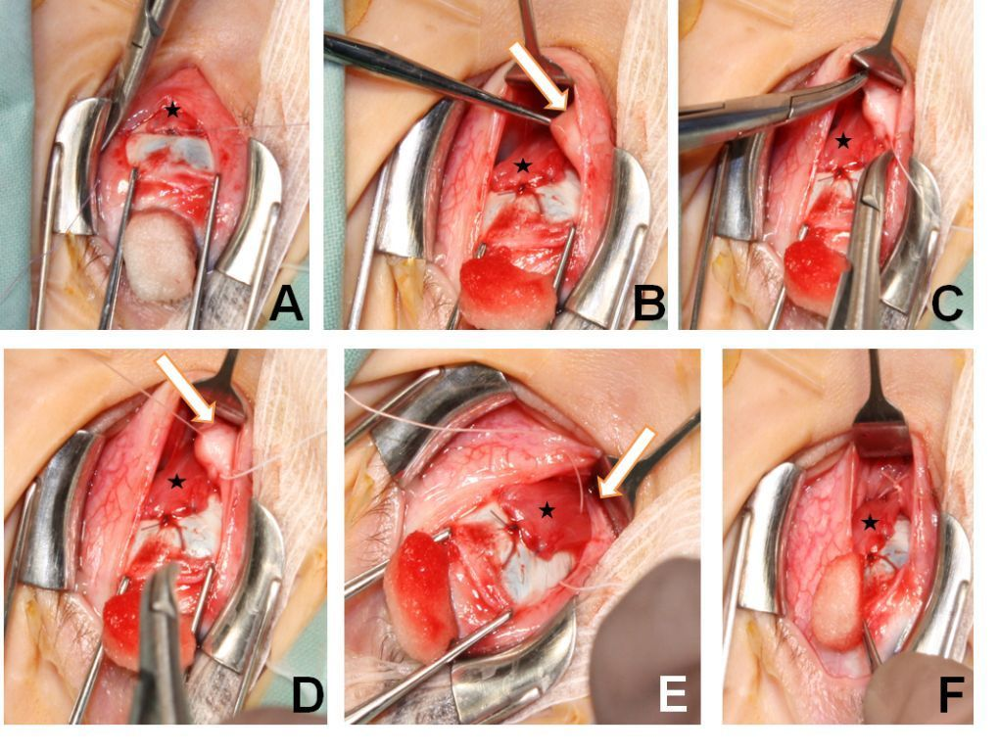

Slide 14
2 key slides – need to demonstrate you have produced a restriction
  1. Measure distance from lateral limbus to caruncle before pulley suture
  2. Repeat measurement after MR pulley suture placed

Slide 15


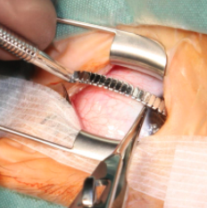

Check duction pre- pulley suture
Curved ruler measuring from
lateral limbus to caruncle
Locking forceps
maximally adducting
The RMR

Slide 16
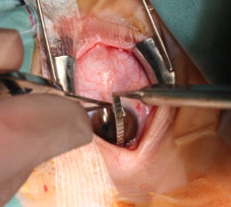
Check duction post - pulley suture
  Average increase in distance from temporal limbus to caruncle on adduction when measured 3.3 mm (n=16)

Slide 17
2 papers in 2012:
#1: Our early experience….

Slide 18
#2: from UCLA

Slide 19
Melbourne Experience:
Pre-operative details for convergence excess cases n=26
 | Mean | Range
Age at surgery (y) | 5.4 | 1.8 – 11
Refraction | +2.9 | +0.25 to +8.50
Distance deviation (∆, with correction) | 22.9 | 0 - 53
N>D disparity (∆) | 26.4 | 13 – 53

Slide 20
Results Convergence Xs cases (n=26)
Δ | Cover Test D ∆ (with best correction) | Persisting N-D ∆ | Change N-D Δ | % decrease in N-D
1-3 months (n=27) | -0.7 | 5.7 | -21.9 | 77 %
4-6 months (n=12) | 0.8 | 2.4 | -23.5 | 88 %
12+ months (n=8) | 0.6 | 3.8 | -22.4 | 87 %

Slide 21
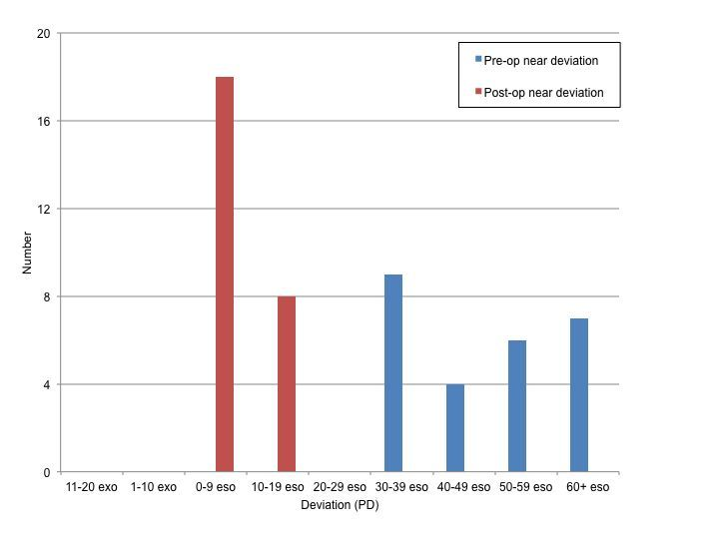

Slide 22
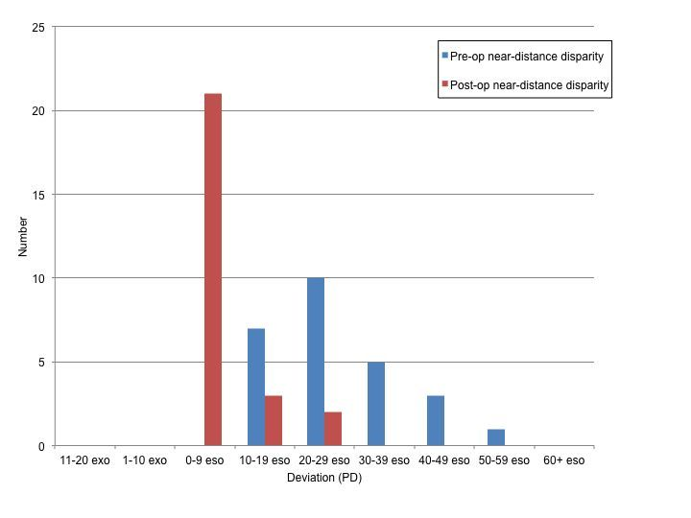

Slide 23
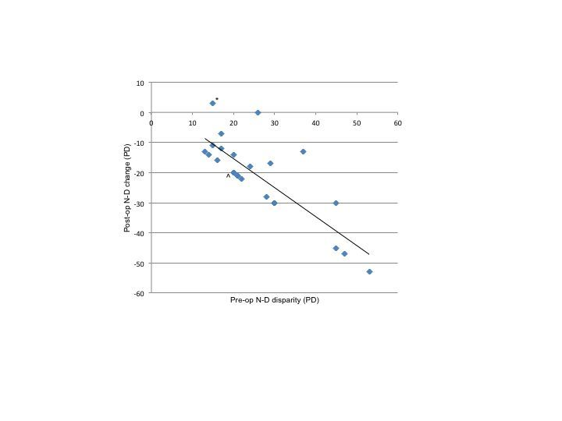

Slide 24
Melbourne Experience:
Outcome measures
For convergence Xs cases (n=26)
  Over-corrections [distance only]
    At 1-3 months: 4 (15%)
    At 4-6 months: 2 (17%)
    At 12+ months: 0
    At final follow-up: 2 (7%), none > 10Δ XT

Slide 25
Followup
Demer av 42 mo Kowal 13 mo
Early result lasts

Slide 26
 | KOWAL 2012 | DEMER 2012
 | PRE-OP
Number | 26 | 21
Age y | 5.4 | 4. 3
ET Δ | 23 | 20
ET N-D Δ | 26.4 | 16.4 p=0.006
Hyperopia | +2.9 | +4.3
Bifocals % | 38 | 33
Planning the surgical dose for MR recession | (ET + ET’) /2 cc | ET cc. Glasses only for ≥+2
 | SURGERY
MR recess mm | 4.9 | 4.4 p=0.18 despite different dosing formula
IO recess % | 23 | 0
 | POST-OP
Follow up months | 12.7 | 44 p=0.0002
ET & ET’ both ≤ 10 Δ % | 61 | 86
ET N-D disparity Δ | 3.7 | 0.7 p=0.06
Any XT % | 7.7 | 9.5

Slide 27
SOME TECHNICAL ASPECTS
  Have only tried this on MR [bulky pulley except for high myopes]
  One PS [upper or lower – whichever is easier] is sufficient to create an intra-operative duction restriction
  Failure to achieve restriction with one PS <10%. NO failures in last ~30 cases [learning curve] except for 1-2 high myopes

Slide 28
Pulley Posterior Fixation Suture
  Logical application of new understanding of orbital anatomy
  Safe
  Effective at decreasing near excess
  Low risk significant over-correction (≤3%)
  Technically difficult
  Learning curve
  Result stable ≥ 3 years

Slide 29

Thank you

