Slide 1

Amblyopia and Strabismus: Latest Information on Patching, Strabismus and Research
ACO PAEDIATRIC OPTOMETRY REFRESHER COURSE 2012
Lionel Kowal Melbourne

Slide 2

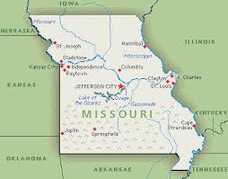
1st stop: Infantile onset esotropia
Lawrence Tychsen
St Louis MO

Slide 3
The Cause of Infantile Strabismus Lies Upstairs in the Cerebral Cortex, Not Downstairs in the Brainstem
Tychsen, L Editorial Archives Ophthal Aug 2012
Infantile-onset strabismus is a constellation (or syndrome) of ocular motor behaviors: eye misalignment; subnormal binocular fusion; a type of nystagmus; dissociated vertical & horizontal deviations.
Children at greatest risk are those who suffer cerebral lesions around the time of birth, esp PVL (=Peri Ventricular Leukomalacia, damage to the posterior-most fibers of the optic radiations, the binocular inputs to striate cortex).
These infants have a 30- to 60-fold greater risk of IOS c.f. with healthy infants

Slide 4
Can Ophthalmologists Repair the Brain in Infantile Esotropia?
Early Surgery, Stereopsis, Monoﬁxation Syndrome, and the Legacy of Marshall Parks Lawrence Tychsen J AAPOS 2005;9:510-521
Costenbader: landmark article published in the 1961 Transactions of the American Ophthalmologic Society, he deﬁned infantile esotropia and reported that 1 in 5 children could develop gross stereopsis if surgically aligned by age 1 year.

Slide 5
1. Stereopsis emerges abruptly in human during the ﬁrst 3 - 5 mo
2. Roughly equal proportions of normal and (prismatically aligned) esotropic infants possess the capacity for stereopsis
3. This capacity degenerates pathologically within a few months in uncorrected esotropes.

Slide 6
The graph of Figure 5A shows that there is no obvious correlation between age of onset of misalignment and subsequent attainment of stereopsis.
When the data are reanalyzed with strict attention to duration of misalignment, a strong correlation is evident: shorter durations mean better stereopsis. Excellent outcomes may be achievable in infants operated upon within 60 days of strabismus onset.

Slide 7

Is it really esotropia?..or not
Confounding issues:
1. Telecanthus
2. Positive/ negative angle kappa
3. Cyclic esotropia - very very rare, unless you think to ask: does it happen every 2nd day?

Slide 8

Pseudo strabismus: is it?
51 children
Av age, 1.5 ± 0.8 y; range, 3-36 mo
Refractive accommodative ET developed in 16% of the children @ mean age of 2.8 ± 1 y.
ET developed in 54% of the children with pseudoesotropia who were > + 1.5 D c.f. 3% of those ≤ + 1.50 D (P=0.0001).
A positive family history of strabismus (P= 0.193) and initial age at presentation with pseudoesotropia (P =0.571) were not predisposing factors.
Development of refractive accommodative esotropia in children initially diagnosed with pseudoesotropia Kanwar Mohan & Ashok Sharma J AAPOS 2012;16:266-268 Chandigarh

Slide 9

Pseudo strabismus: is it?
306 pts were diagnosed with pseudoesotropia with no signiﬁcant refractive error on initial examination.
201 had follow-up exam.
Av age @ initial examination was 13 mo (range, 2-33), @ follow-up 33 mo (range, 4-120).
20 were later found to have strabismus (10%)
15 ET, 3 XT, 1 Duane, 1 Prader-Willi syndrome with ET.
5 had significant refractive error & mild refractive amblyopia (2%).
Of children initially diagnosed with pseudoesotropia < age 3 who returned for follow- up, 12% later found to have strabismus or mild refractive amblyopia
Incidence of strabismus and amblyopia in preverbal children previously diagnosed with pseudoesotropia Ariel L. Silbert, Noelle S. Matta, and David I. Silbert J AAPOS 2012;16:118-119

Slide 10

Incidence of esotropia developing in subjects previously diagnosed with pseudoesotropia: a pilot study.
Strabismus. 2012 Sep;20(3):124-6. Anwar DS, Woreta FA, Weng CY, Repka MX. Wilmer Institute
Retrospective records review of children diagnosed with pseudoET prior to age 5 y, with check for strabismus after age 5 y.
N=31
Median age at diagnosis of pseudoET was 1.3 y.
Six (19%) children were subsequently diagnosed with esotropia.
Conclusion: Even when ‘world’s best’ examiners find no misalignment in young children, a small number will later be found with ET.
Serial examinations and parent education about this possibility need to be considered.

Slide 11
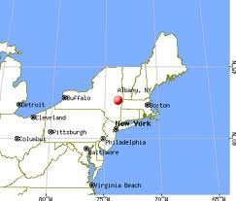
Left-Sided Predominance in Pseudo-esotropia.
Hesham N, Simon JW, Zobal-Ratner J.
Binocul Vis Strabolog Q Simms Romano.
2012;27(1):39-40.
Pseudo-ET is commonly encountered in pediatric ophthalmology.
In our practice, the left eye was reported by parents as being deviated more frequently than the right eye.
We attribute this laterality to the fact that most parents are right handed. They therefore tend to hold their children with their left arm, and to feed them with their right hands, in both cases viewing the left eye of the child in the adducted position.

Slide 12
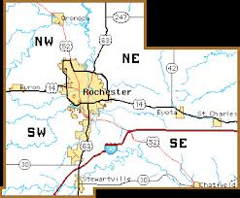

Mayo longitudinal studies on ET
Accommodative ET
Non- Accommodative ET
Mohney et al
Ophthalmology March and June 2011

Slide 13
The Long-term Follow-up of Accommodative Esotropia AET in a Population-based Cohort of Children
306 children with AET
244 (80%) had fully AET (FAET) and 62 (20%) had partially AET (PAET).
Kaplan–Meier rate of discontinuing spectacles for strabismus in this population was 8% by 5 y after diagnosis, 20% by 10 y, and 37% by 20 y.
Children born prematurely or with a greater initial hyperopic refractive error were signiﬁcantly less likely to become spectacle-free during the follow-up period.
During a median follow-up of 10 y (range, 0 –28 y), 33 (13%) of the 244 subjects with FAET eventually underwent strabismus surgery.
Male gender and an earlier age at onset of FAET were associated with a higher likelihood of requiring surgery

Slide 14
Clinical Features Predictive of Successfully Weaning From
Spectacles Those Children With Accommodative Esotropia
Lambert, S et alii J AAPOS 2003;7:7-13
Beginning in 1995, children with fully accommodative esotropia with a baseline refractive error of +1.50 to +5.00 DS were gradually weaned from their hyperopic correction.
Spectacles were prescribed at a mean age of 4.2 ± 1.5 y, weaning was initiated at a mean age of 8± 1 y.
12 of 20 children (60%) were successfully weaned from spectacles.
The spherical equivalent of the least hyperopic eye when spectacles were prescribed was +3± 1 D.
The clinical characteristic most clearly associated with successful weaning was the refractive error at the time glasses were prescribed.
Whereas 10 of 11 (91%) patients with < + 3 D were weaned from spectacles, only 2 of 9 (22%) patients with +3 to +5 D were successfully weaned from their spectacles (P =.005).

Slide 15
Long-term Follow-up of Acquired Nonaccommodative Esotropia in a Population-based Cohort
174 children were diagnosed during the 30y period, yielding an incidence of 1 in 287 live births.
Median age at diagnosis was 4 y (range, 10 months to 18.2 years), and 61% (107) were male.
11% (8/75) of those queried were diplopic, none of the 174 was subsequently diagnosed with an intracranial lesion.
Mean follow-up of 11y (range, 0 days to 37 years), 127 patients (73%) underwent strabismus surgery (mean, 1 surgery; range, 0 –3 surgeries). Among the 127 patients who underwent surgery, the median ﬁnal stereoacuity was 3000 seconds of arc, including 8 pts (6%) with ≥ 50 seconds of arc.
Patients who were older (>44 mo) at ANAET diagnosis and without amblyopia at their initial examination were more likely to achieve excellent ﬁnal stereopsis.

Slide 16

Esotropia : Full +? Half +?
THE INFLUENCE OF REFRACTIVE ERROR MANAGEMENT ON THE NATURAL HISTORY AND TREATMENT OUTCOME OF ACCOMMODATIVE ESOTROPIA (AOS THESIS) BY BRADLEY CHARLES BLACK MD
Trans Am Ophthalmol
Soc 2006;104:303-321

Slide 17
THE INFLUENCE OF REFRACTIVE ERROR MANAGEMENT ON THE NATURAL HISTORY AND TREATMENT OUTCOME OF ACCOMMODATIVE ESOTROPIA AET
285 patients with mean follow-up of 102 months.
After age 7, mean annual decrease in hypermetropia was 0.24 D for pts wearing full cycloplegic refraction and for patients in whom hypermetropia was undercorrected by ≥1 D .
Age at diagnosis, oblique muscle dysfunction & abnormal distance-near relationship were associated with deterioration of AET .
Of 51 patients with an intermittent abnormal distance-near relationship, 19 (37%) had more + on cycloplegic refraction, and prescription of the increased + normalized the distance-near relationship.

Slide 18
THE INFLUENCE OF REFRACTIVE ERROR MANAGEMENT ON THE NATURAL HISTORY AND TREATMENT OUTCOME OF ACCOMMODATIVE ESOTROPIA
AET did not typically resolve.
Hypermetropic correction was discontinued for pts with enduring adequate alignment in 37 of the 285 pts (13%) at a mean age of 11.6 y (range, 7 to 17).
For the 37 pts with resolution of AET, mean + on initial examination was 3.18 DS compared with 4.50 D for the group without resolution of AET(P < .001).
If only patients ≥12 y @ last examination were included, 28 (20%) of 138 patients no longer required a hypermetropic correction to maintain adequate alignment.
Kaplan-Meier survival analysis predicts hypermetropic correction would be discontinued in 30% of the pat population 15 y after initiation of treatment.

Slide 19
THE INFLUENCE OF REFRACTIVE ERROR MANAGEMENT ON THE NATURAL HISTORY AND TREATMENT OUTCOME OF ACCOMMODATIVE ESOTROPIA
Conclusions:
The possibility that undercorrecting hypermetropia speeds its resolution is not supported by this study.
AET is usually stable, but younger age at diagnosis, oblique muscle dysfunction, and abnormal distance-near relationship are associated with deterioration.
Undercorrection of hypermetropia can cause an abnormal distance-near relationship, which in turn can cause deterioration of AET.
Aggressive undercorrection of hypermetropia should be pursued carefully, because the risk may outweigh the potential advantages. .

Slide 20

Genetics of ET & XT
Twin Res Hum Genet. 2012 Oct;15(5):624-30.
Heritability of strabismus: genetic influence is specific to eso-deviation and independent of refractive error.
David Mackey & 15 others

Slide 21
Genetics of ET & XT
The heritability of an eso-deviation was 0.64 . The additive genetic correlation for eso-deviation and refractive error was 0.13 and the bivariate heritability (i.e., shared variance) was less than 1%, suggesting negligible shared genetic effect.
This study documents a substantial heritability of 64% for ET, yet no corresponding heritability for XT, suggesting that the genetic contribution to strabismus may be specific to ET.

Slide 22
Refraction, amblyopia, strabismus

Slide 23

Laser In Situ Keratomileusis for the Treatment of Refractive Accommodative Esotropia de Pagano & Pagano, Ophthalmology 2012;119:159 –163 Argentina
46 eyes / 23 pts with hyperopia and fully or partially refractive accommodative ET treated with LASIK 2000 - 2010.
Age 25± 13y.
Mean hyperopia 3.7±1.3 DS pre surgery and 0.2±0.6 D after surgery (P<0.001).
Mean ET without correction 21Δ before surgery, 4Δ after surgery (P<0.001).
Refractive surgery is a promising option for the treatment of refractive accommodative ET

Slide 24

LASIK as an alternative line to treat noncompliant esotropic children.
Saeed A, Ebsar Eye Center, Benha University, Benha, Egypt
Clin Ophthalmol. 2011;5:1795-801. Epub 2011 Dec 20..
20 eyes of 10 pts with accommodative ET.
All patients were noncompliant with glasses and had refractive stability.
They received brief GA and had bilateral LASIK to fully correct their hyperopic refractive errors aiming to achieve orthophoria.
Preoperative and postoperative best corrected visual acuity, cycloplegic refraction, angle of squint, and any LASIK complications were recorded. Follow-up period was 9 mo.
RESULTS: The age of patients ranged 5-9 y and the hyperopic error range was +3.5 D to +6.75 D, with anisometropia 2 D or less.
No patient had decreased best corrected visual acuity or loss of fusion ability. The postoperative refractive error ranged from -0.75 D to +1.5 D at the end of the study period.
All patients achieved orthophoria. No significant intraoperative or postoperative complications were recorded.
CONCLUSION:
LASIK appears to be effective and relatively safe to treat accommodative ET children by reducing their hyperopic refractive error
Larger studies with longer follow-up are necessary to determine its long-term effects.

Slide 25

Pediatric refractive surgery: Corneal and intraocular techniques and beyond #1
Evelyn A. Paysse, Lawrence Tychsen, and Erin Stahl, MD
J AAPOS 2012;16:291-297
The goal in pediatric refractive surgery: prevent blinding levels of refractive amblyopia
The relevant measure of effectiveness in children who are completely noncompliant with spectacle or contact lens use is uncorrected VA.
Refractive surgery has also been shown to have positive effects on children’s day-to-day visual function
Paysse EA, et al. Developmental improvement in children with neurobehavioral disorders following photorefractive keratectomy

Slide 26
Pediatric refractive surgery: Corneal and intraocular techniques and beyond #2
Evelyn A. Paysse, MD,a Lawrence Tychsen, MD,b and Erin Stahl, MD
J AAPOS 2012;16:291-297
There are 3 subsets in which conventional therapies for amblyopia are often ineffective:
Children with high magnitude isoametropia who are spectacle noncompliant or intolerant – often have neurobehavioral abnormalities related to genetic mutations, autism, cerebral palsy, or prematurity
Children with high levels of uncorrected refractive error unnecessarily exist within a cocoon of visual isolation where visual stimuli are noxious and frightening - ‘visual autism’.
This often leads to or compounds antisocial behavior, lack of interest, and behavioral difﬁculties..

Slide 27
Pediatric refractive surgery: Corneal and intraocular techniques and beyond #3
Evelyn A. Paysse, MD,a Lawrence Tychsen, MD,b and Erin Stahl, MD
J AAPOS 2012;16:291-297
Children with severe anisometropia who are non compliant or intolerant of spectacle and contact lens wear.
Children with high ametropia, either anisometropia or isoametropia, who have other special circumstances that preclude the use of refractive correction, such as craniofacial anomalies, ear deformities, or neck hypotonia

Slide 28

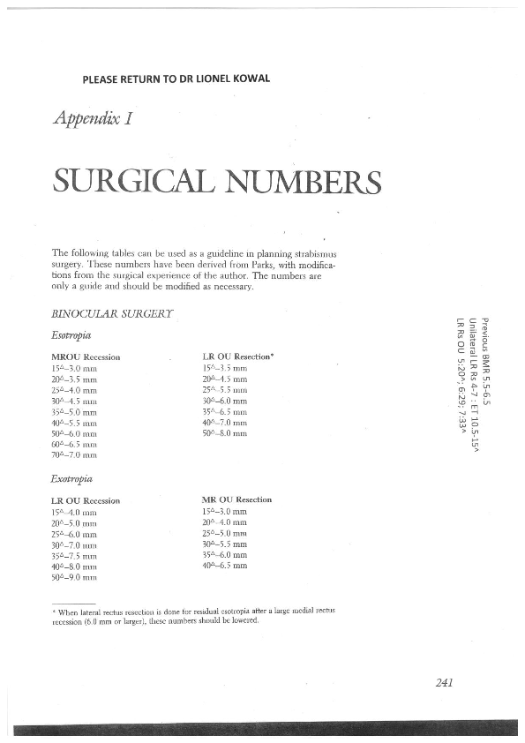
Esotropia surgery
1. Moving target: marked convergence excess
2. Poorer prognosis children

Slide 29

Advances in surgery
1. ET with very high convergence excess ≈ AC/A ratio
Medial rectus muscle pulley posterior ﬁxation sutures in accommodative and partially accommodative esotropia with convergence excess
Logan Mitchell and Lionel Kowal
J AAPOS 2012;16:125-130

Slide 30
MR pulley sutures

Slide 31
MR pulley suture

Slide 32
MR pulley suture

Slide 33
MR pulley suture

Slide 34
Long-Term Outcome of Medial Rectus Recession and Pulley Posterior Fixation in Esotropia With High AC/A Ratio.
Wabulembo G, Demer JL. @ Jules SteinStrabismus. 2012 Sep;20(3):115-20.
Bi- Medial rectus (BMR) recession with pulley posterior fixation (PF) can be used to treat ET with a high AC/A ratio. N=21.
Mean follow-up was 3.5 ± 2.5y. Mean age at surgery 4.3 ± 1.6 y.
Distance pre-operative ET 20Δ ± 10Δ, near pre-operative 37Δ ±19Δ
Mean near-distance (N-D) disparity was 16Δ ± 12Δ.
Early mean postoperative ET was 1 ± 3Δ at distance and 3Δ ± 5Δ at near.
Mean late postoperative ET was 0.1Δ ± 6Δ at distance and 1Δ ± 6Δ at near
At the final postoperative examination, mean N-D disparity was reduced to 0.9Δ ± 3.6Δ.
BMR-PF has a high long-term effectiveness, even in patients with amblyopia and autism.

Slide 35
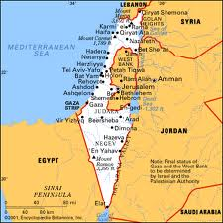
Esotropia surgery in poorer prognosis children
Retrospective analysis of 24 children with developmental delay who had
ET surgery. Mean age 2.8 ± 2.5 y (range, 0.8-10 y).
Mean preoperative ET 50Δ ± 13Δ. Success: ET or XT <10Δ,
All had bilateral medial rectus muscle recessions, mean surgical dosage of 5.1± 0.7 mm per muscle, on average 0.75 mm less than the standard amount.
The average postoperative follow-up was 5.3± 3 y (range, 1-13 years).
Surgical success was achieved in 9 /24 children (37.5%) after one operation.
10/24 were undercorrected, 5 /24 consecutive exotropia. 8/15 agreed to a second procedure.
The overall surgical success rate for all patients after all procedures was 63% after 1.3 surgeries.
CONCLUSIONS
Using reduced surgical doses in children with developmental delay, the initial success rate is ~40%, 5/24 become exotropic on long-term follow-up.
Better results may be achieved with additional procedures.
Long-term results of esotropia surgery in children with developmental delay
Zohar Habot-Wilner, Abraham Spierer, Irina S. Barequet,, and Tamara Wygnanski-Jaffe,
J AAPOS 2012;16: 32-35

Slide 36

ET surgery in poorer prognosis children
Strabismus surgery outcome in
children and young adults with
Down syndrome
Yahalom et alii J AAPOS 2010;14:117-119
Retrospective analysis of 14 consecutive cases of children with Down syndrome who had ET surgery.
Follow-up ≥ 6 mo (range, 0.5-16 y).
Mean preoperative angle 38Δ.
Surgical dose according to standard surgical tables.
Success (≤ 10Δ of orthophoria) in 12 of 14 children (86%).
The remaining 2 (14%) had residual esotropia.
CONCLUSIONS Good alignment outcomes were achieved in children with Down’s after strabismus surgery with standard surgical doses.
The tendency toward overcorrection reported in children with developmental and neurological disorders [& justification for using smaller surgical doses] was not observed in our study.

Slide 37
.
Outcomes of strabismus surgery for esotropia in children with down syndrome compared with matched controls.
Motley WW 3rd, Melson AT, Gray ME, Salisbury SR.
J Pediatr Ophthalmol Strabismus. 2012 Jul 1;49(4):211-4.
16 pts with DS were matched with 16 control patients. Mean preoperative esotropia was 28Δ in the DS group & in the control group.
No significant difference was found in surgical dosages between the two groups .
4-mo and 24-mo postoperative mean angles of esotropia were not different between groups.
The 4-month ET for the DS and control groups were 3.1Δ and 2.7 Δ.
The 24-mo ET angles for the DS and control groups were 7 and 6.6 Δ
Standard bilateral medial rectus recession surgical dosages need not be modified for individuals with DS

Slide 38
Repair of strabismus and binocular fusion in children with cerebral palsy: gross motor function classification scale.
IOVS. 2011 Sep.Missouri USA
N=50. mean age 3.5y
Cong ET 54%, Cong XT 26%
60+% of ET & XT achieved optimal (microtropic) alignment after an average of 2 surgical procedures.
% optimal alignment similar in children with mild vs severe CP.
46% of children gained binocular fusion/stereopsis; quality of fusion gained was greater in children with mild CP (P < 0.05).
Earlier surgery more likely to be successful (P < 0.05).

Slide 39
ALBINISM – NEW INFORMATION

Slide 40

Refractive proﬁle in oculocutaneous albinism and its correlation with ﬁnal visual outcome
Yahalom et al Jerusalem Br J Ophthalmol 2012;96:537-9
OCA 1 (types A n= 53 white blond hair ,B n= 51 blond hair ,C n= 10 platinum hair)
OCA 2 (18 hair light blond to brown)
OCA 3 (Variable pigment) n=0
OCA 4 (similar to #2) n=0
All had acuity, cyclo ret,
genetic testing; some EMRs

Slide 41
Refractive proﬁle in oculocutaneous albinism and its correlation with ﬁnal visual outcome
Yahalom et al Jerusalem Br J Ophthalmol 2012;96:537-9
95% of whole cohort: Astigmatism mean 2.1 DC +:
High + ≥ 5DS 43% OCA1A
Nystagmus 90% of OCA 1 A&B, 80% of OCA 1 C & OCA 2
A few myopes and a few high myopes

Slide 42
Refractive proﬁle in oculocutaneous albinism and its correlation with ﬁnal visual outcome
Yahalom et al Jerusalem Br J Ophthalmol 2012;96:537-9
Conclusions
The poorest visual acuity was found in those with OCA1A, which was associated with the highest rate of high + (statistically signiﬁcant different from other subgroups).
Astigmatism was the most common visually signiﬁcant refractive error across all subtypes of albinism.

Slide 43
Positive Angle Kappa: A Sign of Albinism in Patients With CN
MICHAEL C. BRODSKY, MD, AND KATHERINE J. FRAY, CO
+ve Kappa = pseudo exotropia
21 consecutive pts with albinism & CN and 12 consecutive pts with idiopathic congenital nystagmus, ICN.
Abnormal +ve angle kappa in both eyes was noted in 15/21 (71%) patients with albinism versus 2/10 (20%) patients with ICN).
Abnormal +ve angle kappa in at least one eye was noted in 20/21 (95%) patients with albinism versus 4/12 (33%) patients ICN
The abnormal positive angle kappa persisted under conditions of binocular ﬁxation producing the clinical appearance of exotropia with nystagmus, but no ﬁxation shift was present on alternate cover testing.
No consistent difference in VA or nystagmus intensity between the 2 eyes was noted in patients with asymmetrical or monocular +ve angle kappa.

Slide 44
Amblyopia
Is it a unilateral disease?
Treating older kids

Slide 45

Amblyopia is it a bilateral disease?
VA in the fellow eye of 112 amblyopes was compared with that of age-matched healthy subjects.
112 : strabismic, 14; anisometropic, 51; combined 47
Baseline VA in fellow eye differed signiﬁcantly from that of age-matched controls up to age 8.
Av logMAR acuity reached 0.0 at age 5 in controls vs age 9 in fellow eyes.
21% developed temporary occlusion amblyopia.
Full-time patching had no additional beneﬁt when compared with part- time patching
Visual acuity deﬁcits in the fellow eyes of children with unilateral amblyopia Srinivasa Varadharajan and Jameel Rizwana Hussaindeen J AAPOS 2012;16:41-45 Chennai

Slide 46
Effect of Age on Response to Amblyopia Treatment in Children
PEDIG Jnl Club Arch Ophth July 2011
Meta-analysis of 996 PEDIG cases
there was a decrease in treatment response with increasing age that was most evident for children with more severe amblyopia.
we found an association between a greater improvement in amblyopic eye visual acuity and a less hyperopic amblyopic eye
less improvement in amblyopic eye visual acuity with a history of prior amblyopia treatment than without in children 3 to <5 y

Slide 47
Effect of Age on Response to Amblyopia Treatment in Children
PEDIG Jnl Club Arch Ophth July 2011
Conclusions: Amblyopia is more responsive to treatment among children <7 y. Although the average treatment response is smaller in children 7 to <13 y, some children show a marked response to treatment.

Slide 48
Aniseikonia and other ‘new’ causes of diplopia diplopia

Slide 49
Old Diplopia Qs
Does the 2nd image go away when you close either eye?
Is it to the L / R / above / below?
Does the L / R / higher / lower one go away when you close the L / R eye?
Is one tilted? Which one? Tilted in / out?
Is there a position where the doubling is gone? ..is worst?

Slide 50
‘New’ diplopia Qs – under-recognised SENSORY & MOTOR BARRIERS TO FUSION
Is the image seen by the R:
Larger / smaller than image seen by L
Same shape as L
Are the horizontal and vertical lines on the E as they should be
Paler / darker than L
Tilted [torsion]

Slide 51
Case 1: Reducing anisometropia - “sensible” cataract surgery
56 yo Dr for R phaco/IOL
Pre-op refractions (SE)
R -8 D L -2.5 D
Post-op refractions (SE)
R +0.25 D (6/8) L -2.5 D (6/6)
& CONSTANT DIPLOPIA
PCT = XT 8 ∆, LHT 8 ∆
Presumably this was all asymptomatic phoria before cataract surgery

Slide 52
Knapp’s Rule
Axial anisometropia corrected in the spectacle plane doesn’t usually cause aniseikonia

Slide 53
56 yo Dr
Caught “Knapping”? *
If Axial anisometropia is converted to Lenticular anisometropia, then aniseikonia is to be expected
Aniseikonia impairs motor & sensory fusion and will predispose to diplopia [esp if there is also a (hitherto) trivial motor phoria]
Axial lengths : R 29.48 mm L 26.75 mm
Now has 13% R macropsia
Likely to have been anticipated by pre-op CL testing
Galilean system has resolved diplopia by minimising RE image : + CL [start +1.50, with equivalent - to spectacle lens]
Opposite optical arrangement to LE
Trial / error, or use Aniseikonia Inspector ©
*Thank you Logan Mitchell

Slide 54
Measuring aniseikonia
Free Space Estimation
LK: experience ++, preference +
Space Eikonometer (Stereoscopic method)
LK: no experience
Awaya Test (Direct Comparison Method)
LK: experience ++, preference ±
Size [Thick] lenses
LK: experience +, preference ++
MEASUREMENT ARTEFACT –
each technique can give a different answer

Slide 55
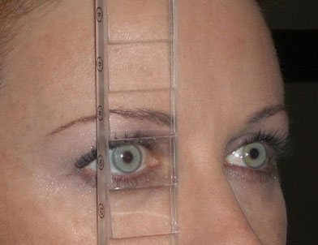
DETECTING & MEASURING ANISEIKONIA 1
Look @ 6/60 E
Which one is bigger? BDΔR, R sees higher image
Does it look like an ‘E’ should? [metamorphopsia]
Is the ‘E’ tilted? [detect torsion]
If a bar of the ‘E’ is worth 20%, how much bigger is it?
Also check with BD
prism in front of other eye - prisms can also cause magnification

Slide 56
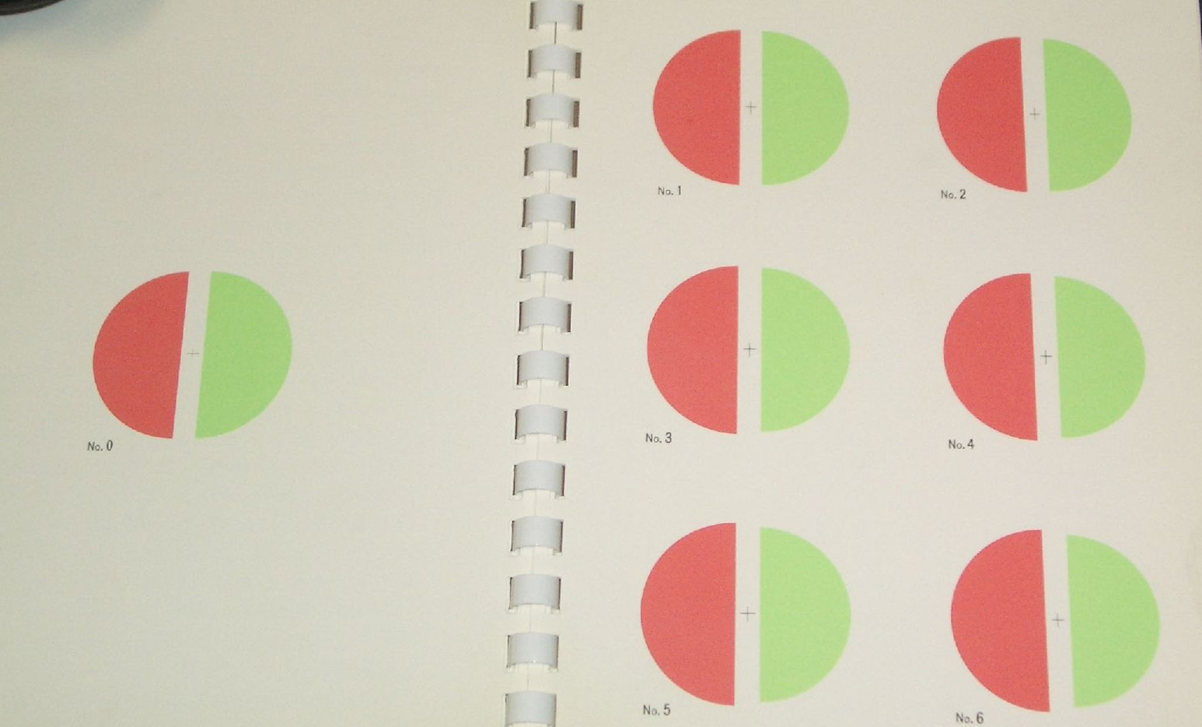
MEASURING ANISEIKONIA 2:
AWAYA’S NEW ANISEIKONIA TEST (NAT)
Use R-G glasses.
Find the pair of semi-circles where the difference in size compensates for the patient’s aniseikonia

Slide 57
Differences in Tests of Aniseikonia
Glen McCormack,* Eli Peli,t and Patrick Stone*
IOVS, Vol. 33, No. 6, May 1992
We compared validity of NAT to the Space Eikonometer in 3 experiments: (1) aniseikonia was induced by calibrated size lenses in a double- blind study of 15 normals; (2) habitual aniseikonia was measured with both instruments in 4 pts; and (3) 8 normals retested with a computer-video simulation of NAT.
The NAT underestimated induced aniseikonia by a factor of 3 in normals and underestimated habitual aniseikonia in 4 pts.
The Space Eikonometer correctly measured the magnitude of induced aniseikonia in normals. The simulation test did not show underesti- mation in the 8 normals.
We could not attribute NAT's underestimation of aniseikonia to the red/green anaglyph method, printing error, psychophysical method, or the direct-comparison test format.
We speculate that NAT induces a different sensory fusion response to aniseikonia than do the other tests, and that this altered sensory fusion response diminishes measured aniseikonia…. NAT is not a valid measure of aniseikonia.
LK: does not exclude it’s continuing use in the one patient: measures ‘NAT aniseikonia’ not ‘True aniseikonia’

Slide 58
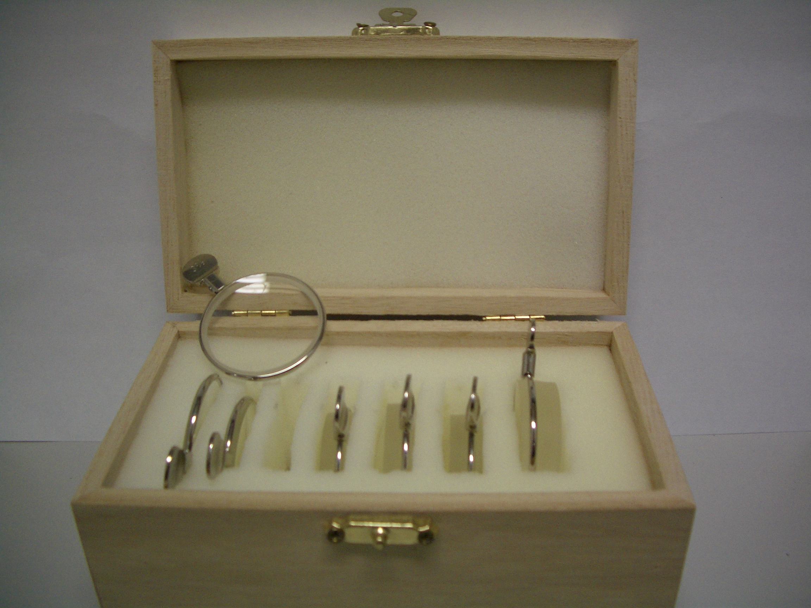
MEASURING ANISEIKONIA 3 most ‘real life’ measurement:
SIZE LENSES up to ±13%
Recommended:
repeatable & leads to
precise optical solution

Slide 59
56 yo Dr
2 very important Qs
1. How much anisometropia is it safe to surgically reduce to try produce glasses independence?
No data
2. How much anisometropia is it safe to surgically introduce in order to give monovision MV?
Some data

Slide 60
Surgical / permanent MV
≠ intermittent / temporary MV 1
3 month MV [early PRK days] : 1/50 pts asymptomatic reduction in fusional reserve
White J. Excimer laser photorefractive keratectomy: the effect on binocular function. In Spiritus M ( Ed): Transactions, 24th Meeting, European Strabismological Association. Buren: Acolus Press, 1997; 252 – 56

Slide 61
Surgical / permanent MV
≠ intermittent / temporary MV 2
118 RS patients. 48 planned MV.
‘Abnormal binocular vision’ (ABV) in 11/48 (22%), ≥1 of
Intermittent / persistent diplopia
Visual confusion
‘Binocular blur requiring occlusion to focus comfortably’.
70 pts did not have MV, 2 had ABV (3%).
Average anisometropia in
13 pts with ABV: 1.90 DS
105 pts with normal BV: 0.50 DS (p<0.001).
Kowal L, De Faber J, Calcutt C, Fawcett S. ‘Refractive surgery and strabismus’ (Workshop in ‘Progress in Strabismology’).
In: de Faber JT, ed. Proceedings of the 9th Meeting of the International Strabismological Association, Sydney, Australia.

Slide 62
Surgical / permanent MV
≠ intermittent / temporary MV 3
3 pts with MV IOLs who developed ET with diplopia ≥2 y after IOLs
Rx: Reverse the MV
Pollard et al Am J Ophthal 2011
This paper also contained examples of CL MV causing delayed diplopia

Slide 64
How much anisometropia is it safe to:
1. reduce? 2. introduce ?
1. Evidence based:
Reduce: no evidence
Introduce:
RS cohort: 1.9DS too much; ~20% have ABV

Slide 65
How much anisometropia is it safe to: 2. introduce ?
2. Eminence based: ..introduce / reduce as little as possible.
Anisometropia in RS: ‘mini- MV’ 0.5 to 1.5 DS… others up to 2.75DS
No universally accepted criteria for IOL-MV.
Common: Full distance Rx to dominant eye.
Ocular Dominance: hole- in- card to VEP. Some ‘cross MV’.
Every time you reduce or introduce anisometropia ….there is an unknown [?] low % of problem patients, and the % probably increases with time after surgery.

Slide 67
Modern macular treatments preserve acuity but do not prevent metamorphopsia & aniseikonia
Can be occult until vision improving surgery

Slide 68
Diplopia Secondary to Aniseikonia Associated With Macular Disease
Arch Ophthalmol. 1999;117:896-899
Nancy M. Benegas, MD; James Egbert, MD; W. Keith Engel, MD; Burton J. Kushner, MD
7 patients : diplopia & epiretinal membranes (6/7) or vitreomacular traction (1/7).
All had aniseikonia, 5% - 18% [Awaya].
5 : the image in involved eye was larger, 2 smaller.
All had concomitant small-angle strabismus and at least initially did not fuse when the deviation was offset with a prism.
Variable response to optical management & retinal surgery.
Concomitant small angle strabismus and the inability to fuse with prisms may lead the clinician to the incorrect diagnosis of central disruption of fusion. Surgical intervention does not necessarily improve the aniseikonia.

Slide 69
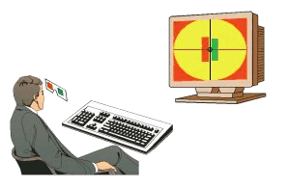
ANISEIKONIA INSPECTOR
Designed by Gerard De Wit
Direct comparison method of the perceived images
Patient fixates centrally whilst the images flash for 0.5 sec (static aniseikonia)
Field angle is set by the size of the rectangles

Slide 70
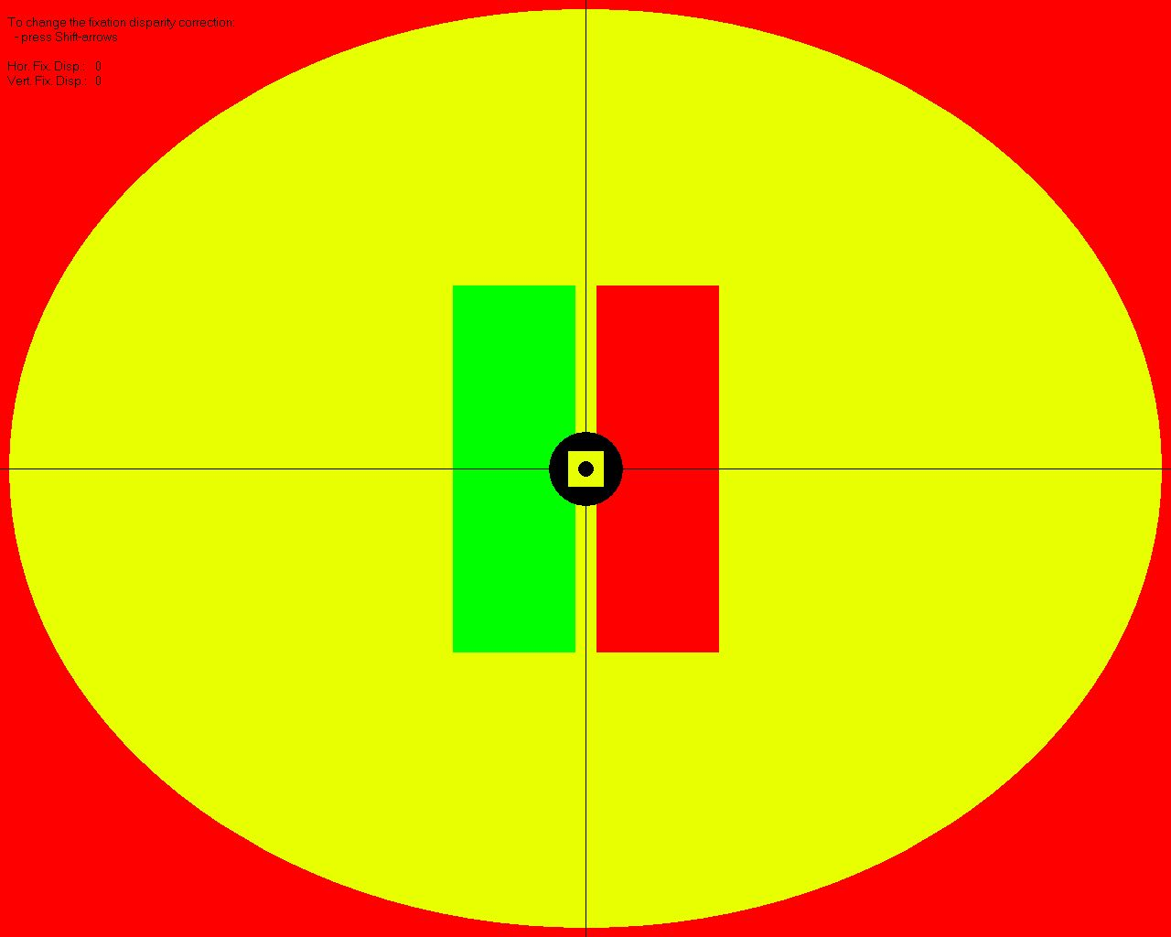
Aniseikonia Inspector Testing

Slide 71
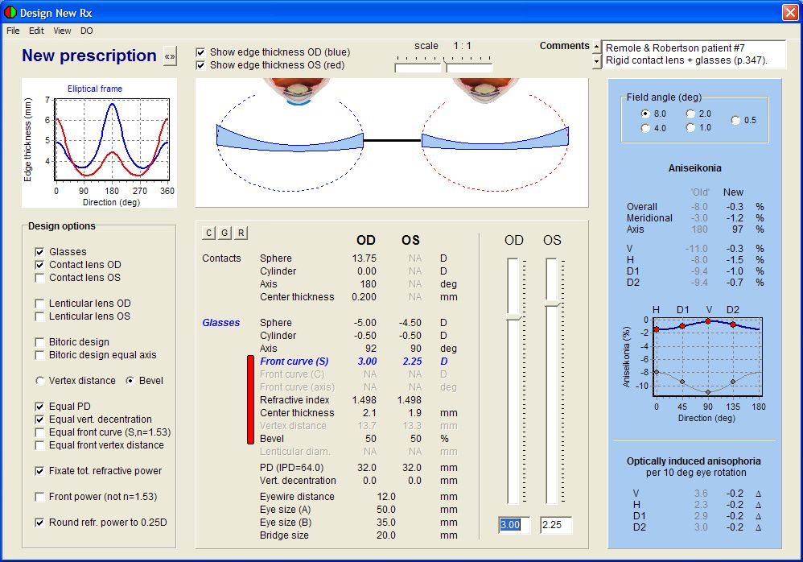
Minimising Aniseikonia

Slide 72
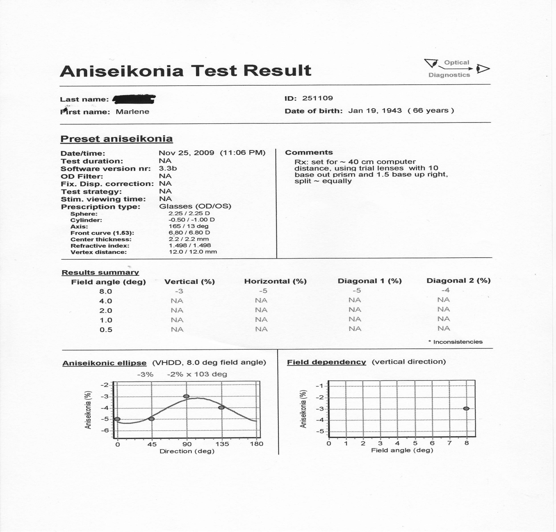

Slide 73
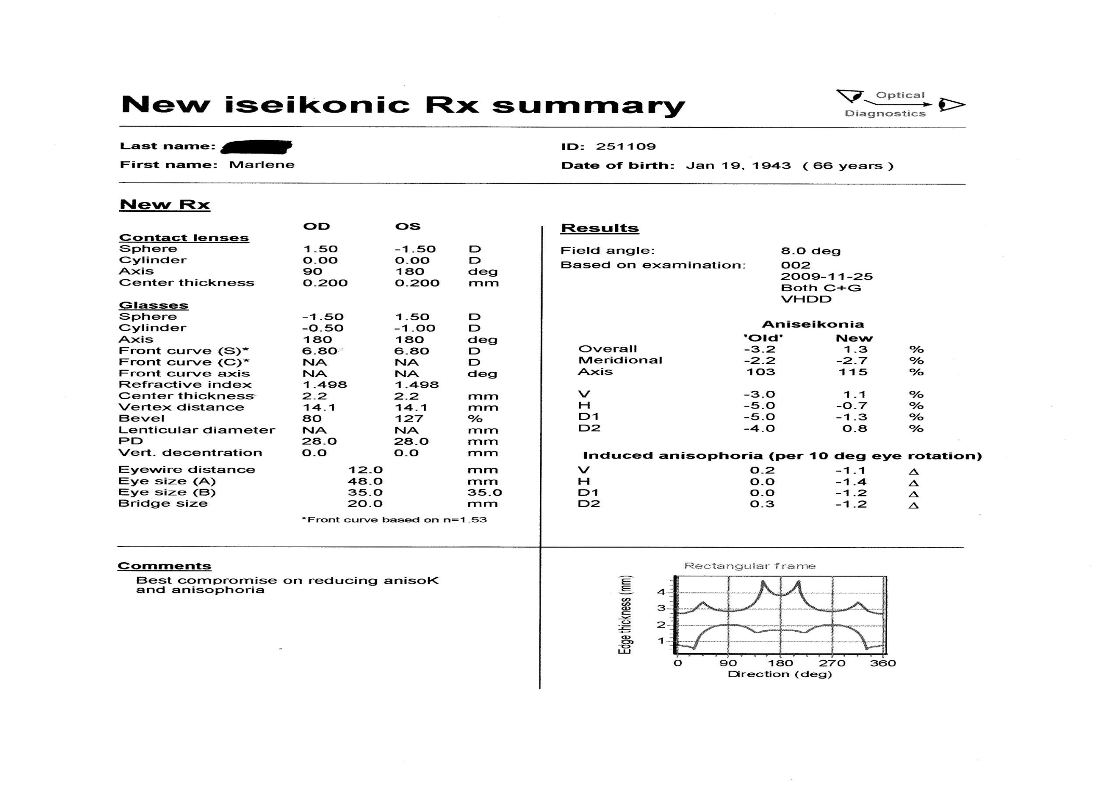

Slide 74
Aniseikona and motor fusion
In most patients, aniseikonia precipitates small angle strabismus due to loss of sensory fusion which in turn impairs motor fusion
Compensation for the strabismus with prisms along with lenses modified to compensate for the aniseikonia works in most optically corrected patients

Slide 75
Case 2: : A newly recognised mechanism for small angle diplopia in the elderly: Saggy eye muscles
82 y o Intermittent Horizontal diplopia, mainly on left gaze, since cataract surgery 4y ago
R 6/9, L 6/6
Horizontal Deviation:
0
0 6ET 12ET
6ET
Small L hypo in primary
Prescribed glasses:
  8Δ BO, 2Δ BU LE ➔ single vision

Slide 76
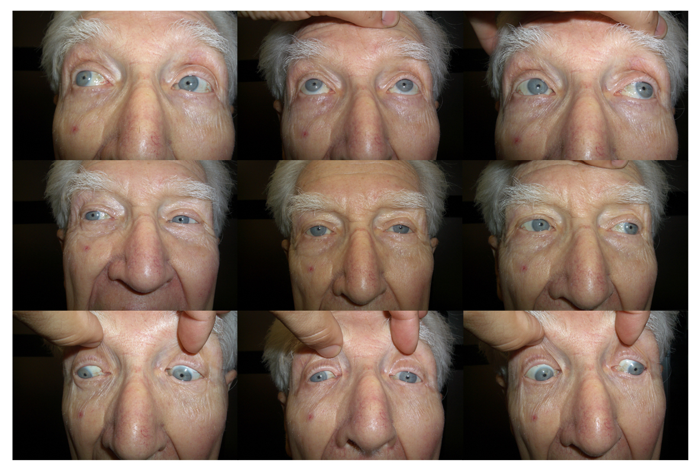
Restricted
depression
on L aBduction

Slide 77
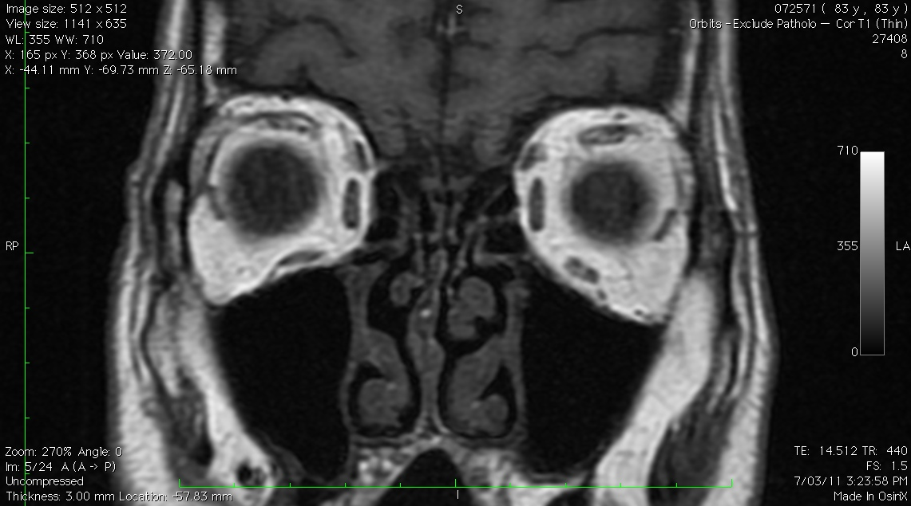
some atrophy of
LSR – LLR tissue sling
‘better’ SR – LR
tissue sling
Sagging of LLR pulley
Not directly related to cataract surgery, but happens in same age group and will be attributed by patients to cataract surgery

Slide 78
LR-SR inter-muscular sling
Degeneration of the LR-SR sling may occur in elderly
Inferior displacement of the LR Pulley.
LR is now a less capable aBductor, & now has an infraduction vector as well
ET & Hypotropia
Demer JL et alii “Heavy Eye” Syndrome in the Absence of High Myopia: A Connective Tissue Degeneration in Elderly Strabismic Patients J AAPOS. 2009 February; 13(1): 36–44.

Slide 79
High risk #1: Beware correcting / ‘improving’ anisometropia
Spectacles compensate for most cases of aniseikonia 2° to axial anisometropia BETTER than do IOLs or corneal refractive surgery
Converting R: -12, L: -4 to -2 DS OU runs a real risk of PRODUCING aniseikonia, ABV & permanent troublesome diplopia esp if there is a small hitherto asymptomatic & unrecognised phoria
NO prospective studies to guide us how to handle anisometropic pts having IOLs

Slide 80
High risk #2: Beware of monovision
There are insufficient prospective studies that can tell us which pts are safe for IOL MV
You need to tell MV pts that there is a small risk [?%] of problems that seem to be fixable by reversing the MV.
Sometimes these problems can present 2-3 y after surgery.
CL testing probably <100% predictive

Slide 81
High risk #3 : Beware macular membranes
Metamorphopsia / aniseikonia can be beyond the ability of optical devices to resolve
Cataract surgery can cause permanent diplopia in these pts

Slide 82
Is the disc swollen..or is it drusen?
IOVS 2011

Slide 83
Differentiating Optic Disc Edema From Optic Nerve Head Drusen on Optical Coherence Tomography
Lenworth N. Johnson et al Arch Ophthalmol . 2009;127(1):45-49
KEY:
Lumpy/ bumpy appearance

Slide 84
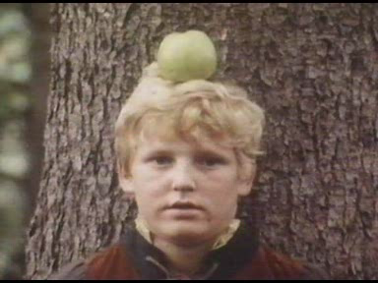
Thank you & good luck
When assessing your results, you need to get the whole picture

Slide 86
Long-Term Outcome of Medial Rectus Recession and Pulley Posterior Fixation in Esotropia With High AC/A Ratio.
Wabulembo G, Demer JL. @ Jules SteinStrabismus. 2012 Sep;20(3):115-20.
Medial rectus (MR) recession with pulley posterior fixation (PF) can be used to treat esotropia (ET) with a high AC/A ratio
N=21 LK 26
Distance and near pre-operative ET averaged LK 23 19.6Δ ± 10.5Δ and 36.9Δ ±18.9Δ, respectively. Mean near-distance (N-D) disparity was LK 26.4 16.4Δ ± 12.3Δ.
The MR recession averaged 4.4 ± 0.9 mm.
Early mean postoperative ET was LK 0.5 XT 1.3 ± 3.3Δ at distance and 2.8Δ ± 5.2Δ at near.
Mean late postoperative ET was 0.1Δ ± 5.8Δ and 1.0Δ ± 6.2Δ at distance and near, respectively.
At the final postoperative examination, mean N-D disparity was reduced to 0.9Δ ± 3.6Δ. LK 4.5

