Slide 1
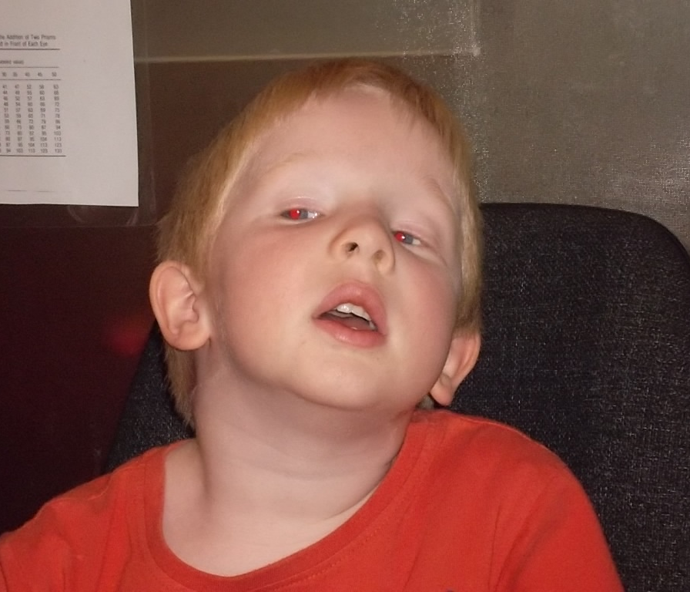
Abnormal Head Posture :
A new look @ an old problem
NIPOSS / CYBERSIGHT 2019
Lionel Kowal
Royal Victorian Eye & Ear Hospital
Melbourne, Australia
Notes:
So how do we sort out this kid in the corner?

Slide 2
$,£,¥,€ & conflict disclosures:
None

Slide 3
1st: WHAT DRIVES THE AHP?
IS THE AHP VISUALLY DRIVEN?
WHICH BOOK DO WE OPEN?
Is the AHP visually driven?
Dr: Close your eyes and hold your head straight,
Pt: The head straightens.
Go to the strabismus textbook
Is the AHP unrelated to visual function?
Dr: Close your eyes and hold your head straight,
Pt: The AHP remains.
Go to the oto-neurology textbook
…& sometimes we need both books
Thank you Marc Gobin

Slide 4
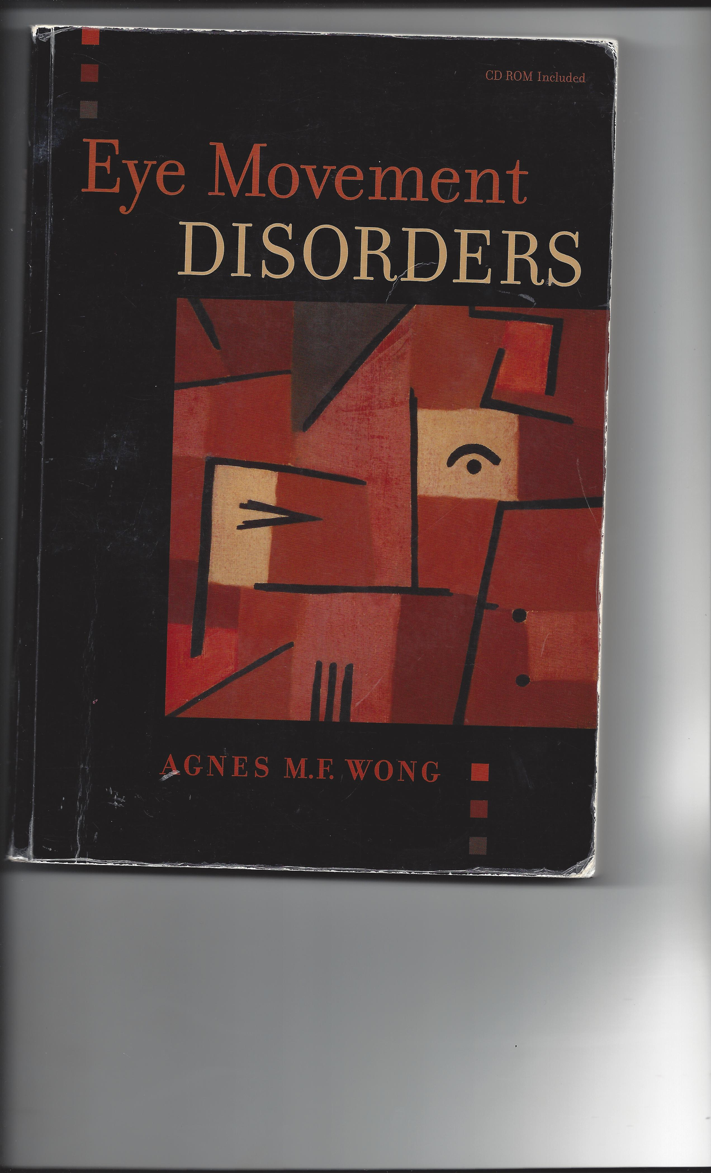
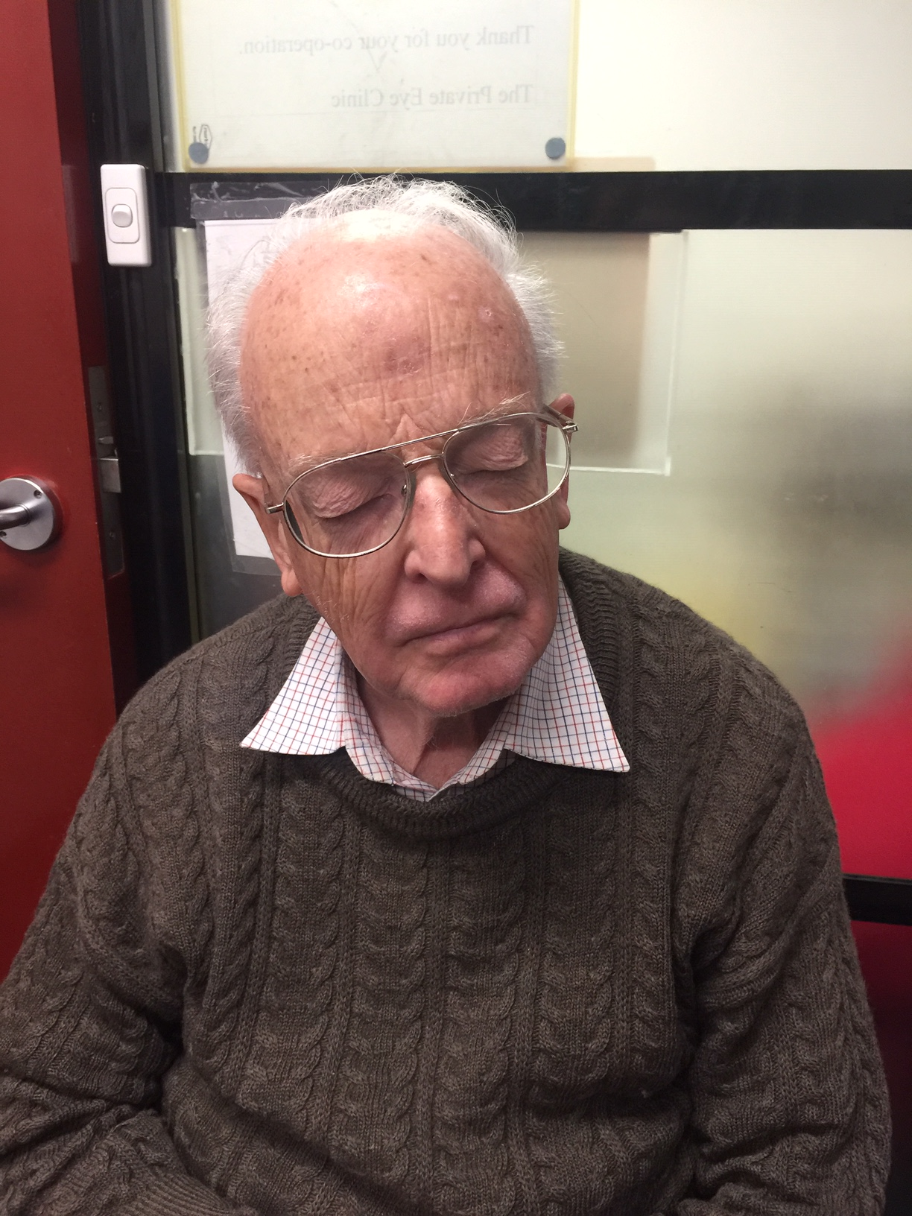
Head tilt with eyes open = eyes closed
Though not driven by an eye problem, some of these conditions can
cause diplopia and can be improved by ophthalmic treatment

Slide 5
2nd: DESCRIBING THE AHP –
THE 3 T’s
Head Tilt ..to L or R
Face Turn ..to L or R
Tip
Up / Down
MEASURE – USE A PROTRACTOR
Thank you Annette Spielmann & Marc Gobin

Slide 6
AHP: usual causes of Head Tilt HT
Vertical strabismus
Ocular tilt reaction
Childhood nystagmus: IIN, torsional FMN
Ciancia’s syndrome [torsional FMN]
Incorrect astigmatism correction
Uncommon
Orbital restriction
Spasmus Nutans
Paroxysmal torticollis

Slide 7
AHP: usual causes of Face Turn FT
Incomitant horizontal strabismus
Childhood nystagmus: IIN, FMN, PAN
Ciancia’s syndrome (horizontal FMN)
Incorrect astigmatism correction
Uncommon
Horizontal gaze paresis / palsy
Hemianopia
Orbital restriction

Slide 8
AHP: usual causes of Tip up TU, Tip Down TD
Incomitant strabismus: CFEOM, A-V patterns, thyroid eye disease, …
IIN with vertical null
Vertical gaze paresis
Uncommon
Paroxysmal Tonic Upgaze PTU / Downgaze PTD
Spino Cerebellar Atrophy SCA syndromes
Sandifer’s syndrome

Slide 9
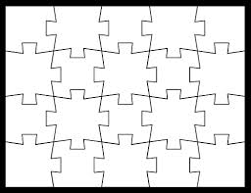
Sorting out the jigsaw puzzle
Infantile
Nystagmus
THYROID
Eye
Disease.
A-V
PATTERN
SCA
OTR /
SKEW
FMN
PAN/
PAGD
CFEOM
GAZE
PALSY
CIANCIA’S
SYND

Slide 10
Today’s examples:
HT Head Tilt to L
FT Face Turn to L
TU Tip Up
TD Tip Down
ANY HT, FT, TU/TD as the null for nystagmus : needs evaluation for convergence null for near & DISTANCE

Slide 11
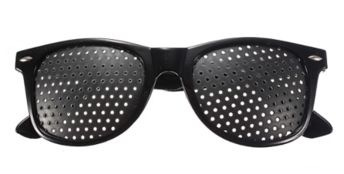
SEMINAL Qs: is the AHP present / driven by -
BEC both eyes closed
BEO only with both eyes open………
RF right eye fixing
LF left eye fixing
EE either eye fixing
Does pinhole fix the AHP? Uncorrected Astigmatism is probably the cause

Slide 12
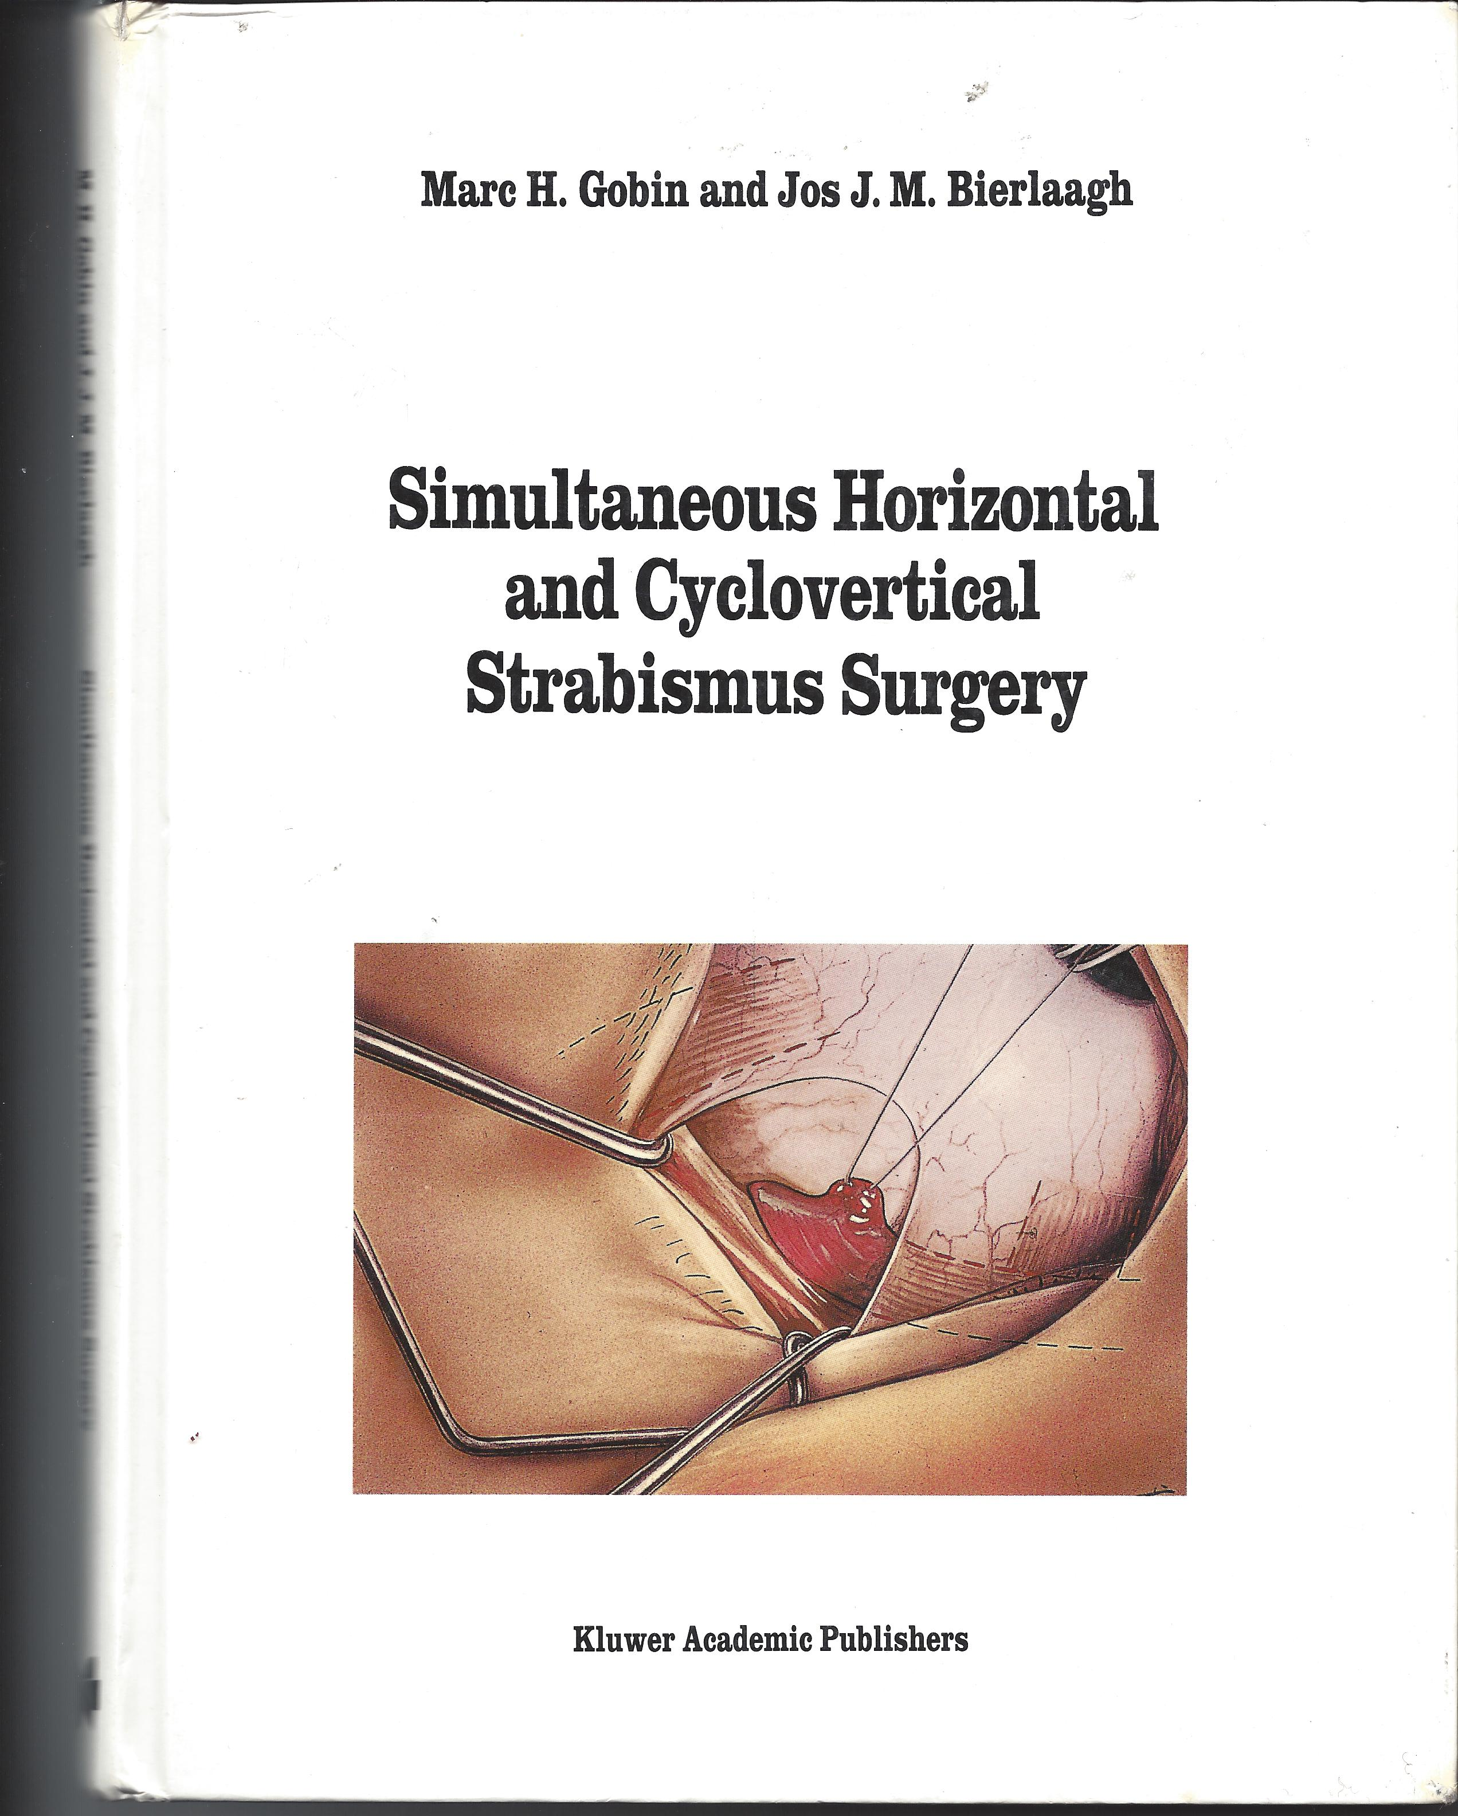
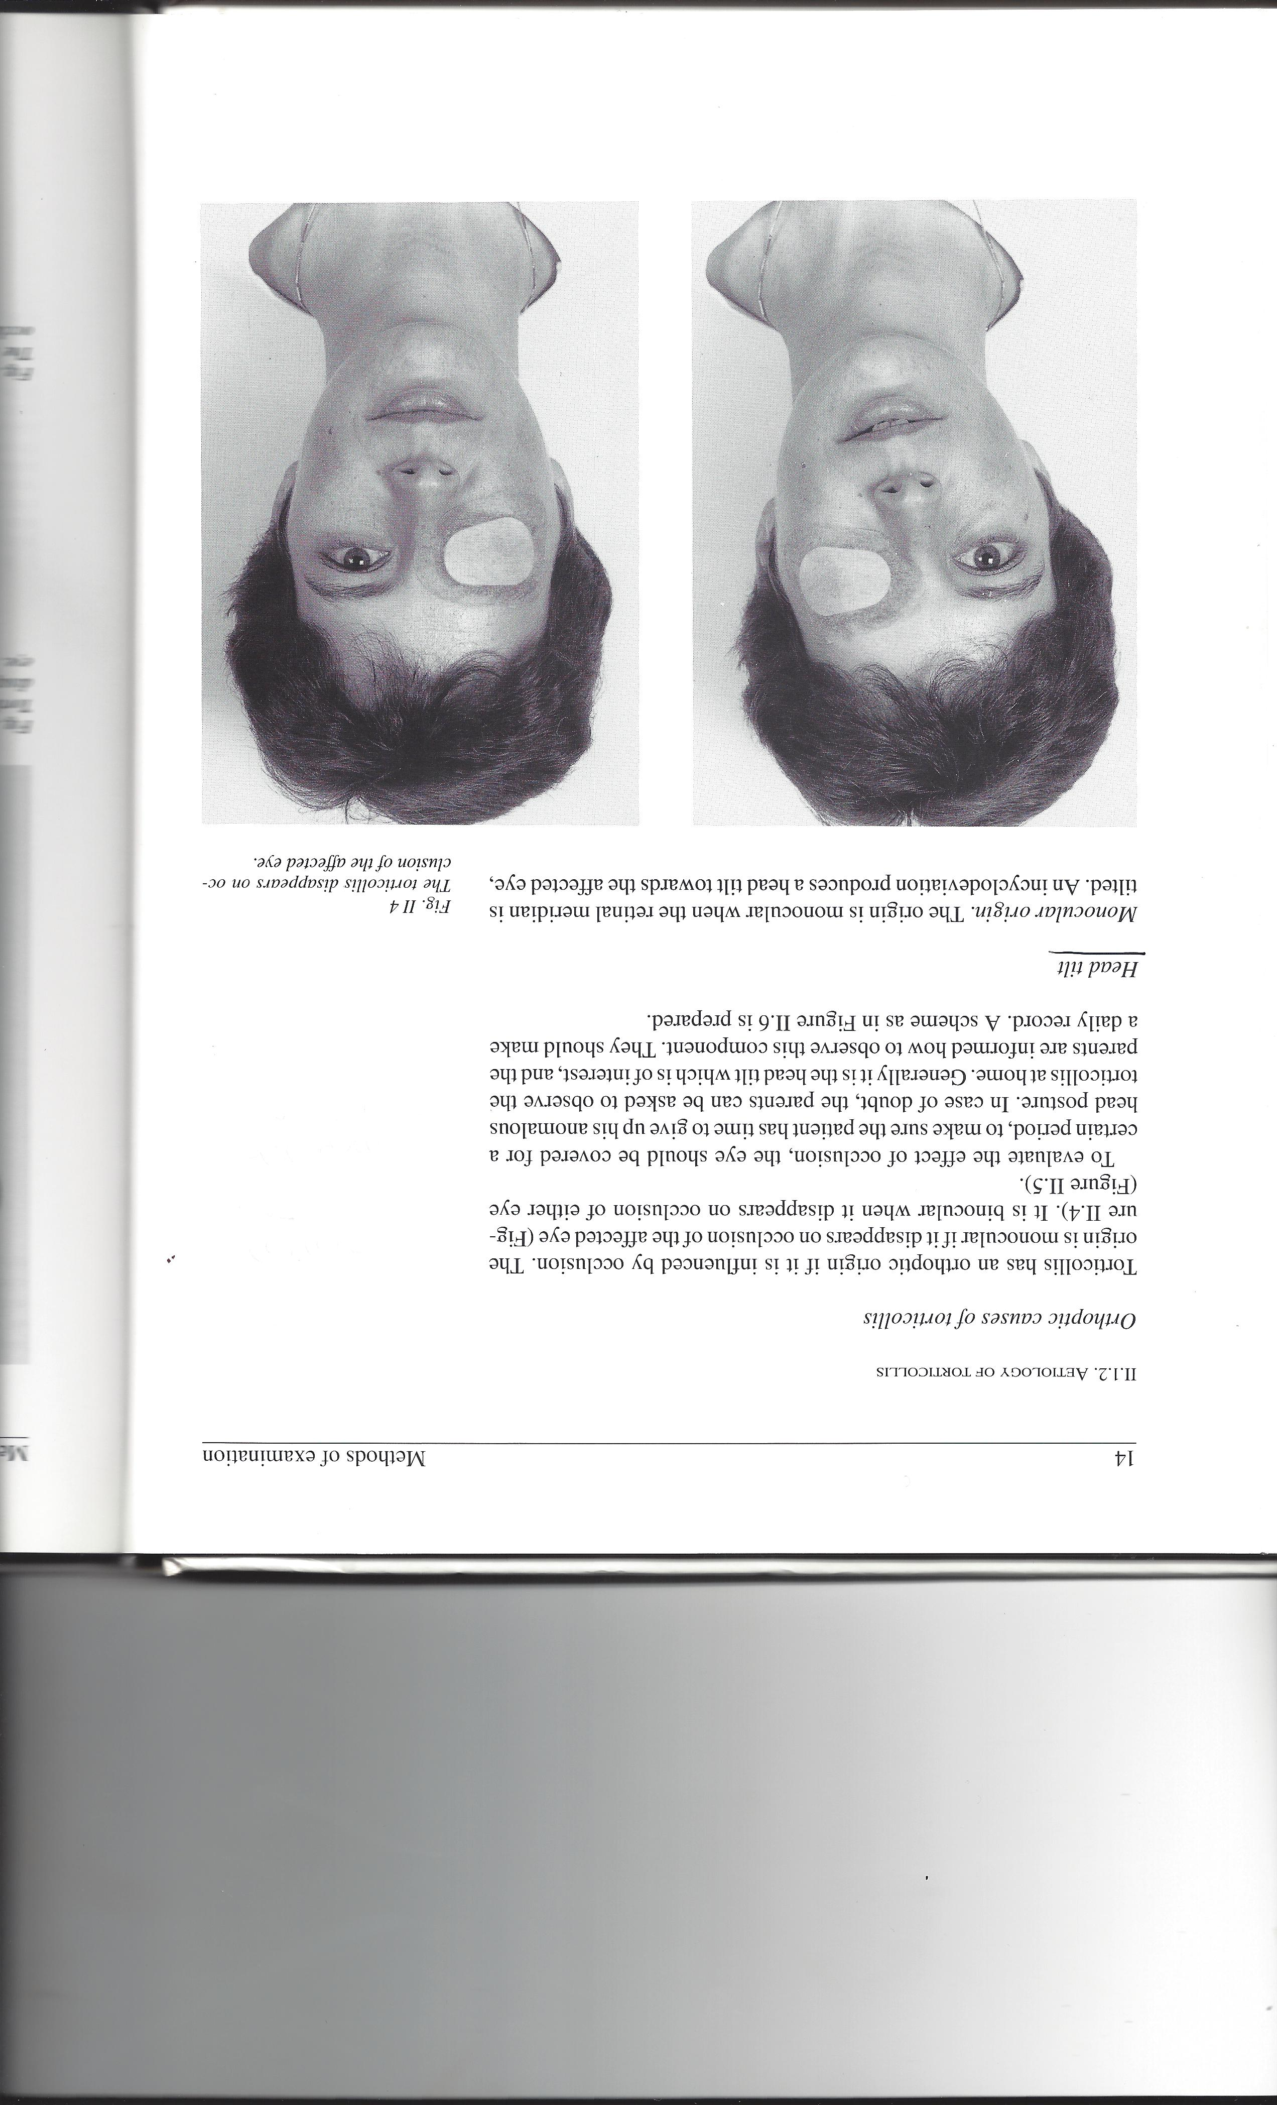
The importance of monocular and binocular patching to assess cause of torticollis
English translation of older Flemish text, 1994

Slide 13
HT to L: only with Both Eyes Open BEO
BEO : HT is caused by vertical strabismus:
1. either eye fixing: no tilt
2. Tilt head to R to find the cause – usually R hyper
A common misconception: ..that HT is driven by TORSION: …NO, it’s driven by VERTICAL Strabismus Kushner J AAPOS 2009
⬆

Slide 14
HT to L – with either eye open EE
BEC : head straight
AHP with BEO = AHP with Either Eye fixing
IN with torsional null
Sometimes no explanation
Lueder GT, Galli M.
Oblique muscle surgery for treatment of nystagmus with head tilt.
J AAPOS. 2012 Aug;16(4):322-6.
Von Noorden, Rosenbaum:
Horizontal transposition of the vertical rectus muscles for treatment of ocular torticollis J Ped Ophth. Strab 1993

Slide 15
HT to L – even with Both Eyes Closed BEC
BEC : OCULAR TILT REACTION OTR
HT independent of visual input
Often has Vertical tropia with diplopia (skew)
Unlike the HT in a SOP, HT in OTR is not therapeutic – the tilt doesn’t fix the hyper!
Supine position fixes the hypertropia

Slide 17
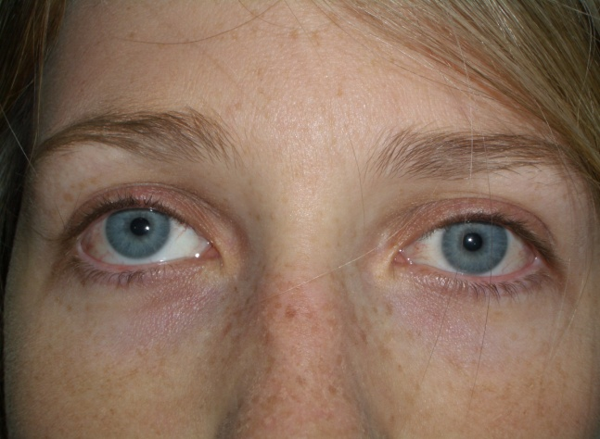
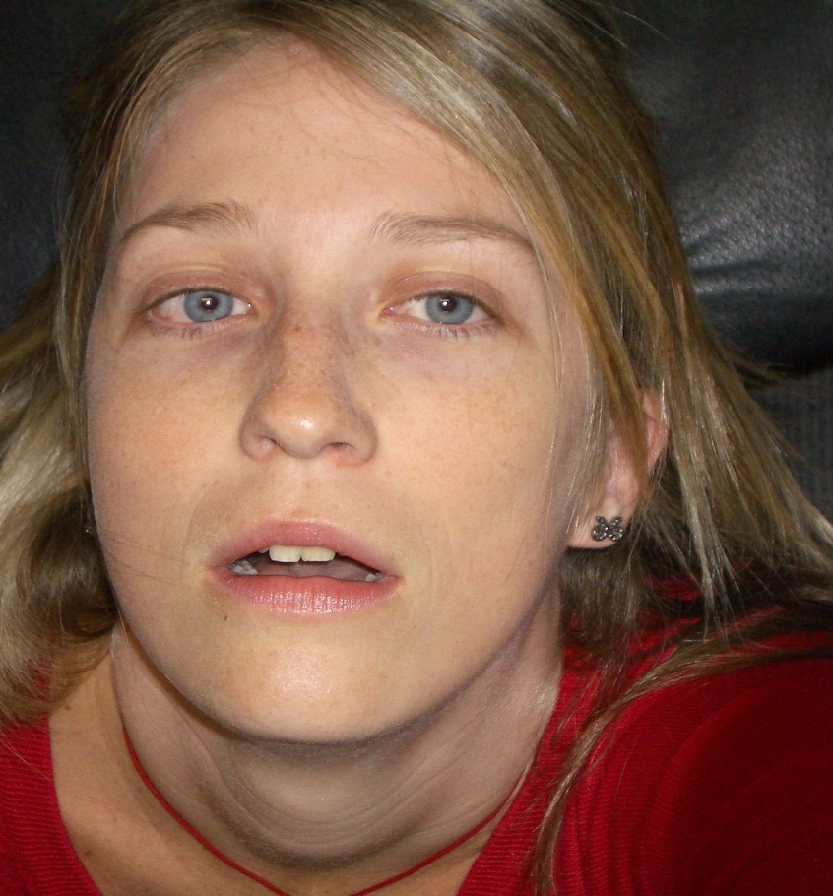
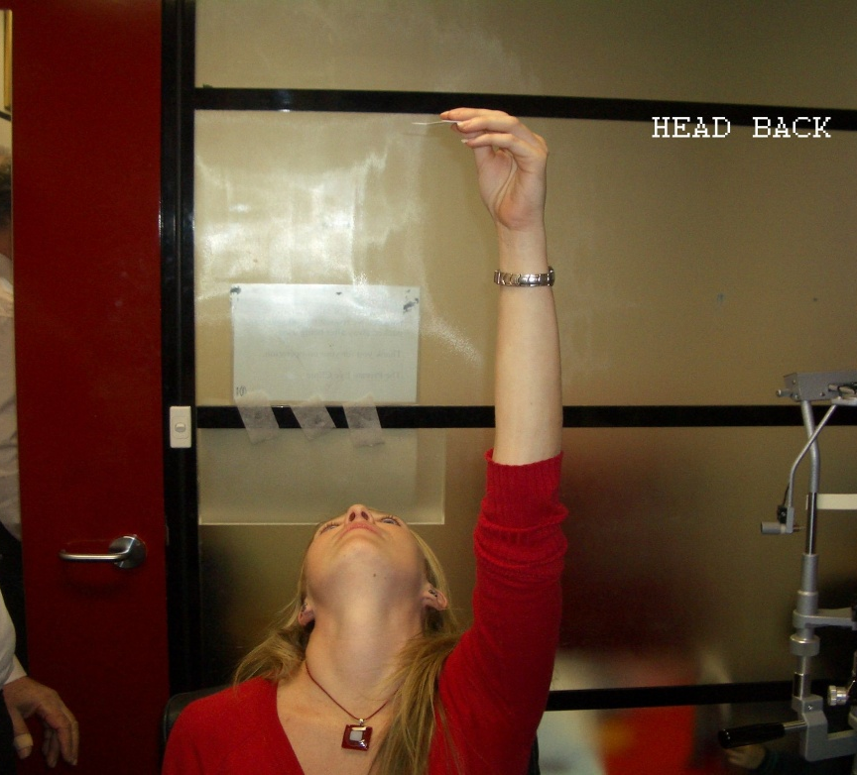
Head supine fixes the hypertropia in Skew
Diplopia, R hyper
when erect
Assess vertical deviation with head supine
Photo taken from above
Single vision with no deviation when head supine
Are the ceiling lights double when you lie down?

Slide 18
FT to L
Both Eyes Open : Face Turn to L
Either eye fixing: no Face Turn
Cause: horizontal strabismus
Turn face to R to find the cause
⬅
FT to L driven by L ET on L gaze

Slide 19
FT to L
Childhood nystagmus & AHP
The AHP may be acuity- dependent: use a slightly supra- threshold changing target that changes every 5-10 seconds
2 main types of childhood nystagmus:
Infantile N = IN
IN : the early onset N seen with SYMMETRIC congenital sensory disorders – OCA, ONHypo, …= CN = CMN = CSN
Fusion Maldevelopment N = FMN= LMLN : the N seen with strabismus &/or ASYMMETRIC sensory disorder

Slide 20
SEMINAL PAPER
The difficulty AND the importance of differentiating the different types of [so called] congenital nystagmus causing torticollis

Slide 21
Childhood nystagmus & AHP : IIN
Infantile N = IN
FT to L with BEO = FT to L with Either Eye fixing unless there also is strabismus
BEC: no AHP

Slide 22
Childhood nystagmus & AHP: FMN
Fusion Maldevelopment N = FMN [formerly LMLN] – the N associated with infantile strabismus
BILATERAL MONOCULAR N
USUALLY HORIZONTAL H
25% TORSIONAL T
N with Right Fixation RF ≠ N with LF
RF: H [beats to R] ± T
LF: H [beats to L] ± T
Blocking the Horizontal N to improve acuity produces a Face Turn FT
Blocking the Torsional N to improve acuity produces a Head Tilt HT

Slide 23
Childhood nystagmus & AHP: FMN
HT to L :
DRIVEN BY LF, DRIVEN BY TORSIONAL FMN
Fixation in intorsion [head tilt to fixing eye] recruits the sup obl & blocks the torsional N of the fixing eye to improve acuity
Looks like: Preference for fixation in intorsion
The same mechanism causes R DVD

Slide 24
Childhood nystagmus & AHP: FMN 2
FT to L :
DRIVEN BY LF, DRIVEN BY HORIZONTAL FMN
Fixation in adduction [face turn to fixing eye] seems to recruit the medial rectus & blocks the horizontal N of the fixing eye to improve acuity
Looks like: Preference for fixation in adduction
The same mechanism causes R DHD / DXD

Slide 25
Childhood nystagmus & AHP FMN 3
A BILATERAL MONOCULARLY DRIVEN H N [25% also T]
e.g. L dominant
Both Eyes Closed: no AHP
Both Eyes Open = Left Fixation : Head Tilt to L [L has torsional FMN].
Right Fixation : Face Turn to R [R has horizontal FMN]

Slide 26
Childhood nystagmus & AHP : IIN
Infantile N = IN
FT to L with BEO = FT to L with Either Eye fixing unless there also is strabismus
BEC: no AHP

Slide 27
Childhood nystagmus & AHP : IIN
Convergence Null
As well an eccentric null causing a FT, Convergence Null is often present with IN & PAN
If you have Conv Null for near, you should test to see if there is a CONVERGENCE NULL FOR DISTANCE [CND].
How?....

Slide 28
CND:
Add 7Δ BO OU with -1 DS OU*.
If this produces a CND, wear these glasses in a ‘real life’ trial for at least a few days.
If the CND is frequently preferred in a ‘real life’ trial, the Δ glasses can be continued for years, or can be replaced with a BMR
* Add -1 DSOU for the CA/C ratio induced by the BOΔ

Slide 29
How common is CND?
n=88 consecutive Eye Movement Recordings
29/88 = 1/3 have CND
True % CND > EMR- demonstrated % CND
Type of nystagmus | CND* | No CND *
IN 53 [60%] | 23 [43%] | 30
PAN ** 18 [20%] | 6 [33%] | 12
IN & FMN 4 | 1
FMN 8 | 0
Uncertain 5 | 0
** PAN is an underestimate - some children labelled IN will later turn out to have PAN
* CND is an underestimate – some children are too young to assess

Slide 30
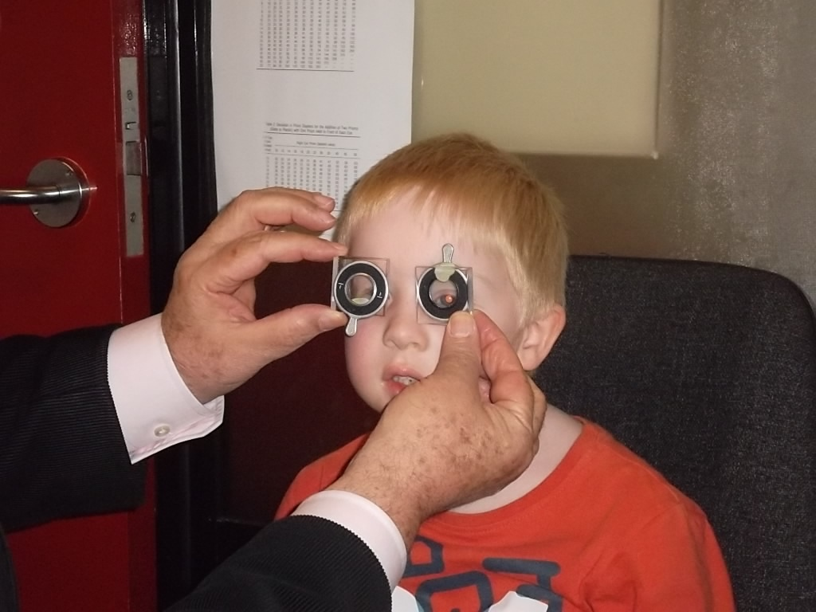
MULTIPLANAR NULL
NEUTRALISED WITH BASE OUT Δ
Face turn to L 25+°,
tip up 20°
7Δ BO OU & -1 DS OU
Creates CND & in the office this is preferred to the nulls of both the turn L & the tip up
COMPLICATED MULTIPLANAR NULL
NOW NEEDS A REAL LIFE TRIAL OF THESE

Slide 31
FT to L AND to R
Periodic Alternating Nystagmus
PAN
Congenital PAN: very asymmetric Cong Aperiodic PAN
CIANCIA’S Syndrome driven by FMN
Ciancia’s: can also be alternating head tilts
BEC: NO FT
RF: FT TO R
LF: FT TO L

Slide 32
TIP UP / DOWN
…with BEO, EE open
Vertical gaze paresis / palsy
IN with vertical null
SCA syndromes
Paroxysmal Tonic Up [or Down] Gaze
Can be orbital (CFEOM, TED) if restrictions are symmetric
Only with BEO: Alphabet pattern strabismus

Slide 33
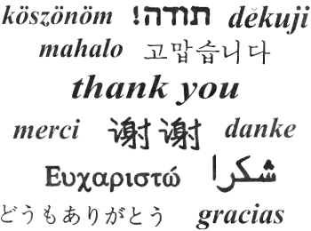

THANK YOU

