Slide 1
Journal Club
16 March 2011

Slide 2
Most previous analyses have looked at dyslexic children, or unselected groups of school-age readers
No prior reports on primary school age poor-readers without dyslexia

Slide 3
Prior Studies
Children with reading and learning difficulties may have:
Higher incidence of hypermetropia, anisometropia, anisokonia, fixation disparity
Exophoria at near, convergence insufficiency, lowered fusional vergence reserves
Vertical phorias
Poor accommodation
or NONE of the above

Slide 4
Prior Studies 2
Children with dyslexia, compared with normal readers may have:
Lower fusional vergence reserves (+ and -)
Vergence instability on dissociation
Poor vergence co-ordination after saccades
Other studies have shown no vergence problems in dyslexics

Slide 5
Study Design
Cross sectional study in Madrid, Spain
87 non-dyslexic poor-readers identified by schools (8-13yo, 30F 57M)
normal IQ
Lowest 30%ile reading battery test
BSCVA 20/20, no strab, <2.00DS <1.00DC
32 ‘age-matched’ controls (14F 18M)

Slide 6
Measurements
Single optometrist measured:
Non-cycloplegic retinoscopy and subjective refraction
Horizontal scanning (DEM test)
N / D heterophoria (von Graefe)
N / D horizontal fusional ranges (rotating prisms)
AC/A ratio (gradient)
Near point of convergence (penlight)
Stereoacuity (Randot)
Refraction +0.20

Slide 7
No relationship between near and distance binocular variables and school grade, or age.
Not commented whether there was a difference statistically, but higher proportion of hyperopia (<2.00) in the study (29%) vs. the control group (15%)
Study eyes +0.20 +/- 0.6D
Control eyes -0.20 +/- 0.8D

Slide 8
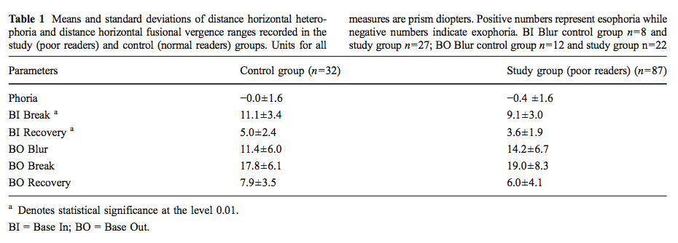
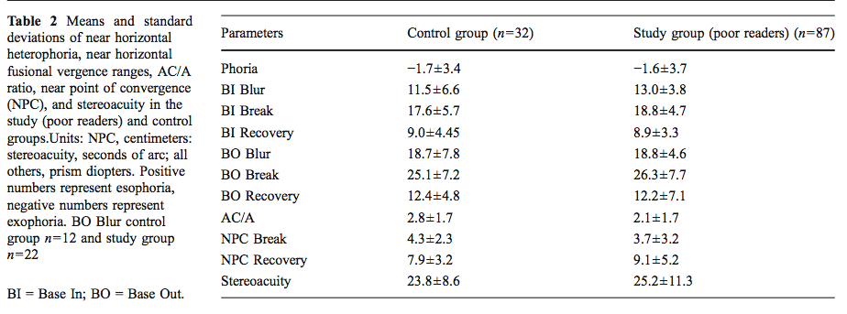

Slide 9
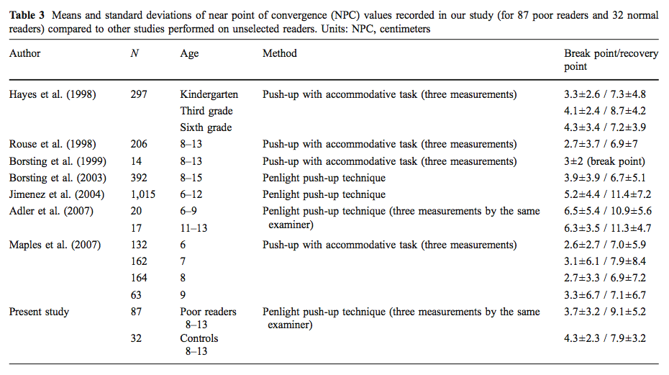

Slide 11
Discussion
Lower base-in break or distance also seen in 51-60 year olds (same authors)
Unsure what mechanisms underly this finding
“it is important to identify any divergence limitation early on so that, through training, convergence and divergence subsystems can be balanced to reduce the symptoms of visual fatigue and loss of attention and interest that often occur in children with reading difficulties … although there are no data to support this proposal”

