Slide 1
Can ophthalmologists repair the brain in infantile esotropia? Early surgery, stereopsis, monofixation syndrome, and the legacy of Marshall Parks.
Tychsen L.
Department of Ophthalmology and Visual Sciences, Anatomy and Neurobiology, and Pediatrics, Washington University School of Medicine, St. Louis, Missouri 63110, USA.
J AAPOS. 2005 Dec;9(6):510-21.

Slide 2

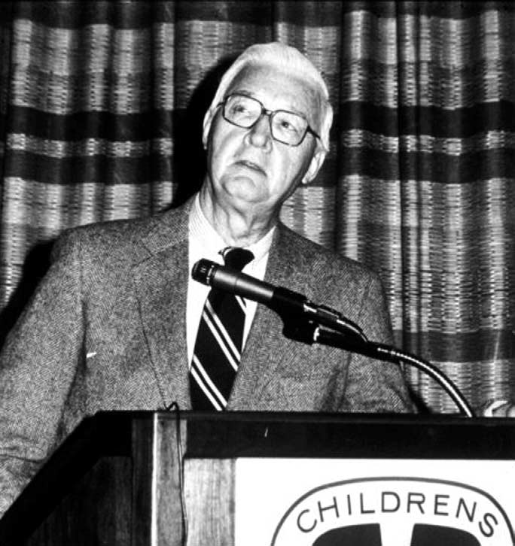
Marshall Parks

Slide 3
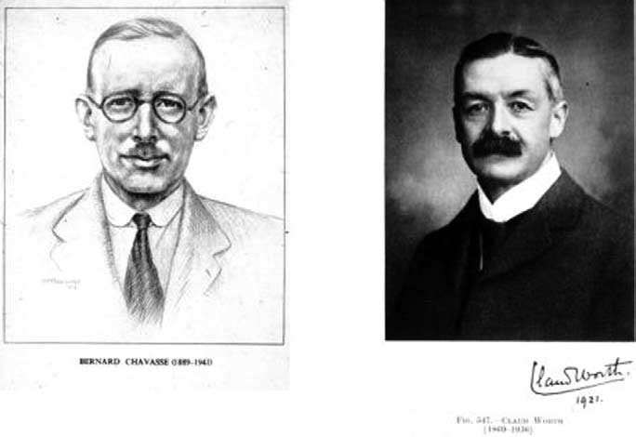
Bernard Chavasse (1889 - 1941)
Claud Worth (1869-1936)

Slide 4
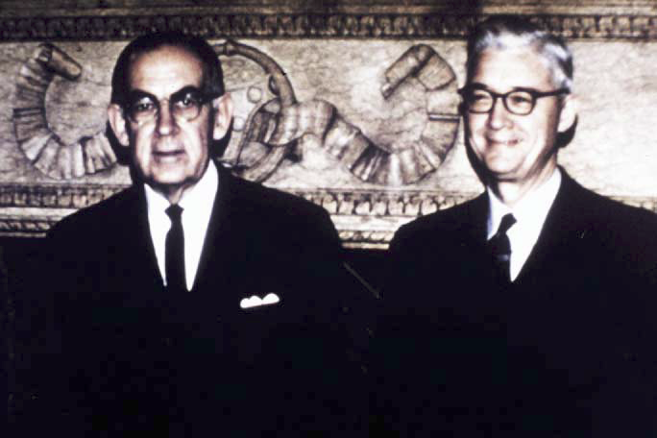
Frank D. Costenbader (1903-1978) with Marshall M. Parks in 1970, the year of Dr. Costenbader’s retirement.

Slide 5
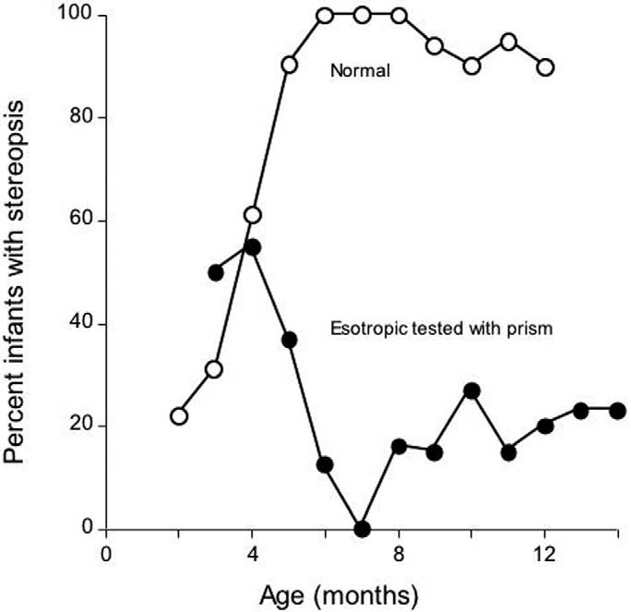
FIG 4. Prevalence of stereopsis as a function of postnatal age in a population of normal (n 50) versus esotropic infants (n 85).
Tested using polarized goggles by the preferential looking method.
Esotropic infants were aligned using prisms and tested before any surgery.

Slide 6
FIG 5. Prevalence of stereopsis after surgical realignment in children with infantile esotropia as (A) a function of age-of-onset of esotropia and (B) as a function of duration of esotropia before realignment. Testing performed at age 5 years. Surgical realignment
achieved generally by age 1 year for the population as a whole.
Dashed line at 40% indicates average prevalence for all the infants.
Data from more than 100 consecutive infants, replotted from Birch et al
Notes:
? The answer to this question encompasses both sensory and motor behaviors because the clinical hallmarks of the disorder are stereoblindness and absence of motor fusion, which manifests as convergently deviated eyes. Functional recovery of sensory and motor fusion in infantile esotropia was a consuming interest, if not career-defining passion, of Marshall Parks. The purpose of this work is to pay tribute to Parks' legacy by showing how human and animal studies, conducted largely during the last 25 years, support both his clinical insights and treatment philosophy.

Slide 7
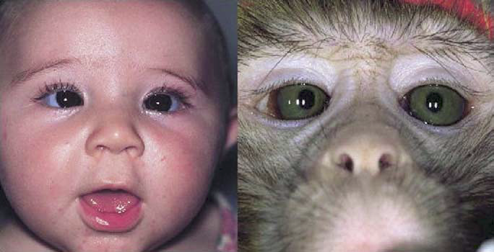
what happens to the visual cortex in unrepaired ET?
Hubel - Wiesel & Crawford - von Noorden
Strabismic monkeys show deficient binocular response and reduced sensitivity in electro-recording from striate cortex (V1)

Slide 8
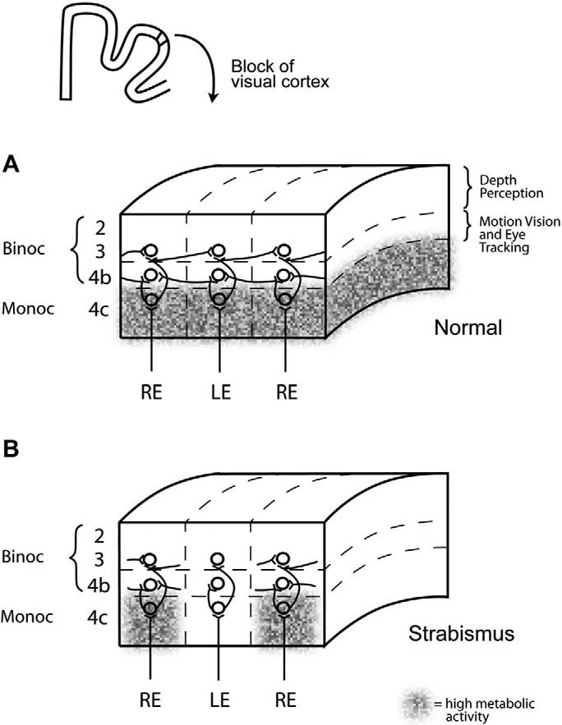
FIG 7. Neuroanatomic abnormalities found in area V1 of monkeys with natural infantile esotropia who alternated fixation and had normal visual acuity in both eyes: lack of binocular connections and metabolic suppression. A, Normal monkey has an abundance of binocular connections between ODCs of opposite ocularity. Metabolic activity (dark staining) is uniform and high within layer 4C of all ODCs. Neurons in layers 2/3 of the interblob pathway play a role in mediating stereopsis. Neurons in layer 4B contribute to motion perception and eye movement. B, Strabismic monkey has a paucity of horizontal connections within layers 2 to 4 for binocular vision; neurons are connected within individual ODCs but there are few connections to neighboring ODCs of the opposite ocularity. Monocular connections to other ODCs of the same ocularity (eg, right eye to right eye ODCs) remain intact. Layer 4c shows lower/suppressed
metabolic activity (evident as paler cytochrome oxidase staining) in opposite-eye ODCs.

Slide 9
Parks Monofixation syndrome
*Subnormal acuity (amblyopia) in the non-preferred eye in 34% of corrected infantile esotropes and 100% of anisometropes.
†Microexotropia in 10%.
Clinical feature | Proposed neural mechanism
Foveal suppression scotoma of 3–5 deg in the nonpreferred eye when viewing binocularly * | Inhibitory-connection-mediated metabolic suppression of decorrelated activity in VI foveal ODCs of non-preferred eye
Subnormal stereopsis (threshold 60–3000 arc sec) | Broader disparity tuning of parafoveal neurons in VI/MT (foveal neurons suppressed)
Stable microesotropia† less than 4–8 PD (2.5–5 deg) | Small angle average horizontal neuron length in VI, eso by default to convergent disparity coding of major MST population
Fusional vergence amplitudes intact for disparities 2.5–5 deg (4–8 PD) | VI excitatory horizontal binocular connections (and VI/MT/MST disparity neurons) intact beyond region of foveal suppression

Slide 10
The reach of V1 horizontal axons and Park ' s 8 pd rule
FIG 9. Distance spanned by the average V1 horizontal axon in normal and strabismic primates. Normal: In a primate with normal eye alignment, the ODC representing the foveola (or 0 deg eccentricity) of the left eye (L) is immediately adjacent to the ODC representing the foveola of the right eye (R). The side-by-side arrangement of the “foveolar” ODCs in this case (white arrowheads) would be well within the range of horizontal connections needed to allow those ODCs to communicate for binocular fusion. Micro-eso: In a primate with microesotropia, a neuron within a foveolar (at 0 deg eccentricity) ODC of the fixating eye can only span a distance in the visual cortex corresponding to an angle of strabismus of approximately 4 PD (dark arrowhead ODC corresponding to pseudofovea position of deviated eye).

Slide 11
Extrapolating to the clinic:
  >Realignment of the eyes 2.5-5 deg within 60 days from beginning of deviation ---> allows fusion & stereopsis.
  >Beyond 60 days – the majority of infants will miss stereopsis but will benefit Monofixation.

