Slide 1
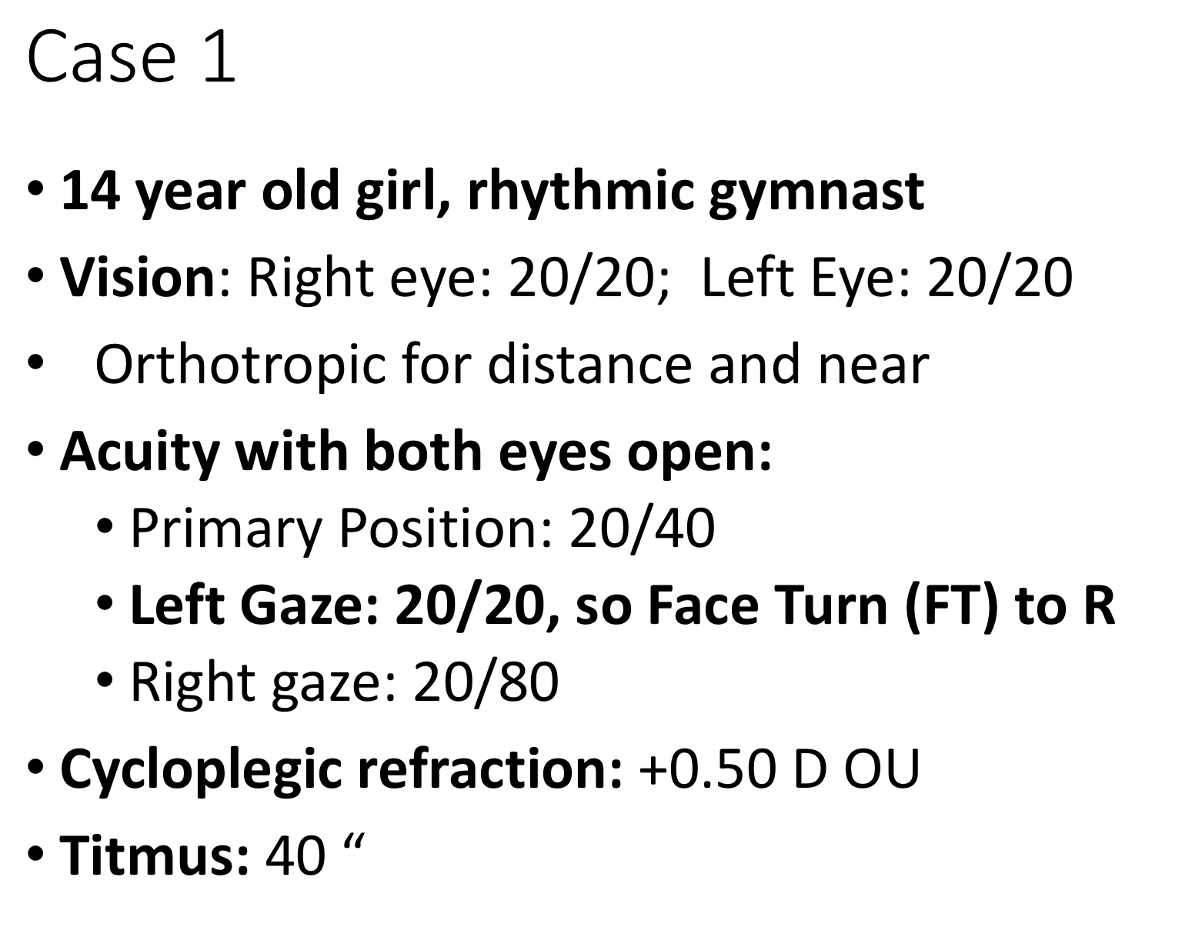
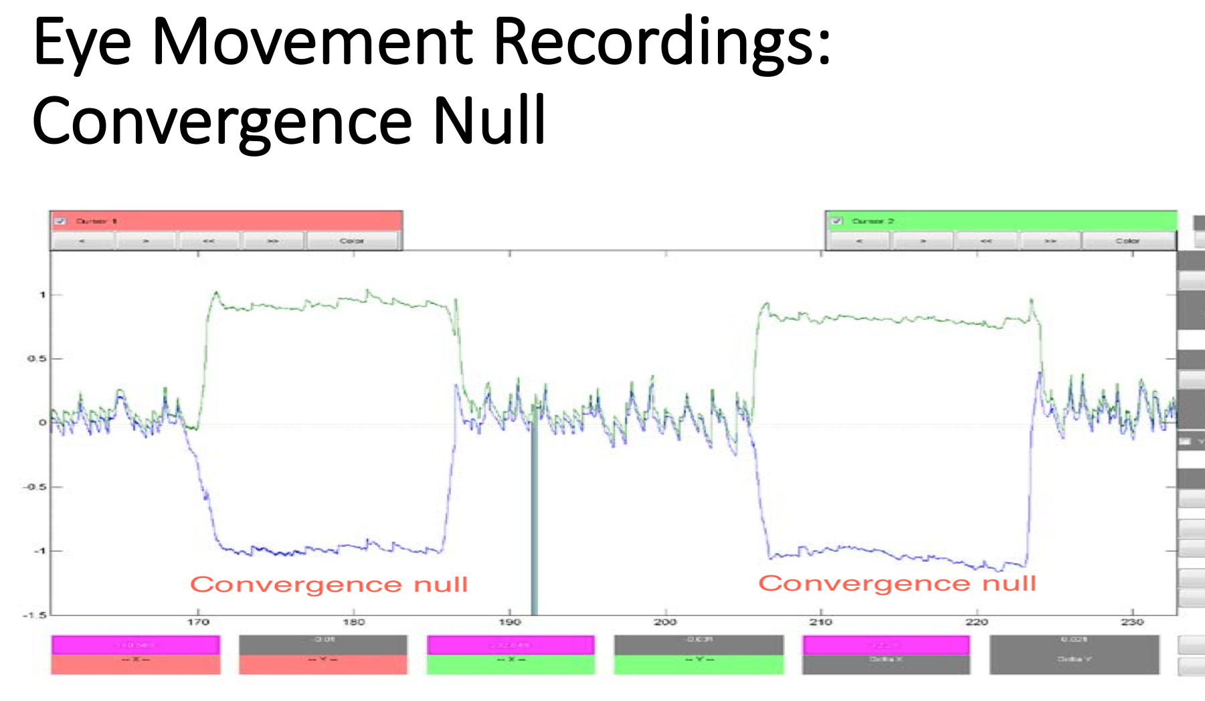
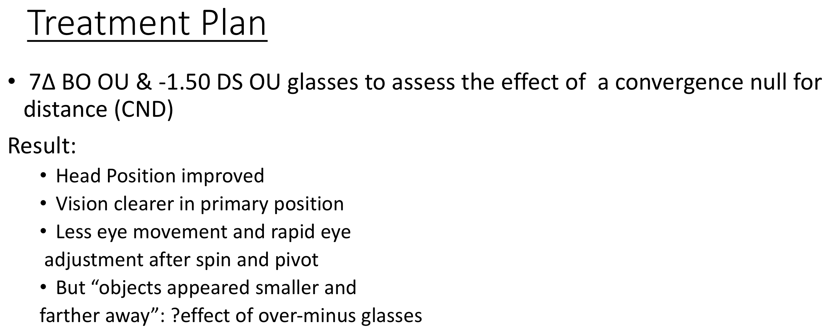
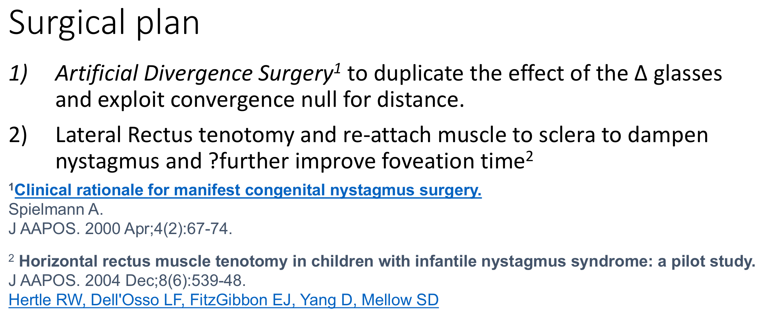
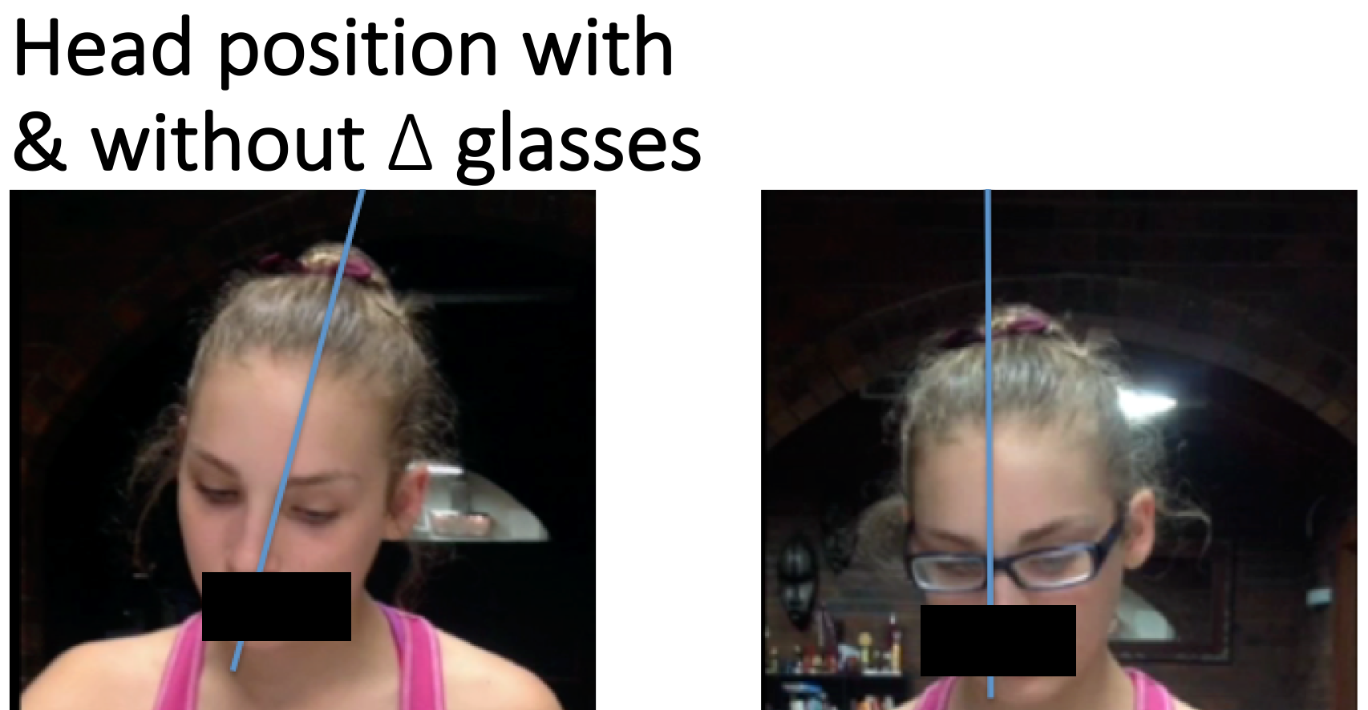
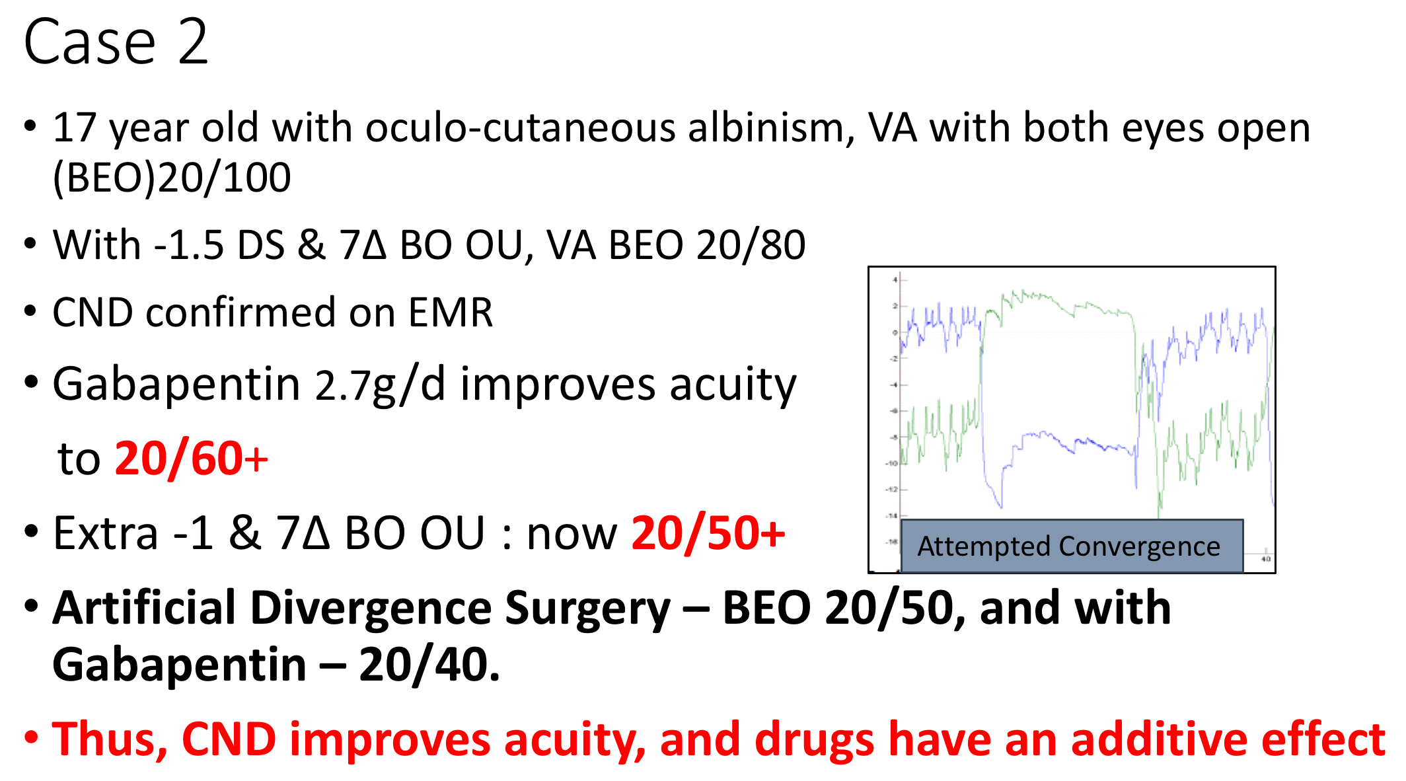
Eye movement recordings for childhood onset nystagmus: When you DO and DON’T need them
Anat Bachar¹, Shivanand Sheth¹, Raghuvir Kini¹, Larry Abel², Lionel Kowal¹
¹Royal Victorian Eye and Ear Hospital (RVEEH), Melbourne, Victoria, Australia
² Department of Optometry and Vision Sciences Melbourne University, Australia
Introduction
Eye movement recordings (EMR) for nystagmus help identify features that guide optical and surgical management and offer prognostic advice. It is not clear, however, if EMR is always necessary.
We try to identify the characteristics of nystagmus that may indicate when EMR may not be necessary, with the help of illustrative cases.
Methods
This was a retrospective review of 44 consecutive cases of nystagmus with EMR between October 2011 to Jan 2015. The level of agreement between an office examination (OE) vs EMR in the diagnosis of common forms of childhood-onset nystagmus was assessed. A separate review of 88 consecutive EMRs was carried out to look at incidence of Convergence Null for Distance (CND).
Results, cases and discussion
Cases with CND
Cases with strabismus
Conclusion
When you have classic features of INS with no strabismus, eccentric null with constant FT and convergence null for both near and distance → EMR is probably not necessary and will not change management, even if INS and APAN are incorrectly labelled. Management will consist of “artificial divergence” surgery to replicate the effect of prisms that induce the convergence null, once the prisms have been tried for a period of time, and found to be useful.
When there is strabismus, EMR is better than office exam alone.

