Slide 1
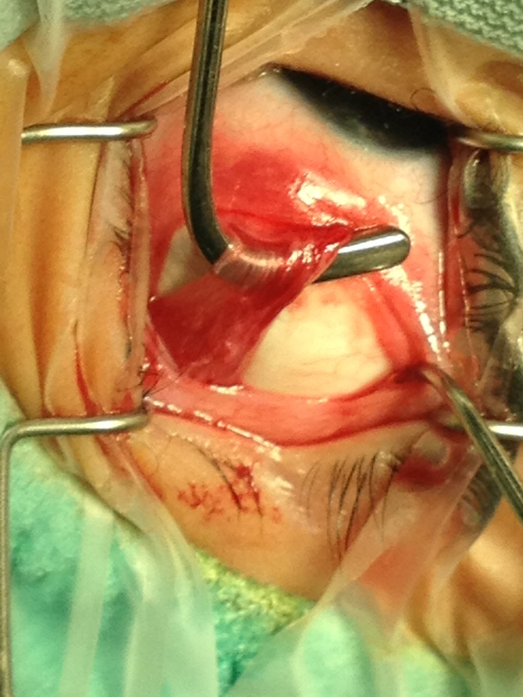
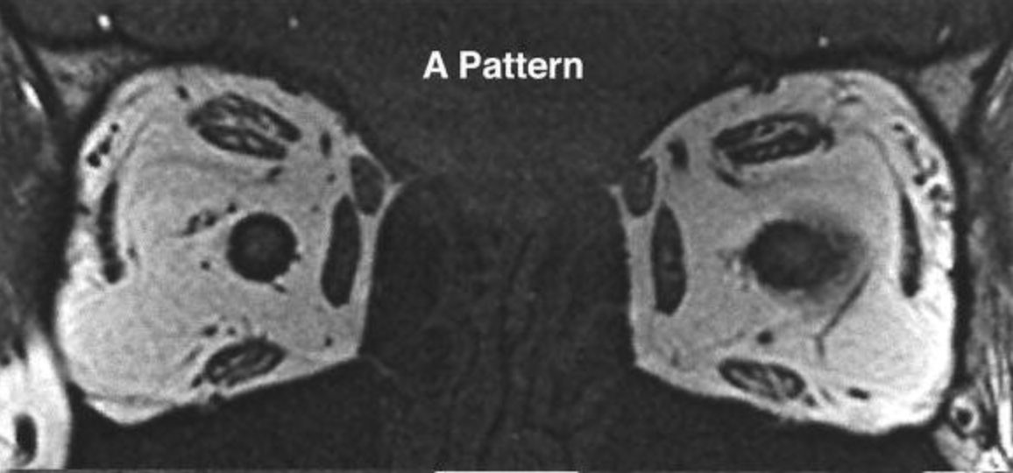
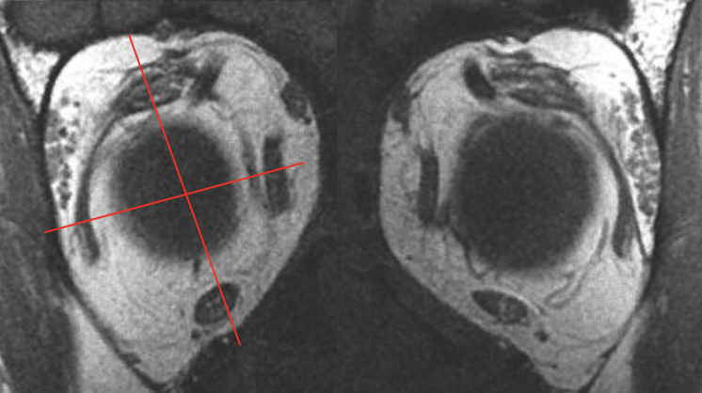
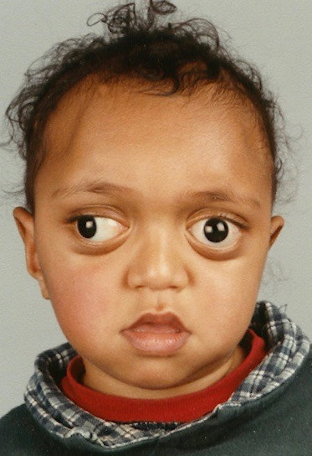
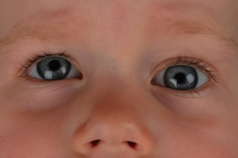
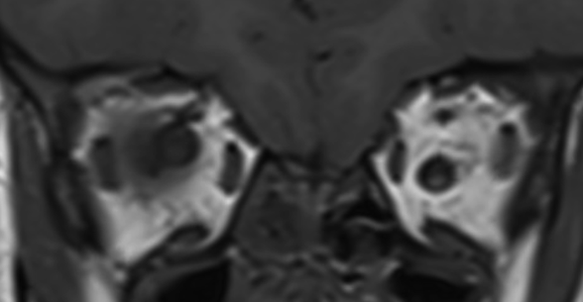
The Clinical Spectrum of Lateral Rectus Heterotopy
Shivanand Sheth^{1,2}, Lionel Kowal¹
¹The Royal Victorian Eye and Ear Hospital, Melbourne
²The Royal Children's’ Hospital, Melbourne
*
Introduction
Lateral rectus heterotopy is an evolving clinical – radiological relationship. It can be an isolated radiological finding with no clinical expression. It can also cause or contribute to strabismus, including pattern strabismus.¹ The purpose of this paper is to describe the varied clinical spectrum in which lateral rectus heterotopy is seen on radiology and intraoperatively.
Methods
Literature was reviewed for reported associations of strabismus with lateral rectus heterotopy along with cases from the authors’ experience. The conditions associated with lateral rectus heterotopy were classified into congenital and acquired heterotopy.
Results
Congenital LR Heterotopy *More likely to have successful sensory adaptation | Acquired LR Heterotopy *More likely to have diplopia
Isolated LR Heterotopy¹ No or minimal heterotopy of other extraocular muscles Patient not syndromic / No craniosynostosis Can present with A or V-Pattern strabismus Can be incidentally detected on radiology or intraoperatively without clinical expression | Sagging Eye Syndrome ^{2,3} Age related connective tissue changes leading to disruption of the lateral rectus – superior rectus band leading to a sag of lateral rectus
LR heterotopy with rotated orbits¹ With heterotopy of other extraocular muscles Not syndromic / No craniosynostosis | Heavy Eye syndrome ^{3,4,5} High axial myopia causing the eye to elongate and expand and/or herniate in the supero-temporal quadrant displacing lateral rectus inferiorly and superior rectus nasally.
LR Heterotopy as a feature of craniosynostosis/plagiocephaly ^{6,7} LR Heterotopy can also occur after Fronto-orbital advancement surgery for coronal synostosis⁸ | Iatrogenic: After Transposition of lateral recti during strabismus surgery After large over-recessions of Lateral recti Tight lateral rectus can have a downward slant
Nasal
Temporal
Superior heterotopy (red arrow) of the right lateral rectus associated with A-pattern strabismus with no heterotopy of other extraocular muscles ¹ (Image taken from reference 1)
Inferior
Intra-operative photo showing infero-temporal path of left lateral rectus (red arrow) in a patient with inferior heterotopy of Lateral rectus
Sagging left lateral rectus muscle (arrow). Red line joins the centre of both medial recti muscles.
Dehiscence of left lateral rectus – superior rectus band (arrow)
Incyclo-rotated right orbit with superior heterotopy of right lateral rectus, temporal shift of right inferior rectus and nasal shift of right superior rectus
Excyclo-rotated right orbit with inferior heterotopy of the right lateral rectus, nasal shift of right inferior rectus and temporal shift of right superior rectus¹ (Image taken from reference 1)
A patient with high axial myopia demonstrating enlarged elongated globes (left) with inferior heterotopy of lateral recti muscle (solid white arrow) and nasal displacement of superior recti (vertical grey arrows) with thinning of the lateral rectus-superior rectus bands (dashed white arrows) ⁵ (Image taken from reference 5)
Excyclo-rotated right orbit with inferior heterotopy of right lateral rectus path, nasal shift of right inferior rectus and temporal shift of right superior rectus in a patient with craniosynostosis
Iatrogenic superior heterotopy of left lateral rectus muscle (red arrow) in a girl with left monocular elevation deficit who had a Knapp’s procedure with transposition of left medial and lateral recti superiorly. (red line shows left medial and lateral recti muscles higher than the right counterparts)
Discussion and Conclusion
Congenital causes of lateral rectus heterotopy include isolated heterotopy or can occur in combination with extorted orbits with or without craniosynostosis. Acquired causes include heavy eye syndrome and sagging eye syndrome, or a combination of the two ³. Iatrogenic causes include surgical transposition of lateral rectus muscles and craniofacial surgery for craniosynostosis. Magnetic Resonance Imaging can be useful to demonstrate heterotopy in these cases.
References
Demer JL, Clark RA, Kono R, Wright W, Velez F, Rosenbaum AL. A 12-year, prospective study of extraocular muscle imaging in complex strabismus. J AAPOS 2002; 6(6): 337–347.
Chaudhuri Z, Demer JL. Sagging eye syndrome: Connective tissue involution as a cause of horizontal and vertical strabismus in older patients. JAMA Ophthalmology 2013;131(5): 619–625.
Tan RJ, Demer, JL. Heavy eye syndrome versus sagging eye syndrome in high myopia. J AAPOS 2015; 19(6): 500–506.
Yokoyama T, Ataka S, Tabuchi H, Shiraki K, Miki T. Treatment of progressive esotropia caused by high myopia - A new surgical procedure based on its pathogenesis. In: transactions: 27th meeting of the european strabismological association. 2001. p. 145–8.
Patel SH, Cunnane ME, Juliano AF, Vangel MG, Kazlas MA, Moonis G. Imaging appearance of the lateral rectus-superior rectus band in 100 consecutive patients without strabismus. Am J Neuroradiol. 2014;35(9):1830–5.
Saunders RA, Holgate RC. Rectus muscle position in V-pattern strabismus - A study with coronal computed tomography scanning. Graefe’s Arch Clin Exp Ophthalmol. 1988;226(2):183–6.
Tan KP, Sargent MA, Poskitt KJ, Lyons CJ. Ocular overelevation in adduction in craniosynostosis: is it the result of excyclorotation of the extraocular muscles? J AAPOS 2005; 9(6): 550–557.
MacKinnon S, Rogers GF, Gregas M, Proctor MR, Mulliken JB, Dagi LR. Treatment of unilateral coronal synostosis by endoscopic strip craniectomy or fronto-orbital advancement: Ophthalmologic findings. J AAPOS 2009 Apr;13(2):155–60.

