Slide 1
“Surgery of Duane’s syndrome; Transposition or recession”.
Kowal, L Australia
Morad, Y Israel

Slide 2
Best reference [still]
Available on Google books

Slide 3
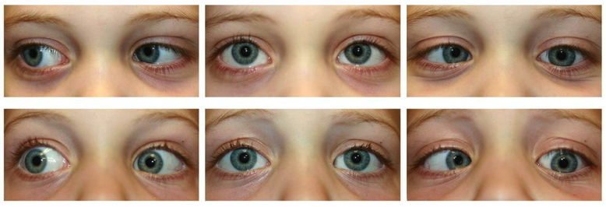
This slide from Boston Children’s paper Archives Ophthal 2012

Slide 4
Typical L DS1 (1) The physiology is VERY complicated
The findings are a balance b/w
R refraction: un-/under corrected + increases LMR innervation [accomm convergence] & then reduces LLR innervation [Sherrington]
RMR innervation on L gaze: increased LLR innervation (Hering) and reduced LMR innervation (Sherrington).
A recessed RMR will have increased innervation in primary position (fixation duress) with increased effects on LLR and LMR as if on L gaze
LMR: change in L-T balance [increased tightness, shorter muscle] will produce a face turn to L, and L aBduction deficit

Slide 5
Typical L DS1 (2) the physiology is VERY complicated
LLR innervation is a balance b/w contributions of 3rd & 6th. Increased 3rd contribution increases retraction. Decreased 6th contribution increases aBduction deficit.
LLR abduction deficit due in part to lack of 6th innervation, and in part to tight LMR
LLR: change in L-T balance [increased tightness, shorter muscle] will increase retraction and produce aDduction deficit
Transposition acts as a ‘rubber band’. When LMR relaxes, LE aBducts b/c of this rubber band effect. Augmentation of transposition [resection or post fixation sutures] probably augments the effect

Slide 6
Clinical presentation depends on balance of abnormal innervation to LR
LR innervation
3 N 6N
30% 70%
ET – less
Some retraction on ADduction
LR innervation
3N 6N
70% 30%
ET more
More retraction on ADduction
ABduction restricted LR innervation
tight MR ‘chronic ET’
ADduction restricted tight LR
slide by Dr Elina Landa

Slide 7
Why do we operate?
‘Old’ indications:
1. to improve appearance of ET
2. to improve appearance of face turn
3. to improve appearance of retraction, upshoots,…
‘New’ indication:
4. to improve field of binocular vision to L gaze without compromising field to R gaze

Slide 8
What do we do?
‘Old’:
1. to improve appearance of ET
2. to improve appearance of face turn
3. to improve appearance of retraction, upshoots,…
Sx: LMR Rc [+/- RMR Rc if ET large]
‘New’
4. to improve field of binocular vision to L without compromising field to R
Sx: transposition, RMR Rc, L Rc-Rs

Slide 9
Surgical options for L DS1 (1)
1. RMR Rc: to change 6th component of innervation to LLR & secondarily to inhibit LMR
2. LMR Rc: to fix ET and face turn
3. BMR: better effect on ET than LMR alone, some effect of RMR Rc
4. LMR Rc / LLR Rs: to fix ET, face turn & improve aBduction

Slide 10
Surgical options for L DS1 (2)
5. SR-IR transposition [various techniques]: to improve aBduction, reduce ET & face turn
6. SR- only transposition and LMR Rc: to improve aBduction, reduce ET & face turn
7. LMR Rc and 50+% transpsoition: to improve aBduction, reduce ET & face turn

Slide 11
some seminal papers LMR Recess
Large LMR recession can result in uncorrectable XT
#1: 7mm recess. Early overcorrection. 6m ‘FGT pulling of LLR on attempted aDduction’. LMR advance 4mm ineffective
#2: 5.5mm recess. Good early result, then late recurrence. LMR re-Rc 2mm. Large overcorrection. Further surgery: incompletely improved
#3: 8mm recess. Large overcorrection. Further surgery: incompletely improved
Message:
Do not do large LMR Rc in DS1
Re-recession also perilous
My recommended max is 4mm, prefer 3.5mm
Shiratori et al JPOS 1999;36:98-100
Nelson Arch Ophth 1986;104: 859-862

Slide 12
An Analysis of 5 Duane’s Retraction Syndrome Patients With Preoperative Abnormal Face Turn Reversal and/or Worsening after Standard Horizontal Eye Muscle Surgery Arif Khan bvq 2012
MR recess
5-6.5mm

Slide 13
Unilateral rectus muscle recession in the treatment of Duane syndrome Natan & Traboulsi J AAPOS 2012;16:145-149
Av recession of 6.3 mm, followed av 4 y.
27 pts: 93% post- operative head turn of <10° in primary, 85% deviation <10Δ.
Excellent outcome : all of stereoacuity <100”, head turn <10° , strabismus <10Δ was achieved by 63% of pts.
Not seeking to enlarge binocular field

Slide 14
Seminal paper Vertical Rectus Muscle Augmented Transposition in Duane Syndrome
UCLA paper on how / when to use SR/ IR transposition
Many subsequent ‘fine tuning’ papers from Coats & others
Velez, Foster, Rosenbaum J AAPOS. 2001;5:105-13

Slide 15
Results
54 patients
Group A: 32 patients augmented transposition
14 small deviation ; 18 large deviation
Group B: 22 patients transposition without posterior lateral fixation suture
13 small deviation; 9 large deviation
Face turn:
Augmented: 22±10 to 3.6±4 °
Non-augmented: 19±7 to 7±7.5 °
Improvement in face turn was sig better in augmented group
Possibly related to selection bias i.e. had more patients with worse turn therefore more scope for improvement
Mean angle of deviation
Augmented: 21±9 to 4±5 Δ
Non-augmented: 18±10 to 8±8 Δ
Improvement in angle was not significantly different between the two groups

Slide 16
Authors’ Conclusion
Vertical rectus transposition surgery improves abduction and expands the size of the field of binocular single vision
Augmentation by posterior lateral fixation sutures results in fewer under-corrections in pts with larger ET and larger face turns

Slide 17
Gobin
… showed enlargement of the field of BSV in most of 67 Duane cases using "standard" lateral transposition and MR recession @ same operation
Small aDduction deficit frequent
No anterior segment ischemia
1974, BJO

Slide 18
Some expert opinions: Al Cossari
Rosenbaum reported an enlarged field of BSV of 42-66° - which is significant for pts’ quality of life.
None of my Rosenbaum transpositions (whole muscle transposition + Foster sutures) subsequently complained about overshoot issues, which I think is related to their ability to gain horizontal BSV expansion in the aBducted field without having to rely on the aDducted field where the overshoots occur.

Slide 19
Some expert opinions: Irene Ludwig
Sx: VRT with the full tendon temporal transposition, together with Foster augmentation sutures.
If one uses non-absorbable sutures, this avoids the complications of new vertical misalignment.
If necessary 6 m later, the MR can be recessed.
Allow the pt to choose between a large operation which may allow some aBduction, and a simpler procedure (recess the MR) which will correct the AHP alone.
Most go for the transpositions - with a high long term satisfaction rate.

Slide 20
Management of vertical deviations after vertical rectus transposition surgery Ruth, Velez, Rosenbaum Journal of AAPOS. 2009;13:16-19
One concern when performing VRT is the possibility that transposition of the superior or inferior rectus muscle can lead to induced vertical deviation (~13-30% of cases; LK <5%)

Slide 21
Results
7 patients
6 hypotropias
1 hypertropia
Before revision surgery the mean acquired tropic deviation was 10Δ
After revision surgery:
Mean tropia 0 Δ
Head turn improved for all patients but one (a third procedure was performed)
Stereopsis was improved in 3 patients, unchanged in 1, and worsened in 3

Slide 22
Seminal paper #3
Innovator: Dr Earl Crouch
Validated by this paper from Harvard

Slide 23
Technique of SR transposition & LMR Rc

Slide 24
NO pt with DS1 had an induced vertical deviation

Slide 25
Torsion
One might expect incyclotorsion as a result of SRT
Assessed in n=6 postoperatively
2 no torsion
3 others had 2,2,5°
1 had scleral augmentation suture pass that was removed immediately postop because of diplopia and torsion and ended with 2-3° excyclotorsion

Slide 26
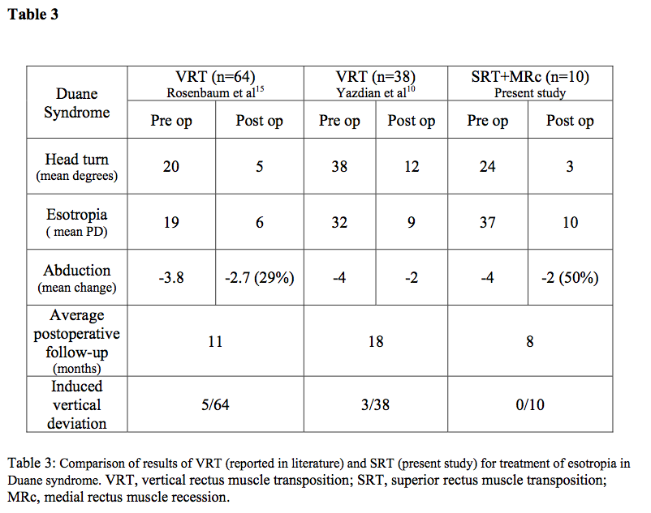
⬇

Slide 27
This slide from Boston Children’s paper

Slide 28
Dr Morad’s experience
n=4

Slide 29
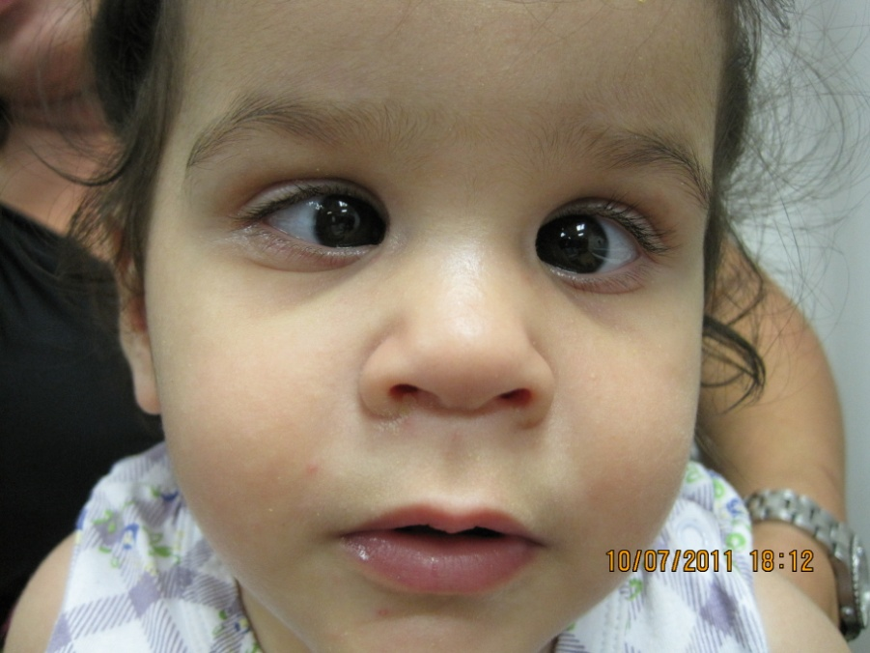
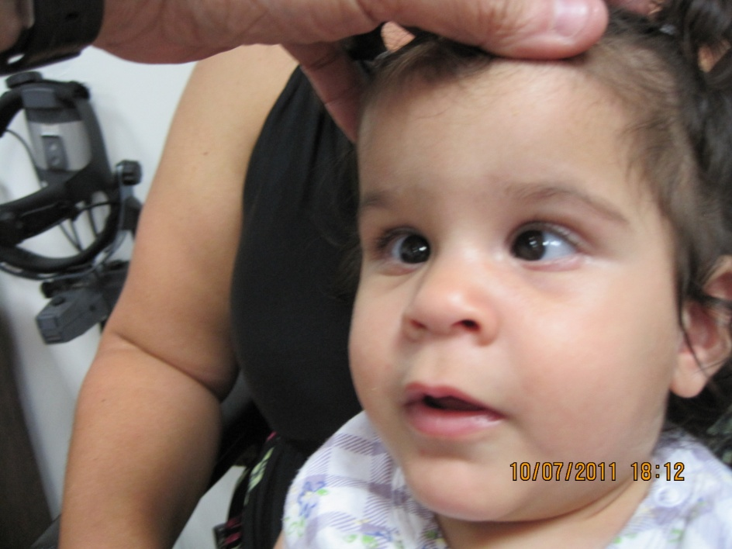
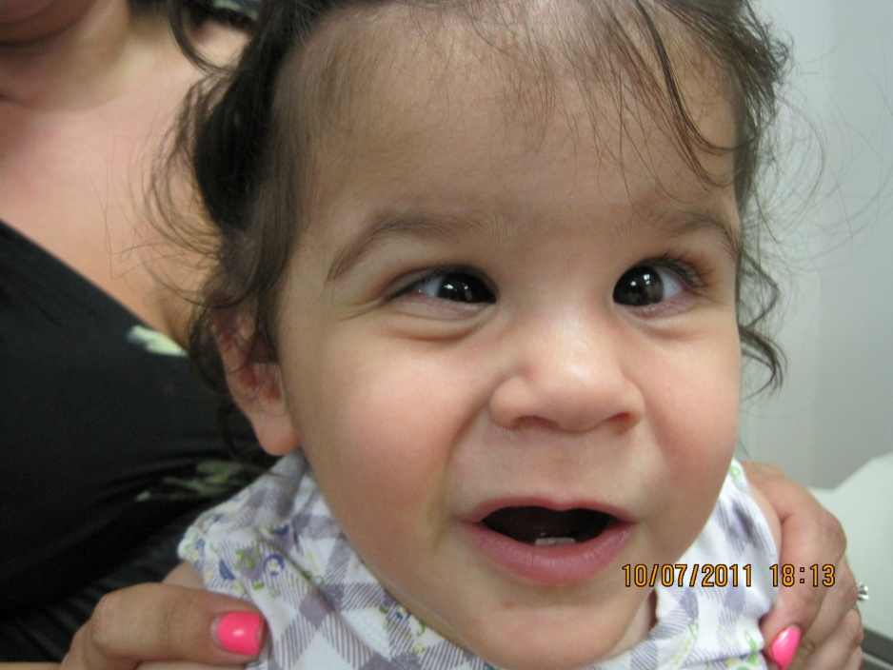
MS 11m old girl
Bilateral Duanes
aBduction deficit -4 OU
30Δ ET in primary
Retraction on aDduction

Slide 30
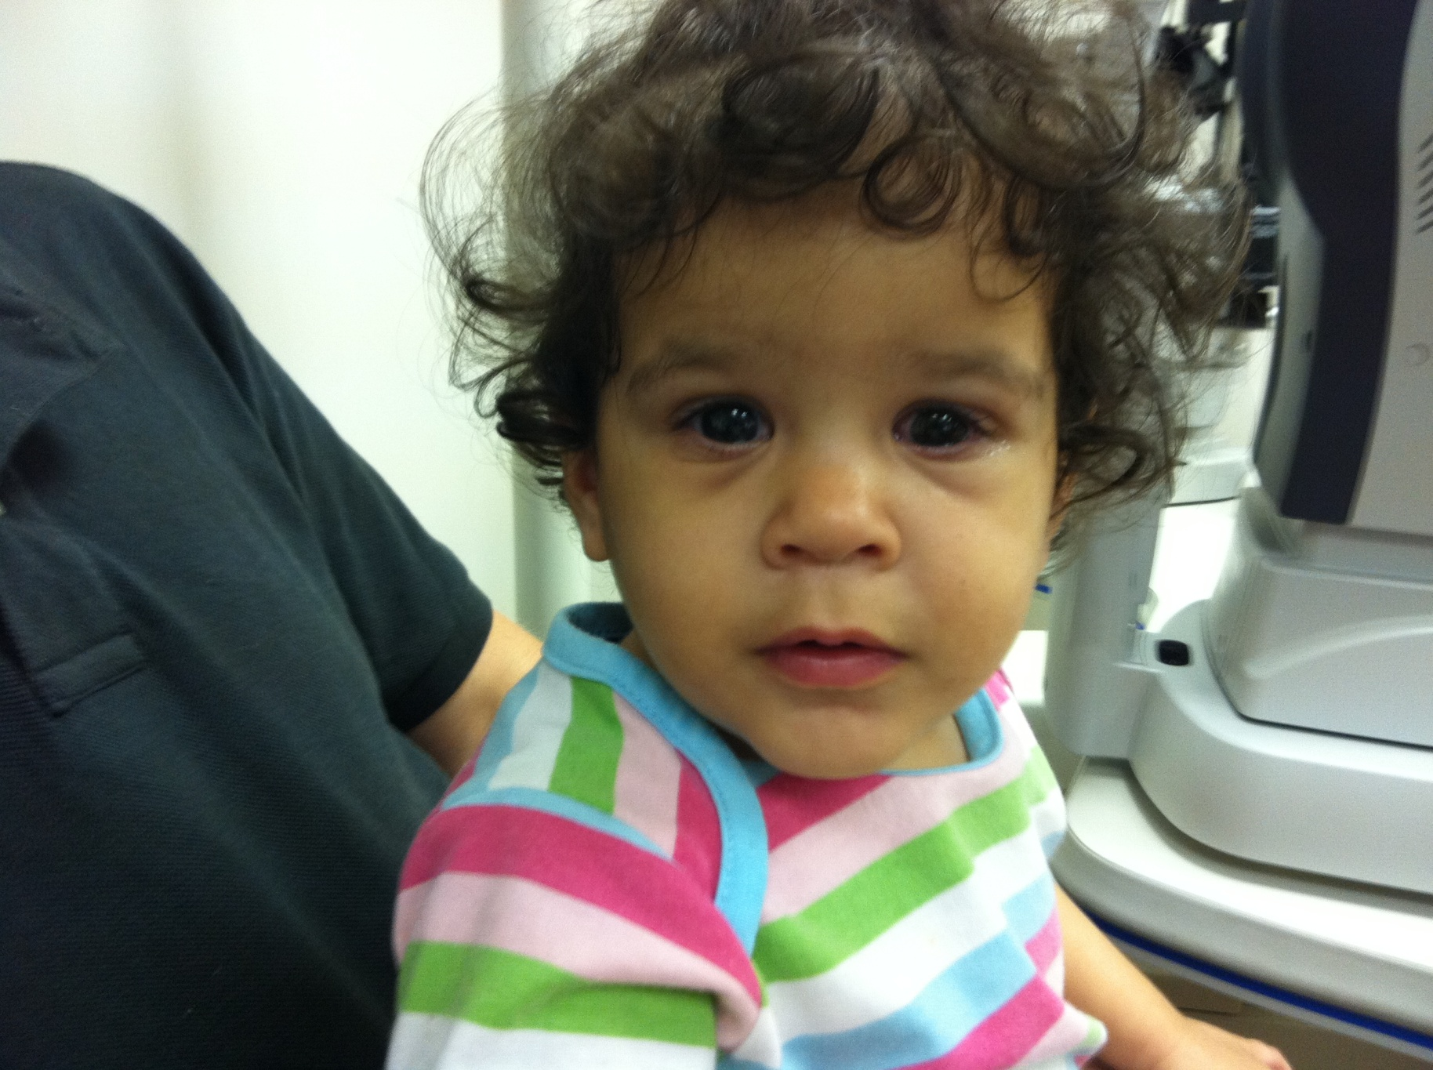
BMR 4mm [tight muscles], SR transposition to LR [Ethibond 5/0].
Result: 10Δ XT, LR -2 OU.

Slide 31
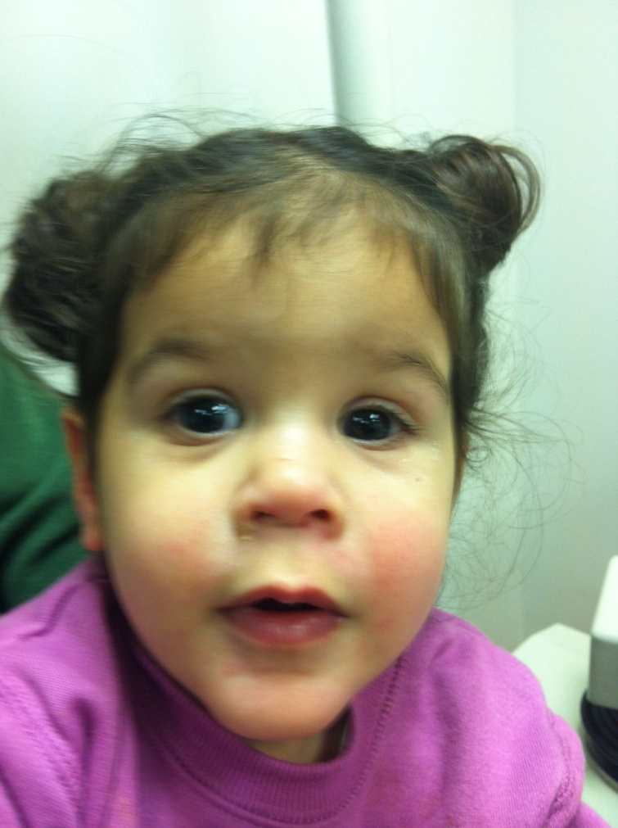
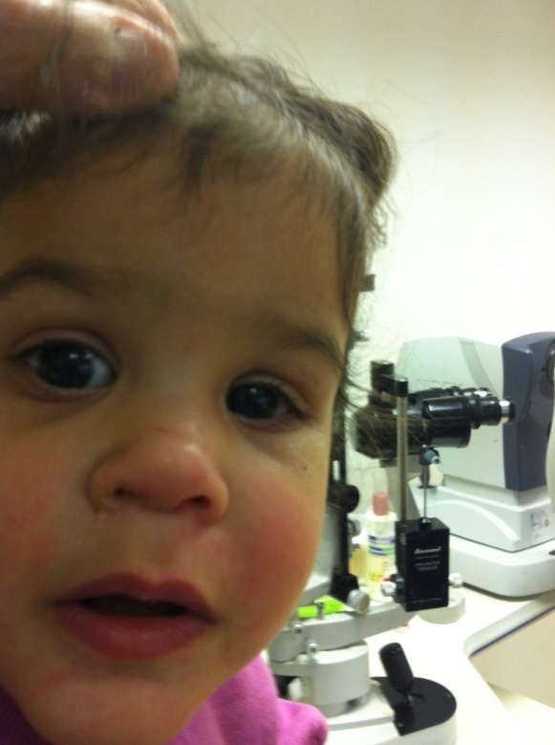
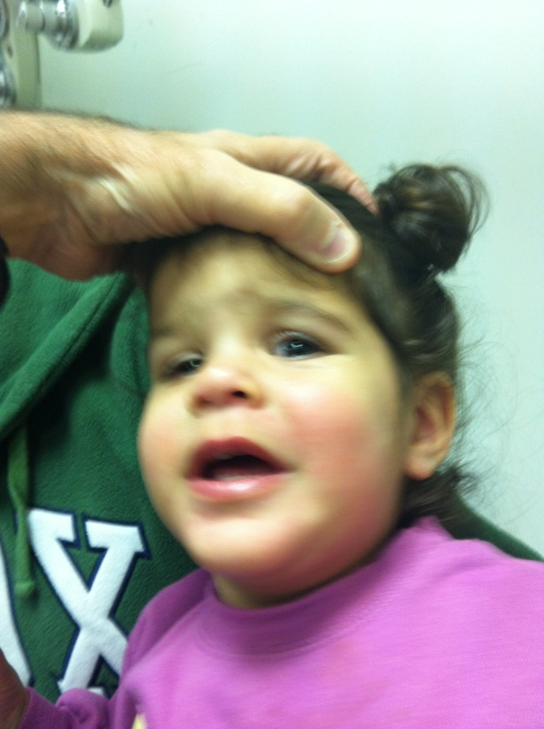
Result:
10Δ XT, LR -2 OU.

Slide 32
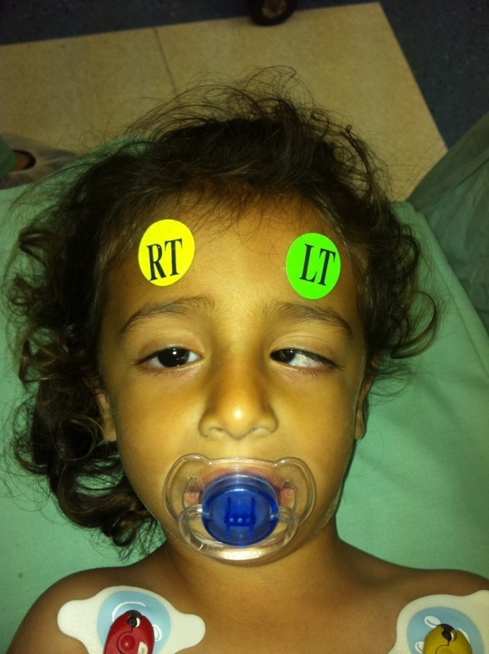
#2: AM 2 yo boy
ET noticed at birth
L -4 aBduction
65Δ ET in primary
MRI normal

Slide 33
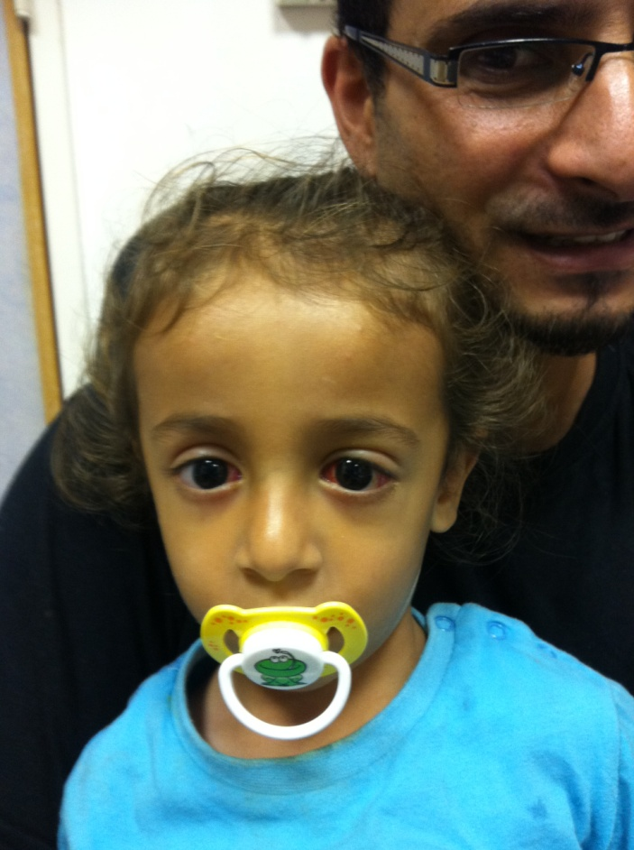
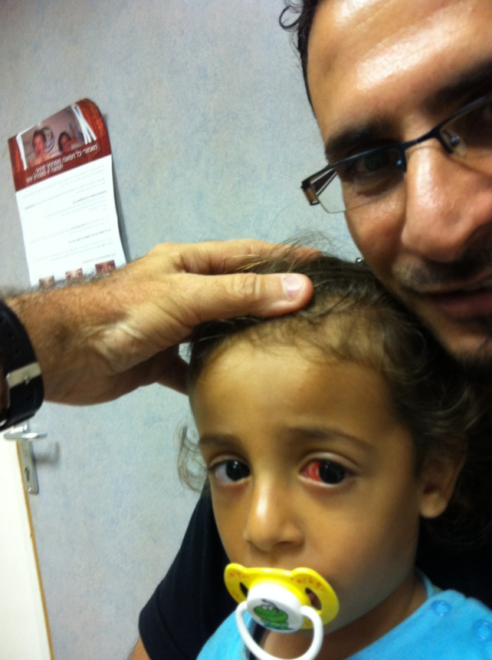
Left eye: SR transposition to LR
LR : atrophic
BMR 6 mm

Slide 34
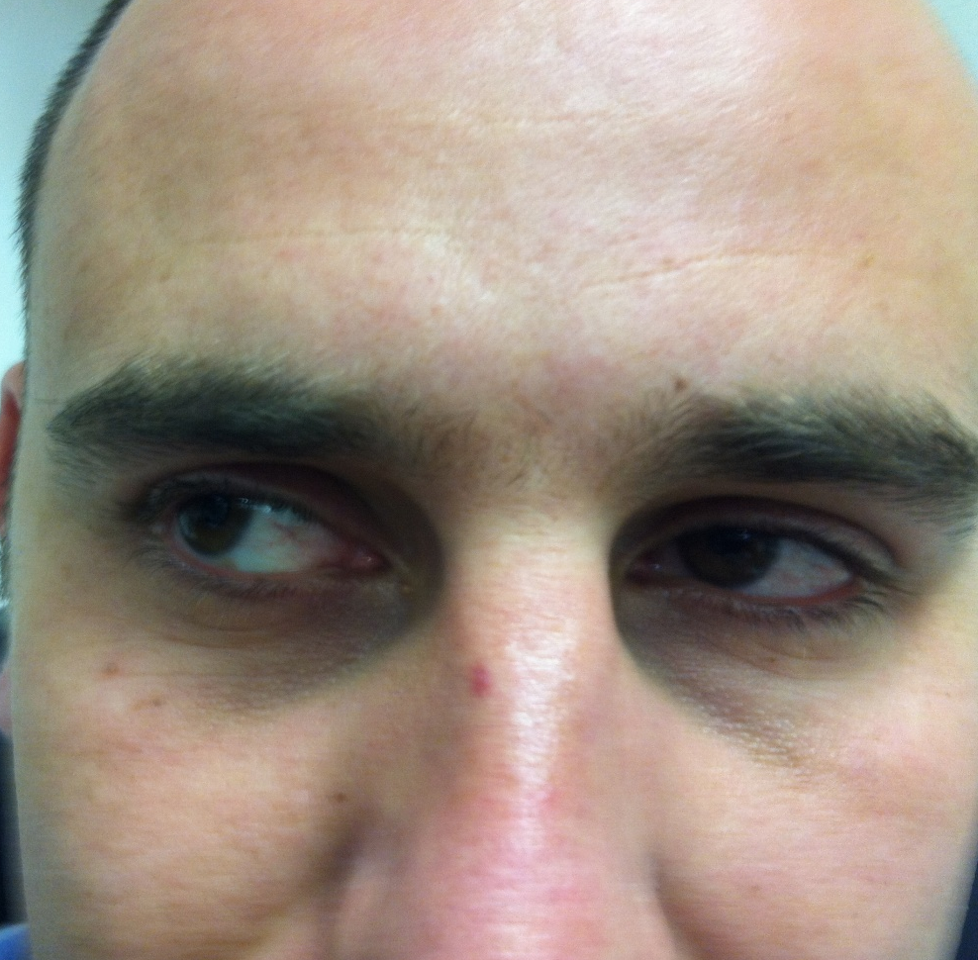
#3: AS 32 yo male
L Duanes : Abd def -4 OS, 18 Δ ET in primary, 15°head turn, Titmus 40”
LMR recess 4 mm, SRT to LR
No augmentation suture

Slide 35
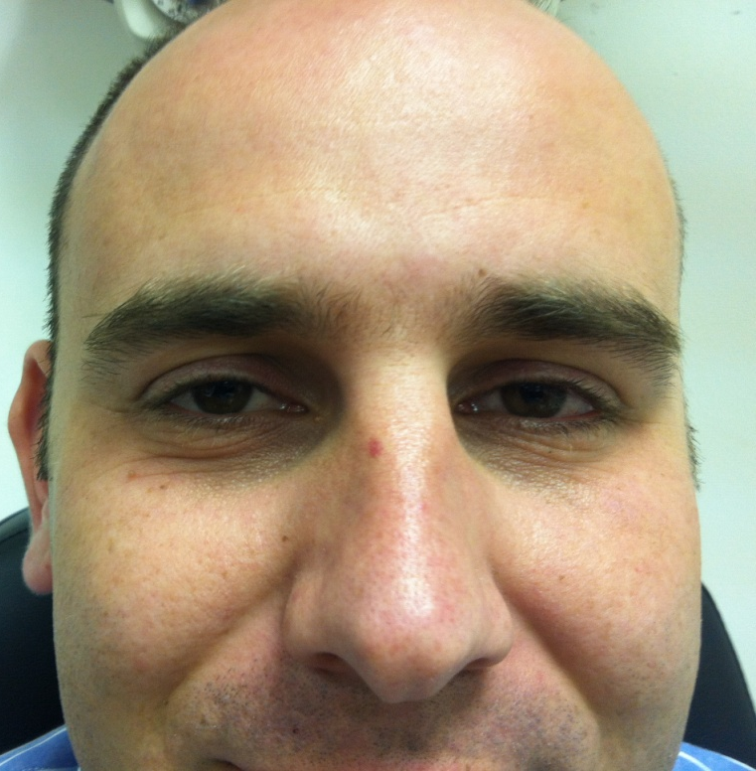
One week later..
Intractable torsion
SR transposition reversed
Today: ortho with -4 abduction

Slide 36
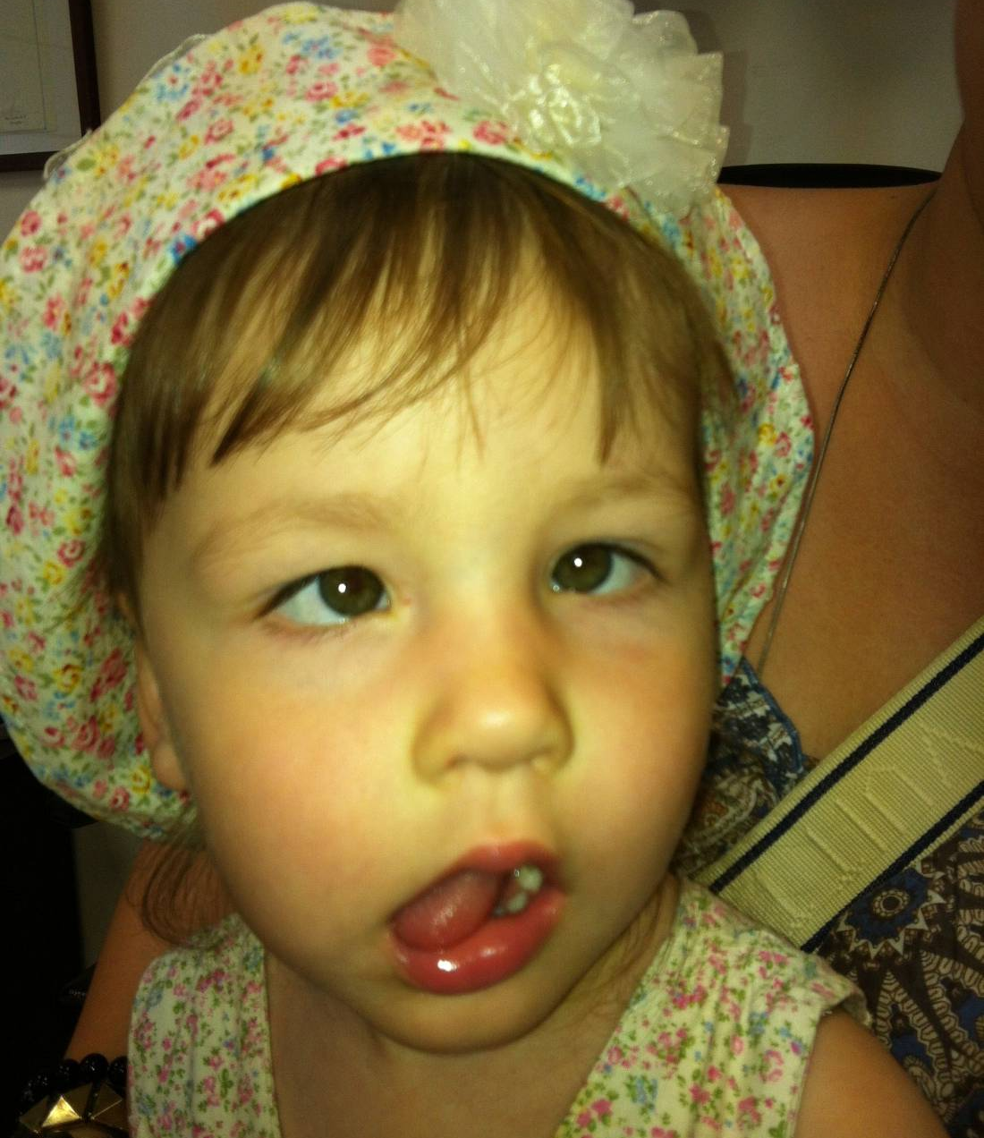
EL 2.5 yo girl
Bilateral Duanes
Abd def -4 OU
30 Δ ET in primary

Slide 37
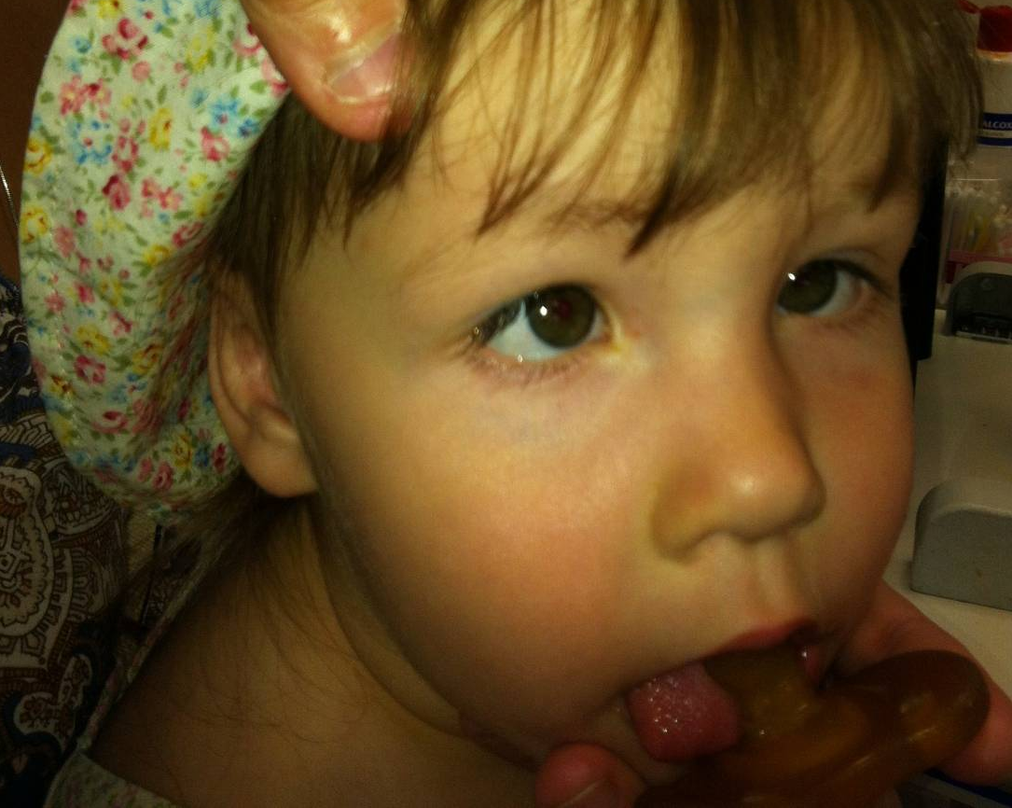
EL 2.5 yo girl
Bilateral Duanes Abd def -4 OU 30 Δ ET in primary
Surgery:
Extremely tight MR’s: BMR 3.5, & SR transposition to LR + augmentation suture

Slide 38
RESULT:
XT 8 in primary
Abd def -3 OU

Slide 39
RESULT: XT 8 in primary Abd def -3 OU

Slide 40
Conclusion
SR Transposition to LR insertion is effective and safe in DS
Abduction improves
No verticals
Fusing adults may have torsion, as in Boston series

Slide 41
Dr Kekkunaya, Hyderabad
I was worried when I did the case. But I was ok after the case went off well. I did the second and the third now. So n=3, follow up 2-6 months, so far so good (touch wood!)

Slide 42
Dr Lloyd Bender recently Melbourne, now GOS
I last saw her about 6 weeks post sx.
Induced height had resolved as had face turn.
Probably no improvement in abduction deficit.

Slide 43
The place of the SRT
An innovative way to handle the difficult problem of tight MR & wanting to improve aBduction
Small numbers of pts from a small number of particularly fine Drs
Looks very promising even to the sceptic
Innovative = ground- breaking, inventive, pioneering, original, new, ….& untried
[quoted inaccurately from Alex Levin]

Slide 44
The possible place of the SRT for me
DS who has had previous MR Rc
Bilateral symmetric DS
Child
Total 6th with tight medial (n=1)
…watch this space!

Slide 45
Overlooked? Recess / Resect
Small R-R for pt with large aBduction deficits
Matched near-perfectly with BMR group
BMR group had better result for retraction, R-R better for aDduction deficit
ABduction ≈ same
Unilateral Recession and Resection in Duane Syndrome
Morad, Kraft & Mims J AAPOS 2001;5:158-62

Slide 46
Steve Kraft
“I have found that the recess and resect procedure in patients who meet the listed criteria, with no abduction beyond midline, do very well – with results that match and sometimes exceed the reported range of movements from transpositions (and with almost no risk of inducing vertical deviations). But I cannot comment on how the recess-resect compares to the recently described variation of SRT – I have not had any experience with that option yet”.

Slide 47
Alan Scott
“For the unilateral ET Duane that has minimal anomalous innervations and a bit of LR activity for lateral gaze, R/R works well. When aBduction past the midline is absent due to MR restriction, aBduction saccades can show the LR activity. For complete LR inactivity for aBduction, transposition gives the larger single binocular field. These are the same rules as for C N VI palsies: R/R for partial paralysis; transpose for complete paralysis.”

Slide 48
Steven M. Archer
“Why only if abduction is absent?
You need a fair amount of normal innervation of the LR for contralateral MR rec to do anything good; so in cases with decent aBduction, BMR at least isn't totally insane, but Rec - Res works great for these cases too”.

Slide 49
“Surgery of Duane’s syndrome; Transposition or recession”. My conclusion:
Allow the pt to choose between a large operation which may allow some aBduction, and a simpler procedure (recess the MR) which will correct the AHP alone.
Most go for the transpositions - with a high long term satisfaction rate.
Irene Ludwig

Slide 50
“Surgery of Duane’s syndrome; Transposition or recession” – how to handle the tight MR
1. whole muscle transposition and delayed MR recess [or vice versa]
2. MR Rc and 50% transpositions
3. MR Rc & SRT
..all ± RMR Rc

