Slide 1
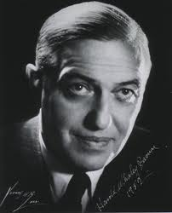
Brown’s syndrome - subsequent surgeries
Lionel Kowal
Melbourne, Australia
1898- 1978

Slide 2
What is Brown’s?
Hypo > on contralateral gaze
FDT: sup obl tight
FDT [nearly] free after sup obl tenotomy
Tight & lowered LR can simulate
Minor diagnostic criteria :
V pattern, no A pattern, yes for A pattern, fundus intorsion,….

Slide 3
Causes
3 major groups:
1. ‘congenital’/ childhood
2. adult / acquired
3. overlaps congenital / acquired A syndromes and inf obl paresis if that exists
Subtypes 1-3

Slide 4
Congenital / childhood
An abnormality of anatomy or of growth of:
1. the anterior / reflected SO tendon
1a: length
1b: other features e.g. unusual path or insertion, &/or
2. the trochlea, or the tendon / trochlea unit

Slide 5
Variable natural history
Many get better
Waddell (1982): n= 36, followed 1–14 y.
2/3 showed partial or complete improvement.
Gregersen (1993) : n=10 followed over 13y.
9 improved, 3 completely.
Kaban (1993): full recovery in 10/60
follow-up of 4y
Moorfields (2009): 75% improved
Lambert (2010): 1 pt: onset Y1.
no improvement by age 13, improved by 22.

Slide 6
When to intervene
1. Resistant amblyopia
2. Looks weird
- eye movement
- abn head posture
3. Bothersome diplopia

Slide 7
When to intervene
Too soon
But many get better
By interfering, will you make the natural history WORSE?
At the right time
Too late
You will have allowed too many secondary mechanical effects to develop and distort the clinical picture and outcome
How to tell the right time to
intervene

Slide 8
Secondary mechanical effects from waiting too late to intervene
1. Tight IR from ‘chronic hypo’
2. Effects of fixation duress:
tight contralateral SR also

Slide 9
FIXATION DURESS Consider normal vertical alignment. In primary position, there is equal baseline vertical (& horizontal) innervation to all the EOMs.
⬆
⬆
⬇
⬇

Slide 10
If there is a L hypo & restriction of upgaze of the L due to Brown’s , AND if we encourage the L to fix [e.g. patch the R to treat L amblyopia] there will need to be extra innervation to the LSR to keep the L in / near primary position
⬆
⬆⬆
⬇
⬇

Slide 11
Hering’s Law means there will then be increased innervation to the RSR, and the RSR will also become tight within months
RSR gets tight
⬆⬆
⬆⬆
⬇
⬇

Slide 12
Whenever the R fixes, there will be a L hypo. ‘Chronic’ L hypo will result in increasingly tight LIR.
⬆⬆
⬆⬆
LIR gets tighter
⬇
⬇
Increasingly tight RSR and LIR (and chronically abnormal LSO) will probably
result in ever increasing R hyper. As well as fixing the tight SO, now need to recess
RSR and LIR for comitant stable mechanically balanced result

Slide 13
First surgery
Superior oblique weakening:
A. Tenotomy / -ectomy
B. Tenotomy / -ectomy & inf obl weakening
C. Wright spacer
D. Suture spacer
E. Split tenotomy
F. ‘Sharpening’ [reducing the diameter; Gomez]
G. Recession
Need to demonstrate relief of restriction

Slide 14
Author’s preferences
Superior oblique weakening:
A. Tenotomy & inf obl weakening – some inadequate results
B. Wright spacer – some extrusions, orbital inflammation++ x2
C. Suture spacer – scarring / ineffective
D. Split tenotomy - n≈ 5-6; all good so far

Slide 15
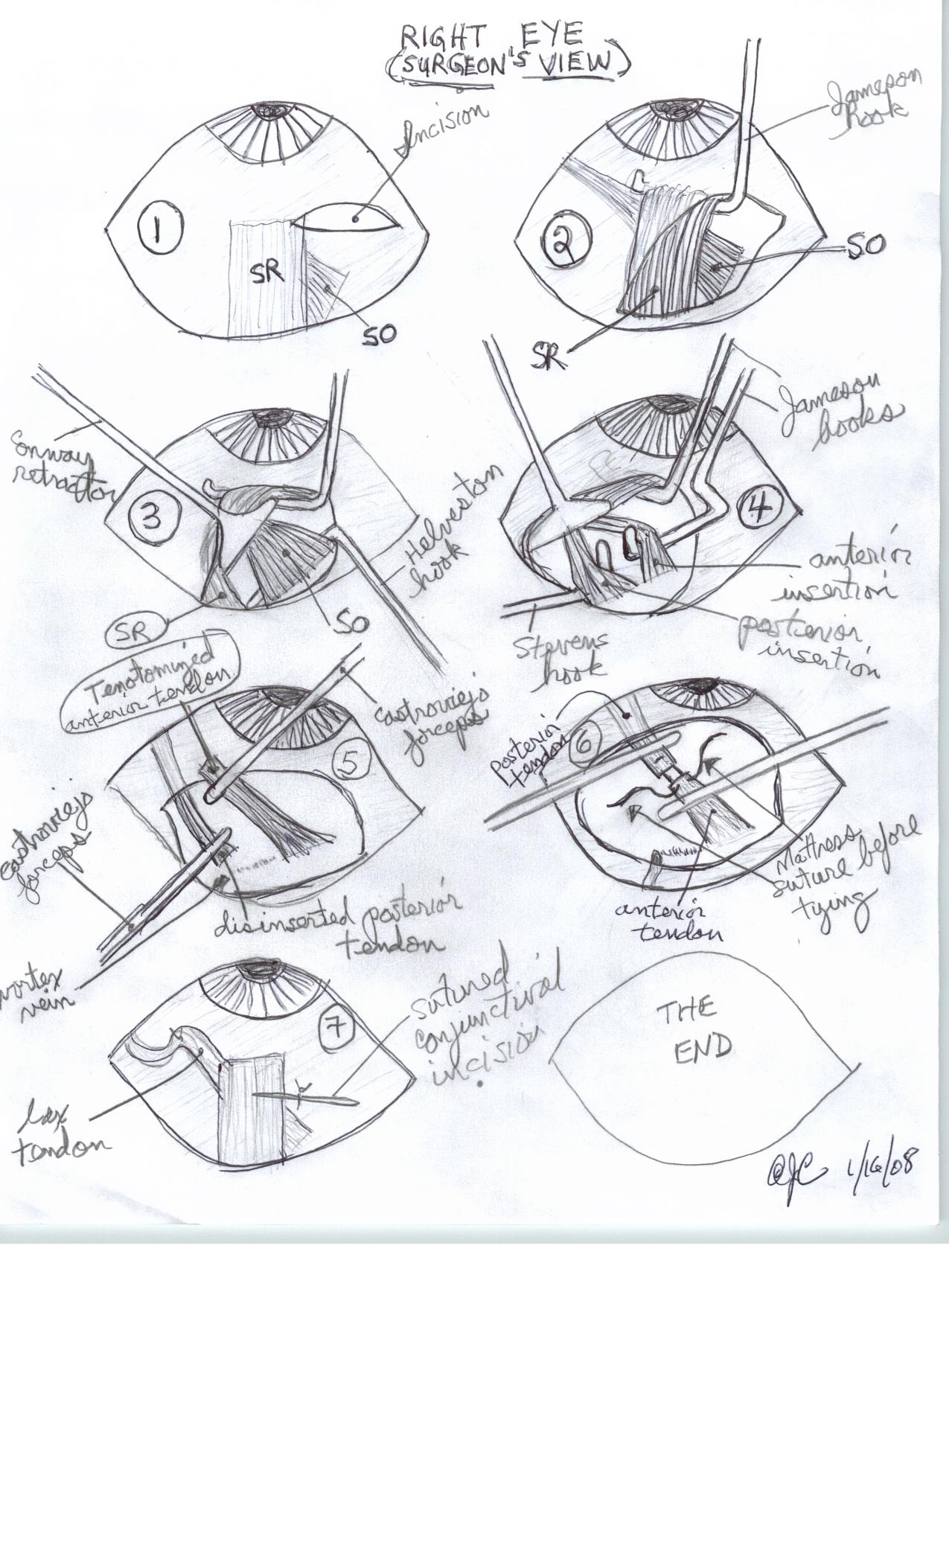
Split tenotomy Thanks to Dr Cossari

Slide 16
Re-operations
1. Related to sup obl surgery
2. Related to other effects of Brown’s

Slide 17
Re-ops directly related to sup obl surgery
1. An inadequate result
2. Scarring around suture: excise scar – convert to tenotomy
3. Extrusion of spacer – fibrous capsule around spacer may maintain result & no further treatment required
4. Persistent progressive overcorrection

Slide 18
1. Re-op: an inadequate result Don’t rush – sometimes an inadequate result will improve
Klin Monbl Augenheilkd. 2005 Aug;222(8):630-7.
Results of surgery for congenital Brown's syndrome. [German] Gräf M, Kloss S, Kaufmann H.
Sx: SO recess in 22 pts. At end of operation, elevation in adduction (forced duction test) was free.
3 mo postop, in spite of free passive motility, monocular elevation in adduction was only slightly improved to - 5 to 15° (median 5°).
At the last visit, elevation in adduction (5 - 35°, median 15°) significantly improved.
?takes a while for mechanically abnormal inferior oblique to start functioning

Slide 19
1. Re-op: an inadequate result
Don’t rush – sometimes an inadequate result will improve
Similar anecdotal reports from Dr Cadera, Seattle
I have had a few cases over the years that had an SO tenotomy (with and without IO weakening) who initially looked like nothing had been done for their Brown syndrome… all improved over 6 to 8 mo, some completely normal in elevation where there had been a marked deficiency at 1 month. …..I wait 6 or more months before declaring defeat.
Stager DR et alii
Long term results of silicone expander… J AAPOS 1999:3;328-32
Frequent undercorrection that improves with time
?takes a while for mechanically abnormal inferior oblique to start functioning

Slide 20
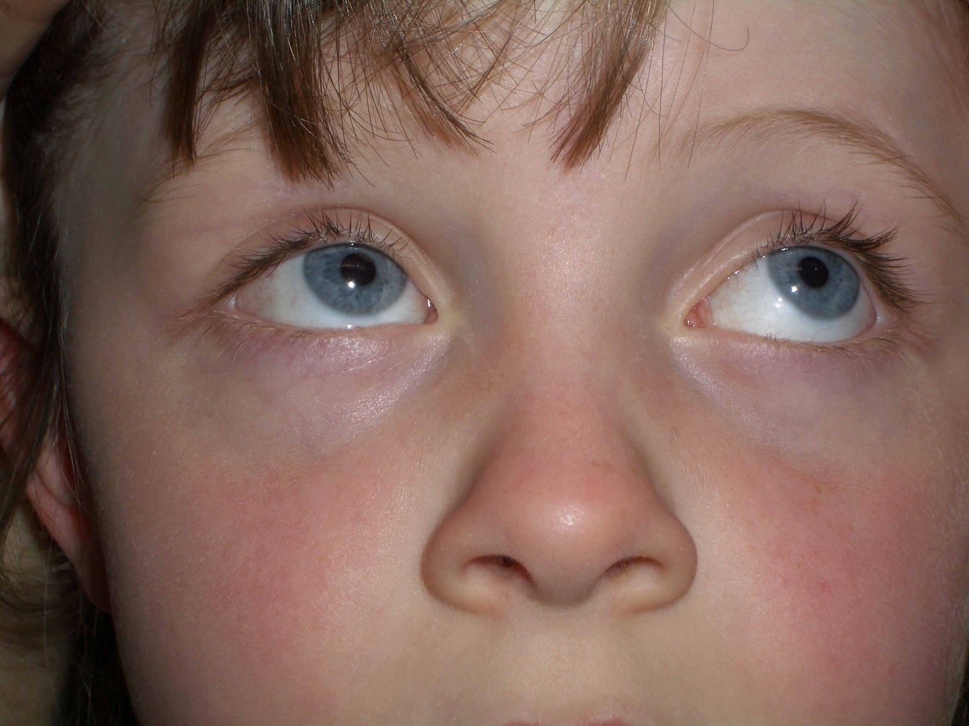
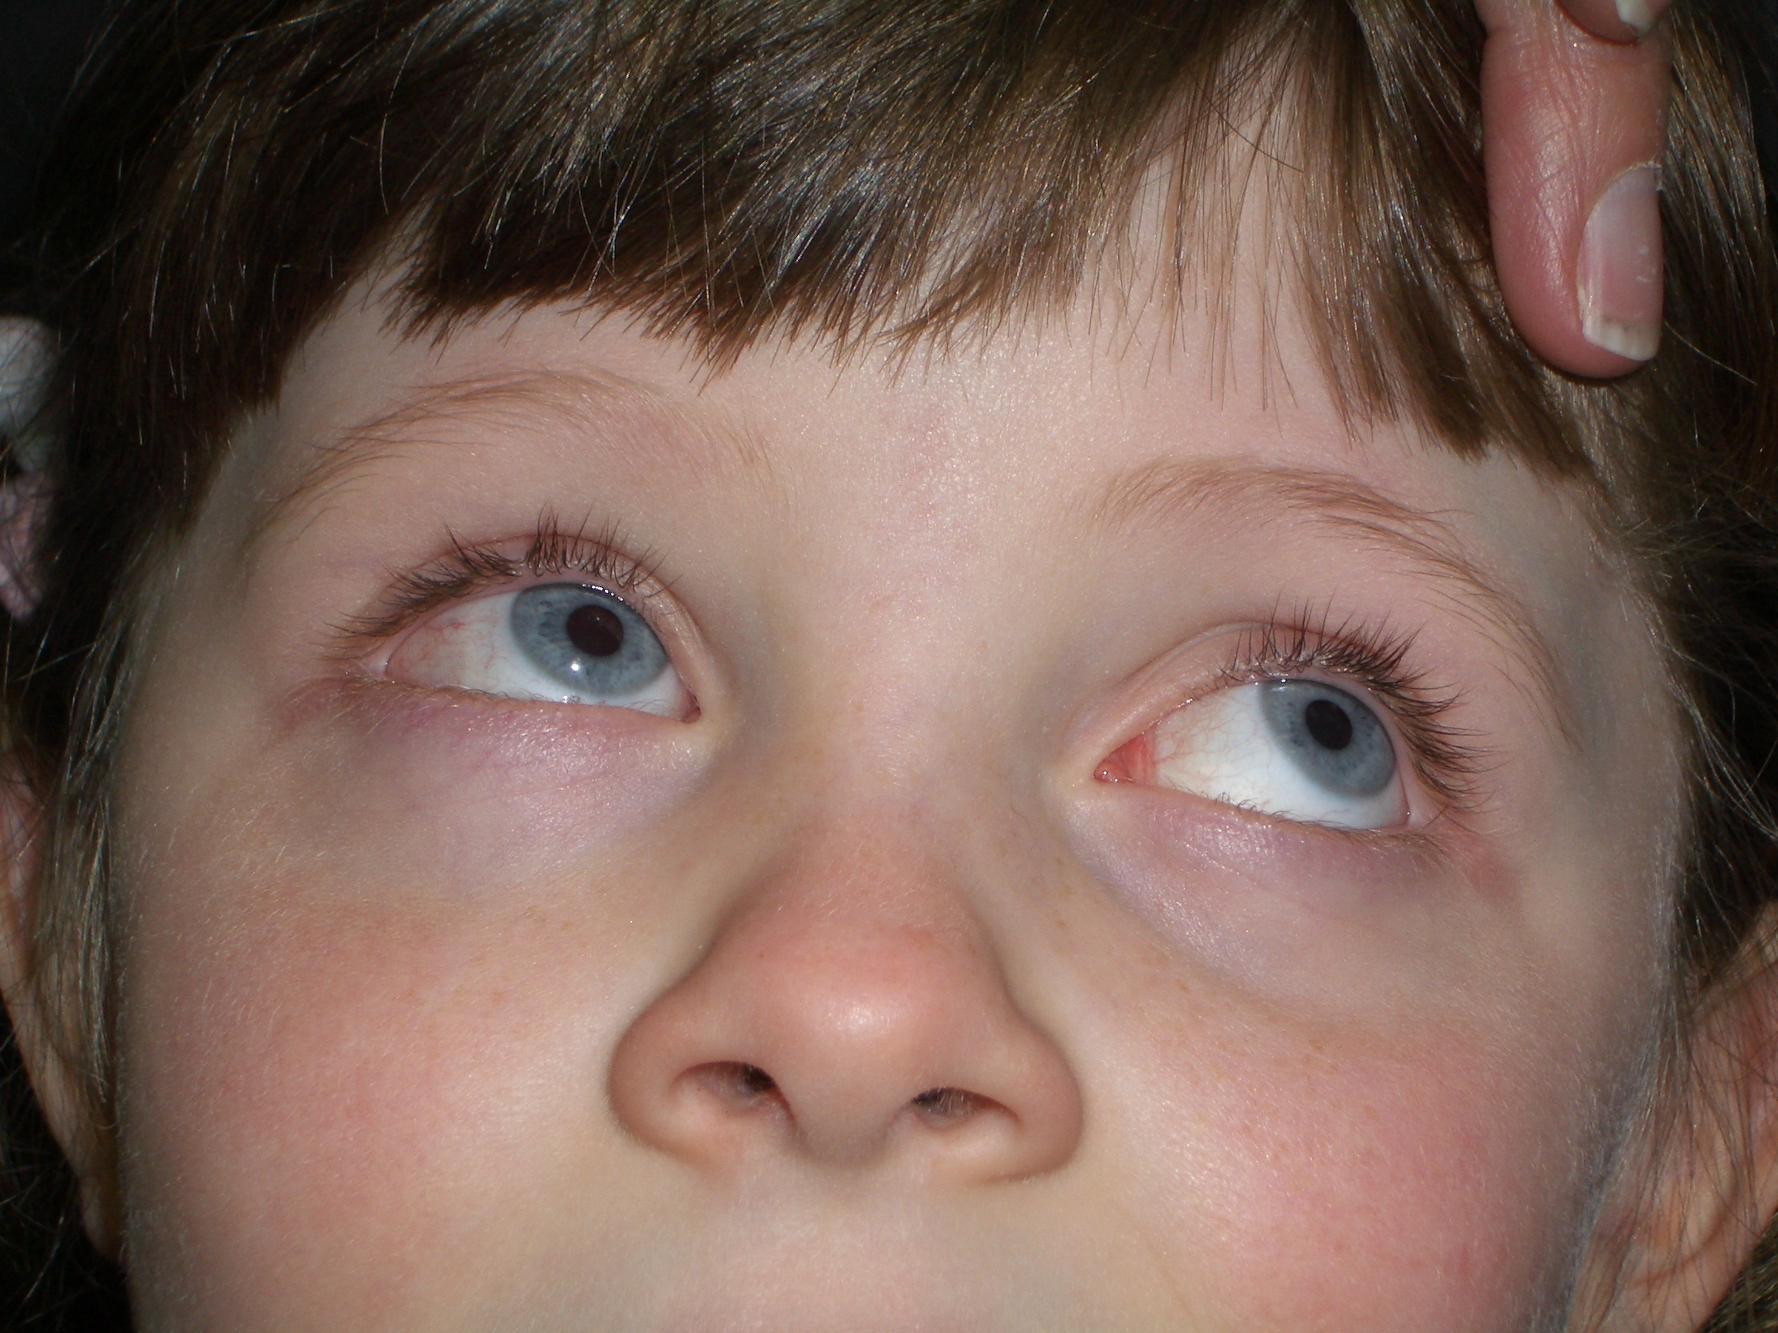
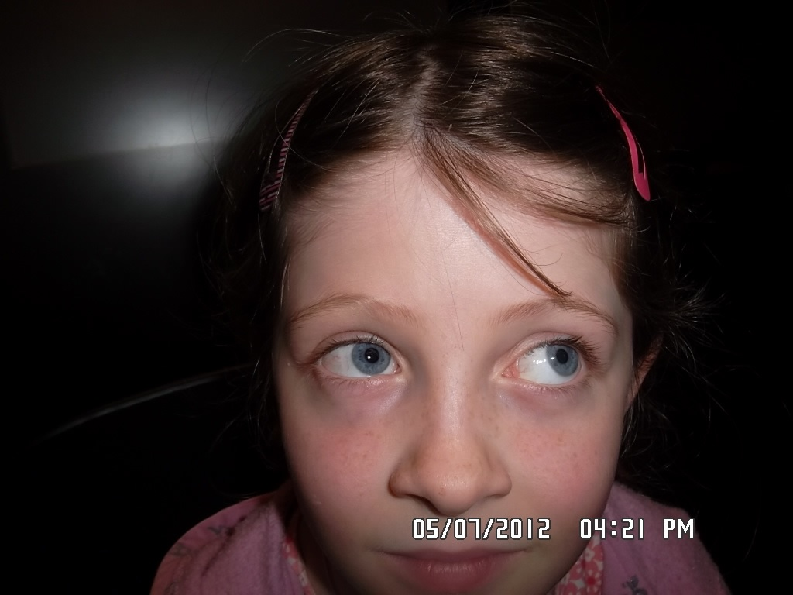
Eg laura twining
RSO tenectomy terminal 10mm,
RIO Parks’ recession
6 weeks postop
Inadequate result
3 months postop
Better result
3.5 y postop
9 months postop
Good result
UNDER CORRECTIONS TEND TO GET BETTER : WAIT

Slide 21
Troublesome SOP [over correction]
1. without concurrent IO-
Weaken the IO
2. after concurrent IO-
Augment the IO weakening e.g. anteroplace a Parks’ or Fink recession
3. after spacer.
Consecutive SOP [?10-20%] mimicked by & may co-exist with adhesion between spacer & nasal edge of SR
Explore: clear adhesions if present & remove spacer; convert to tenotomy & do ipsilateral IO-

Slide 22
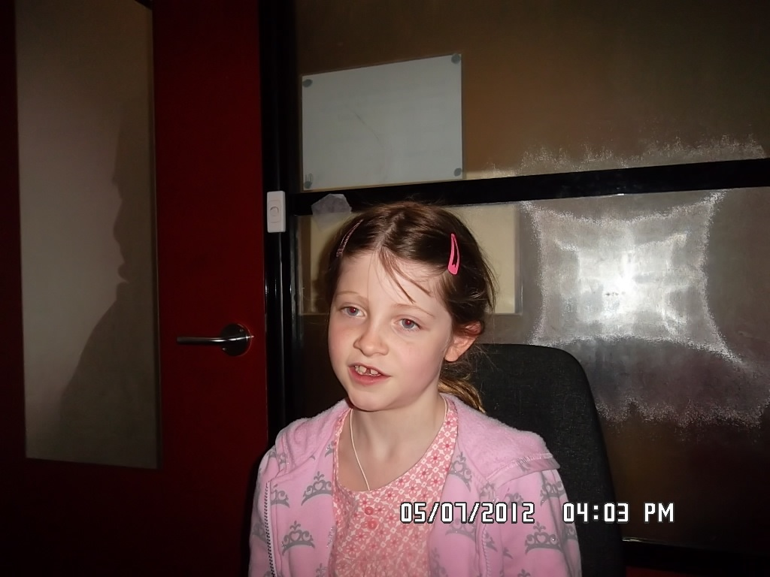
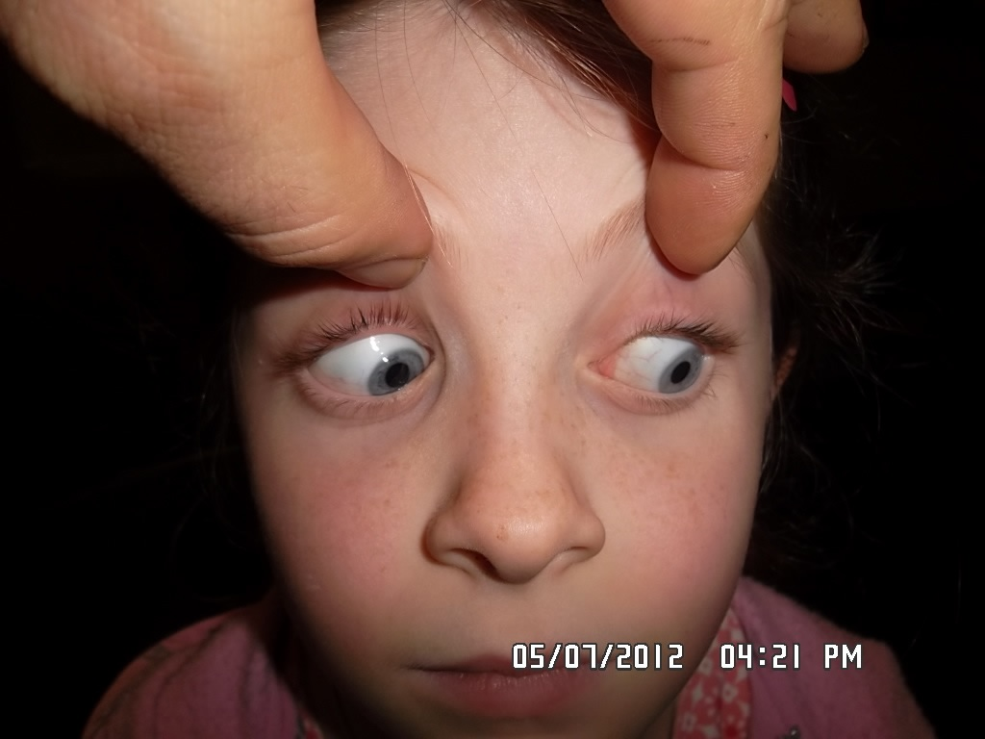
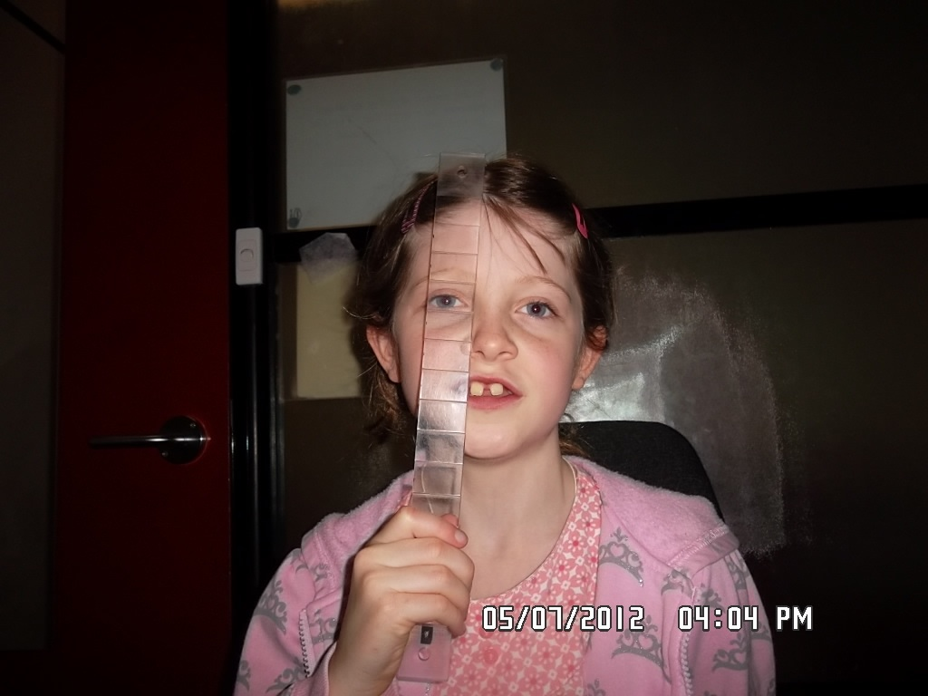
UNDERCORRCTION @ 6w. OVER CORRECTED @ 3.5Y
9 mo postop
No RSO UA
3.5y postop
3.5 y postop
Slight RSO UA
PRISM STRAIGHTENS HER HEAD TILT
3.5y postop

Slide 23
The worst re-operation case: Iatrogenic SOP that can’t be fixed
‘Grave Complications After Superior Oblique Tenotomy or Tenectomy for Brown Syndrome’
Santiago & Rosenbaum JAAPOS, 1997
4 cases of persistent diplopia after SO tenotomy
Only ¼ had successful re-anastomosis of SO & good outcome
‘Patients may be left with a permanent disability that may not be surgically reversible. …..
An alternative surgical procedure that is potentially reversible should be considered.
This should include a reliable method to recover both ends of the tenotomized superior oblique tendon in case the procedure needs to be modified at a later date e.g. by using nonabsorbable sutures (e.g., Mersilene, Novafil) to mark the cut ends of the tendon before allowing the tendon to retract (Knapp P. Personal communication, 1985)

Slide 24
Re-ops un-related to sup obl surgery
Residual verticals:
Will be ipsi-lateral IR tightness OR contralateral SR tightness

Slide 25
For the surgical enthusiast – take care
1. Variable & sometimes good untreated natural history
2. Imprecise diagnostic criteria
3. Imprecise thresholds for considering surgery
4. Numerous surgical approaches, all imperfect, all with morbidity
5. SOP may become the dominant problem
6. 2ary mechanical sequelae on ipsilateral IR and contralateral SR may come to dominate the clinical picture

