Slide 1
‘Congenital’ Superior Oblique Palsy / Paresis: Is radiology useful?
Dr Lionel Kowal
Director Ocular Motility, Royal Victorian Eye and Ear Hospital
Senior Fellow, University of Melbourne, Australia
Dr Logan Mitchell
Senior Lecturer – Ophthalmology
University of Otago, Dunedin School of Medicine

Slide 2
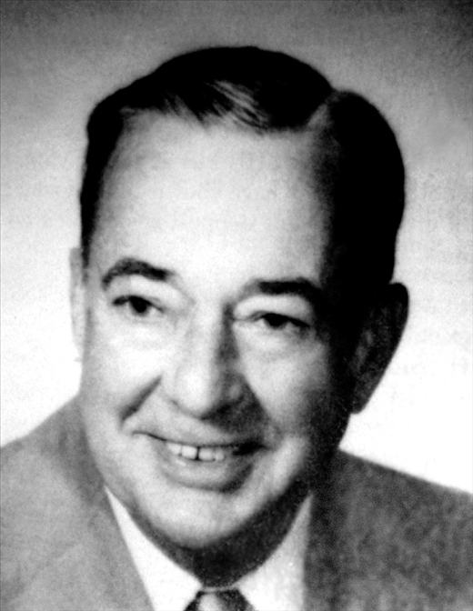
SOP: Lumpers and splitters has never been tested prospectively
Lumpers:
Every pt with a vertical misalignment that is or could be SOP has a standard inf obl weakening as 1st procedure
Nucci P
Superior oblique palsy: promoting a simpler approach. Eur J Ophthal. 2006 Jan-Feb;16(1):1-2.
Kolling in Kaeser et al
Inferior oblique muscle recession with and without superior oblique tendon tuck for treatment of unilateral congenital superior oblique palsy
J AAPOS 2012;16:26-31
Splitters
Is it Knapp 1,2,3,…,7? … based on measurements and
versions..& specific treatment for each type

Slide 3
The newest splitters NEW definitions of SOP
1. Simonsz:
if the SOM does not contract after succinylcholine stimulation during surgery
2. Demer:
if the SOM is atrophic on coronal scans

Slide 4
The newest splitters 1 : Simonsz : 2 similar papers ALL pts diagnosed ‘sop’ by subspecialist ophthalmologists .
Expt 1 [GA, before & after IV succinylcholine] : 7/14: non-contracting SOM = true SOP, but others ‘contracted vividly’ : Incompatible with diagnosis of SOP
Clinically diagnosed SOP = ‘true’ SOP ~ ½ the time
H. J. Simonsz.et al. Length-Tension Curves of Human Eye Muscles During Succinylcholine-lnduced Contraction. IOVS , August 1988 & Klin Monbl Augenheilkd. 1992 May;200(5):414-7.

Slide 5
The newest splitters 1 : Simonsz : 2 similar papers ALL pts diagnosed ‘sop’ by subspecialist ophthalmologists .
Expt 2: topical anesthesia:
3 recordings: pt looked ahead, into the field of action of the muscle, out of the field of action of the muscle.
Some patients had a non-contracting SOM & stiff inferior oblique muscle = true SOP.
Others had SOM that contracted vividly :
Incompatible with diagnosis of SOP
Clinically diagnosed SOP = ‘true’ SOP ~ ½ the time
H. J. Simonsz.et al. Length-Tension Curves of Human Eye Muscles During Succinylcholine-lnduced Contraction. IOVS , August 1988 &
Klin Monbl Augenheilkd. 1992 May;200(5):414-7.

Slide 6
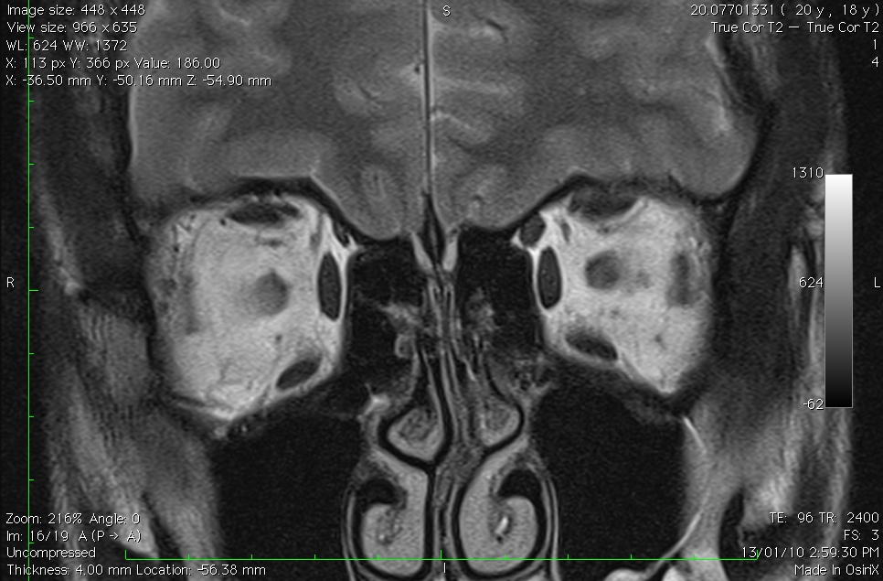
The newest splitters 2 Clinically diagnosed SOP CDSOP Radiologically diagnosed SOP RDSOP
Demer & Herzau:
RDSOP found in ~ 50% of those with CDSOP
Demer JL et al MRI of the functional anatomy of the sup obl muscle.
IOVS 1995 & 1994 AAPOS / ISA joint meeting proceedings
Siepmann K, Herzau V
Klin Monatsbl Augenheilkd. 2005 May

Slide 7
50% of CDSOP confirmed as accurate by L-T and radiology: what about the other 50% false +ves?
Some may be resolved SOP leaving minimal atrophy
Many [?most] are probably variants of orbital anatomy

Slide 8
21st century options
Lumpers:
Every pt with a vertical misalignment that is or could be SOP gets inf obl weakening as 1st procedure
Splitters:
Is it Knapp 1,2,3,…,7? There clinical / surgical implications of splitting, & specific treatment for each subtype
Newest splitters:
Is there a Simonsz- type SOP?
Is there RDSOP?
Seminal Q: are there any clinical / surgical implications of the newest splitting?

Slide 9
Seminal Q: are there clinical / surgical implications of the newest splitting?
Sato M. Magnetic resonance imaging and tendon anomaly associated with congenital superior oblique palsy. Am J Ophthalmol. 1999
N=31 RDSOP: MOST 9/15 have SO tendon laxity
Most 5/9 of these have tendons that are both floppy and abnormal – tendons are absent or insert into Tenons
4/15 tendons are floppy and insert into sclera
Dr Sato
Local organiser of December 2014 ISA meeting in Kyoto – watch for it

Slide 10
surgical implications of floppy sup obl
Floppy SO tendon more common in RDSOP
For many: Floppy SO tendon is best treated with SO tightening
It is good to know in advance if SO tightening may be required - more difficult than other surgeries, not in everyone’s repertoire, higher morbidity,..
Since Sato, I have imaged most cases of CDSOP and anticipated an increased expectation of unequivocally floppy SO tendon in RDSOP (in some of these the tendon may be absent or insert into Tenons) & need for SO exploration & tightening
Have not encountered floppy SO with normal radiology [=Sato]

Slide 11
Congenital vs Acquired SOP
‘Congenital’ SOP
No history to suggest acquired SOP
Though can present @ any age, history goes back to childhood or adolescence
No head injury, birth trauma, vascular disease, ?MS
Acquired SOP
Vascular disease
Head injury
Rare: SOP- specific CNS pathology
MS
New: Trochlear schwannoma

Slide 12
Melbourne (Kowal) Cohort: 30 pts with congenital RDSOP
30% under 10y
30% age 31-50
Average age 32
20 had surgery
17/20 one surgery
16/20 one muscle.
2/20 2 muscles
1/20 2 surgeries
2/20 3 or more surgeries

Slide 13
Melbourne (Kowal) Cohort: 20 pts operated for congenital RDSOP
3 had floppy SO tendons
2/3 SO plicate [1/2 2nd surgery]
1/3 SO plicate + IO AT
2 tight SR: SR Rc
[1/2 IR Rc also]
NO cases of absent SO tendon or of tendon inserting into Tenons
A colleague in Melbourne has had one case where tendon inserted into Tenons

Slide 14
Melbourne (Kowal) Cohort: 20 pts operated for congenital RDSOP
17/20 one surgery
16/20 one muscle
14/16: one muscle, one surgery = Inf Obl
1/16: = SR
1/16: = SO

Slide 15
3 cases of floppy sup obl
005 M | RH | RSO plicate
2 |  | 24
8 | 14 | 20
8 |  | 20
015 D | LH | LSO plicate
13 |  | 0
20 | 6 | 0
18 |  | 0
022 W | LH | LSO+, ATLIO
45 |  | 16
45 | 45 | 3
45 |  | 20
None of the floppy sup obliques can be definitely predicted by measurements
Marked lateral incomitance in #015 & #022 suspicious of floppy SO

Slide 16
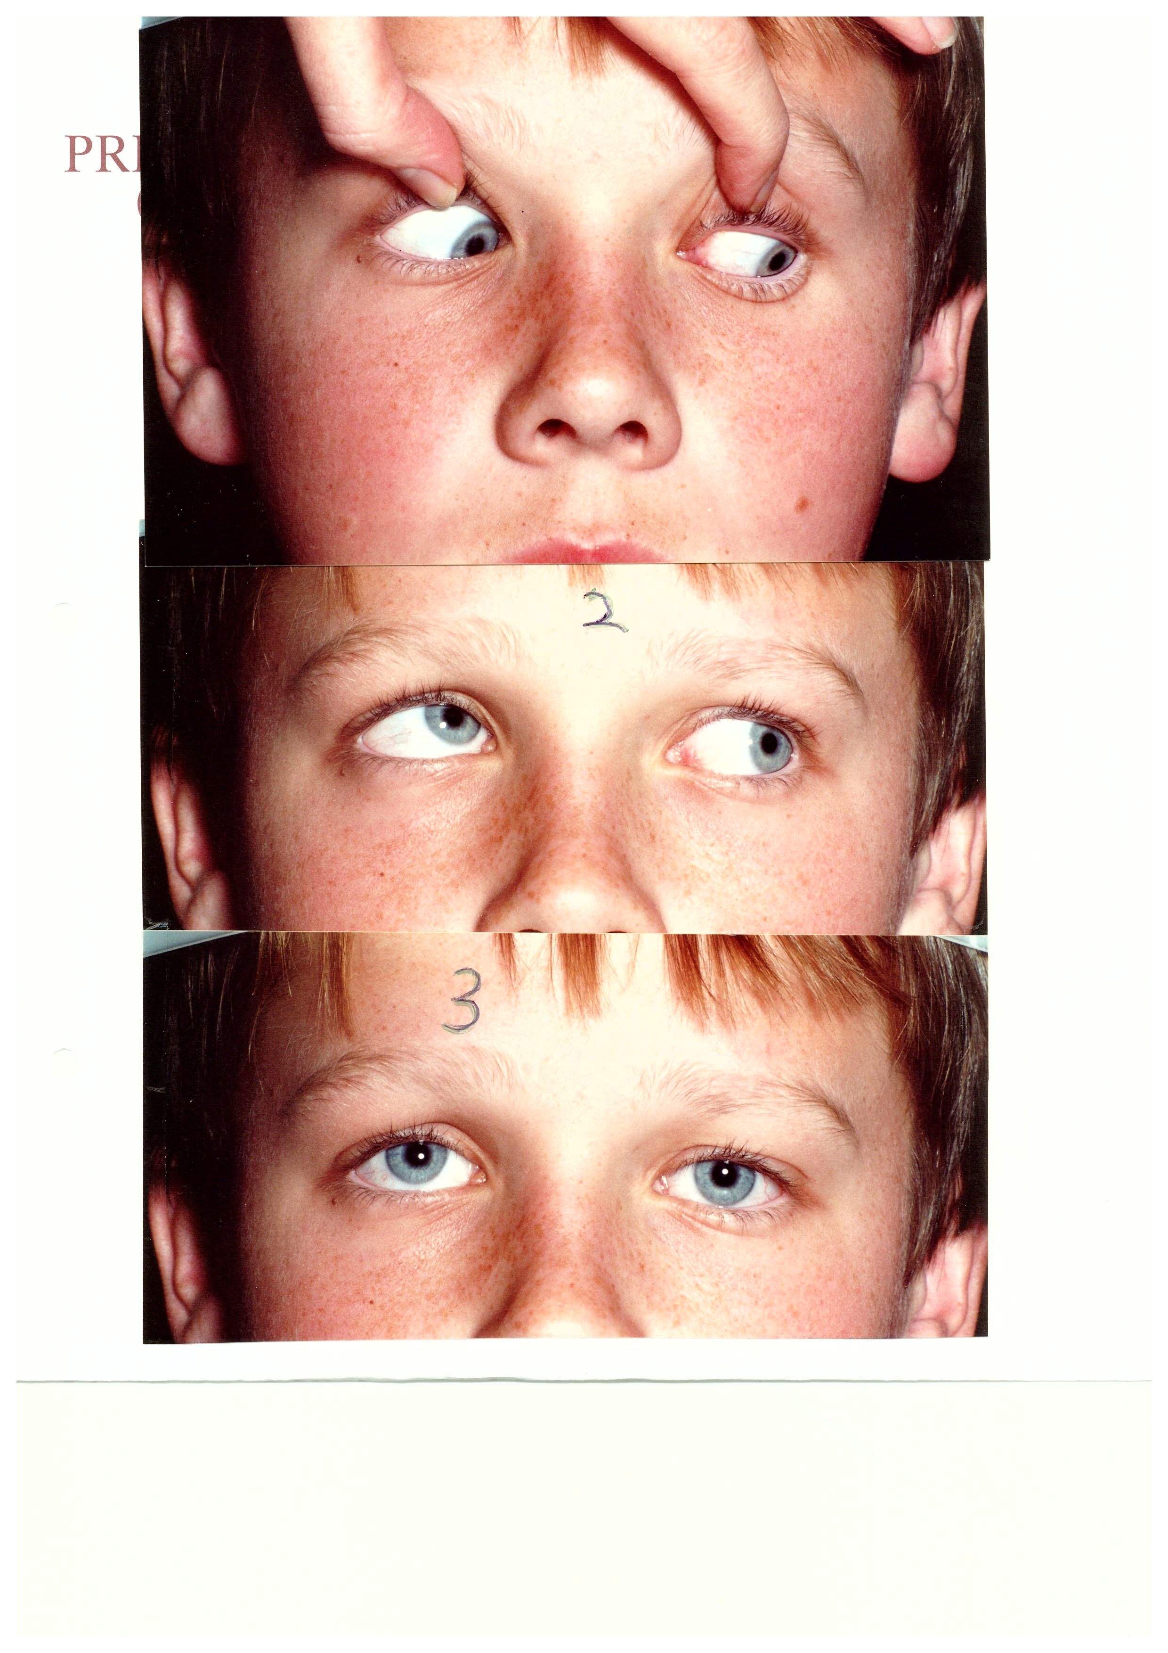
Case 5 Floppy SO, not suspected on rotations

Slide 17
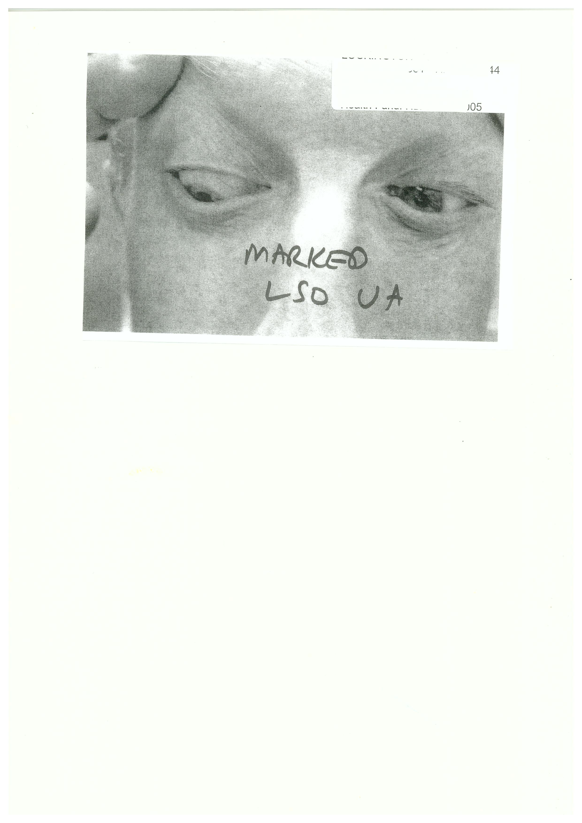
Case 22, LSO UA obvious on versions

Slide 18
30 cases of congenital RDSOP
3/20 that went to surgery had floppy sup obliques
Sato experience NOT relevant to Australian population
9/15 radiologically atrophic SO = floppy
A difference from Melbourne cohort very unlikely due to chance (p = 0.015)
5/15 c.f. 0/20 tendons were absent or inserted into Tenons (p=0.02)

Slide 19
Splitters/ lumpers
Clinical diagnosis SOP confirmed physiologically or radiologically ~50% of cases
RDSOP is surgically significant in 3/20 = 15% of cases

Slide 20
CDSOP: Do we need to know if the SOP is radiologically normal?
Floppy SO is rare / absent with normal radiology
Floppy SO unusual even with abnormal radiology.
Other helpful findings might be large lateral incomitance and large version deficit [but not reliable]
If SO tightening is comfortably in your repertoire, no need to image.
If SO tightening is NOT in your repertoire, a normal scan probably excludes floppy SO. RDSOP implies a floppy SO will be found in a small number of cases, 15% in this series.

Slide 21
Title of lecture: ‘Congenital’ Superior Oblique Palsy / Paresis: Is radiology useful?
Answer:
Each population needs to answer this Q
In Sato’s cohort in Japan, RDSOP is much more frequently associated with floppy, absent and abnormal insertion of tendons than in [predominantly Caucasian] Australia

